Slide 1
Youth employability
Renata Danielienė
ECDL Lithuania,
Young Advisor to Neelie Kroes
Telecentre Europe 2014 “eSkills for the 21st century”
Zagreb, 24th of September

Slide 2
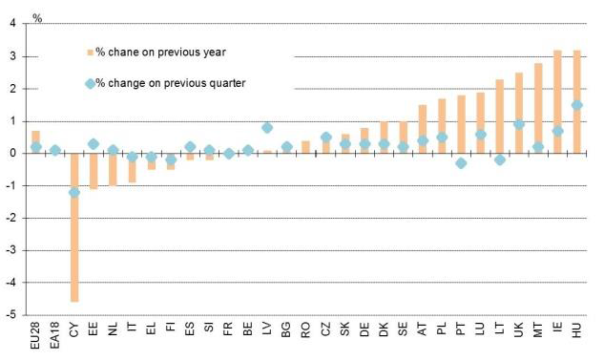
Employment change in the first quarter of 2014

Slide 3
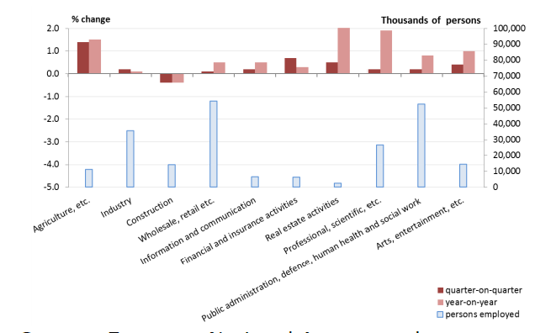
Employment is increasing in most sectors

Slide 4
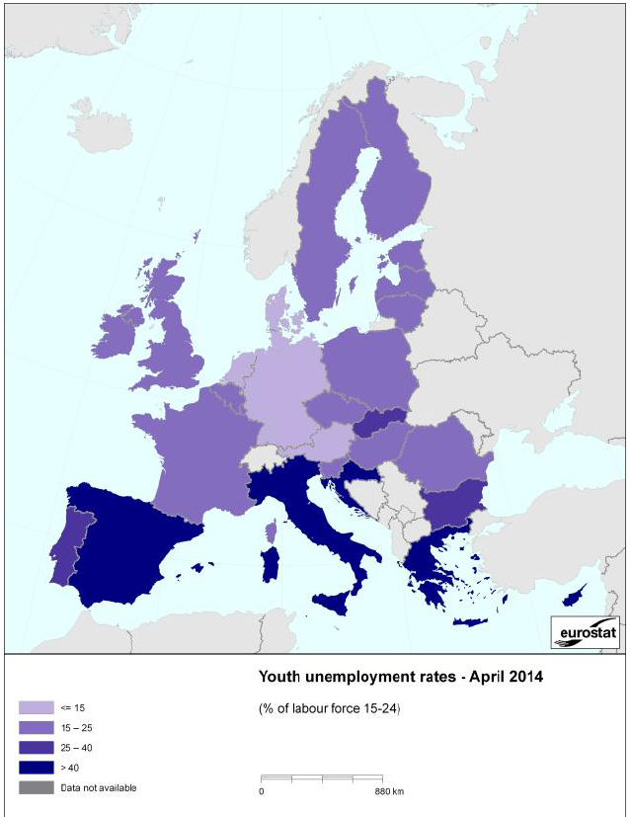

Slide 5
What is the current situation?
Youth unemployment rates in EU
5.2 million young people were unemployed
This represents an unemployment rate of 22.2%
7.5 million young Europeans between 15 and 24 are in the NEET group
The gap between the countries with the highest and the lowest jobless rates for young people remains extremely high.
Youth employability

Slide 6
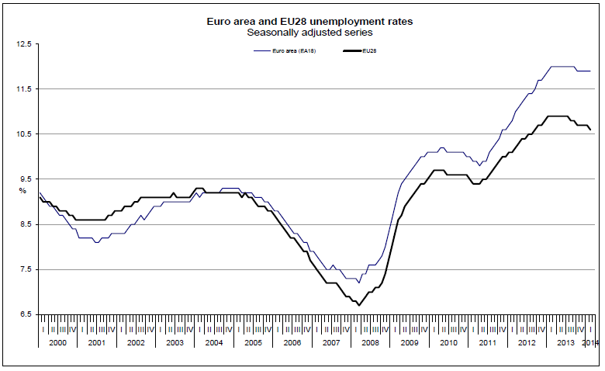
What is the current situation?
Youth unemployment rates in EU
Youth employability

Slide 7
What is the current situation?
In the last four years, the overall employment rates for young people fell three times as much as for adults.
The potential of job mobility to help tackle youth unemployment could be further developed.
Youth employability

Slide 8
Reasons for youth unemployment
Young people did not have the basic skills to take the available jobs.
School graduates lacking basic employability skills, such as communication, self-esteem, confidence.
There is a persistent mismatch between skills available and the needs of the labour markets.
Youth employability

Slide 9
Directions for working group: Youth employability
1) How to motivate young people choose IT carriers, start coding etc.
2) How to ensure all young people have satisfactory digital skills ( needed for any job, personal development and learning)
3) What are the digital tools that help to assess young people skills and help them to enter to job market ,to get first job experience?
Youth employability

Slide 10
Thank you!
More information:
renata@ecdl.lt
http://ec.europa.eu/digital-agenda/en/young-advisors
Youth employability
Notes:
Thank you for attention

Slide 11
Youth employability
Renata Danielienė
ECDL Lithuania,
Young Advisor to Neelie Kroes
Telecentre Europe 2014 “eSkills for the 21st century”
Zagreb, 24th of September

