Slide 1

Rocking: September 2014

Slide 2
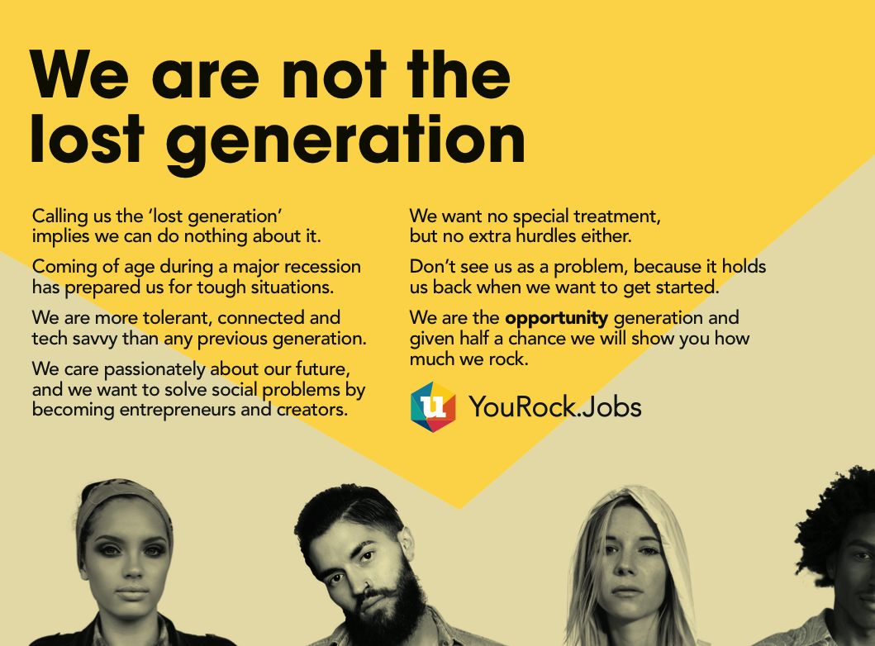

Slide 3

What is YouRock?
How does the profile work?
What progress so far?
What is the plan from here?
How will it reach people?
Why use YouRock?
Background
Who is behind YouRock?
What’s the evidence?
Where is the PR?
How to engage with us?

Slide 4
What is YouRock?
YouRock is a Social Business
http://YouRock.Jobs
is an exciting, online youth employability platform
    Focuses on skills supporting youth with little or no work history
    Profiles in 15 languages support cross-border recruitment
    Supports three sectors of employer: large, SME, and entrepreneur
is a social media campaign with attractive viral messages
has high level EU political & industry engagement
meets EU economic & social priorities
has a wide delivery network ready for user recruitment
has a multi-skilled team with a proven history of delivery

Slide 5
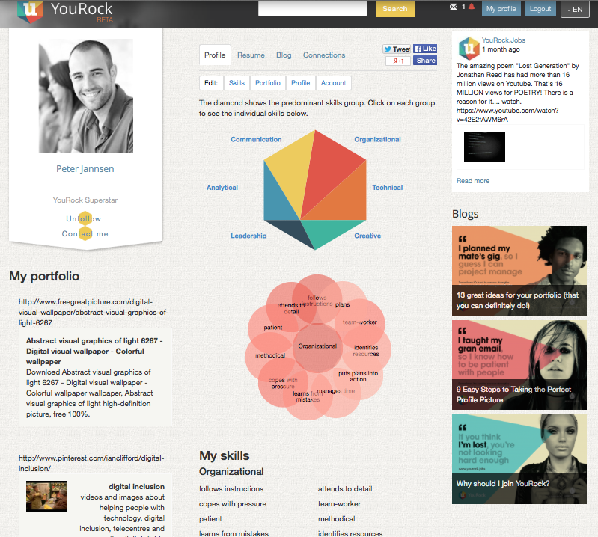
How does the profile work?
Skills discovery in language of employers
Target age range 16-30
Everyday activities create a personalized ‘diamond’ that reflects the users’ main skills.
120 activities matched with 100 work skills
e.g. makes clothing: patient, methodical, designs, expressive, visualizes, attends to detail.
Generates a dynamic “cloud” of specific skills.
Also traditional resume, portfolio, endorsements, blog and social media feed
Notes:
gives the user the language of employers to describe their skills
encourages repeat ‘skill discovery’ behavior
Demographics may have variance between countries.
Employed, unemployed, or in full time education;
Have little or no workplace experience or career profile;
School Council member: takes initiative, organizes, plans, team worker, builds relationships, expresses ideas, negotiates, presents, generates ideas, solves problems, assesses needs
Sells items on online auctions: understands customers, entrepreneurial, analyzes data, calculates, estimates, predicts, recognizes opportunities, ICT-competent
Social media user: expresses ideas, presents, understands audience, forms opinion, content publisher, creates digital content, data literate, ICT-competent

Slide 6

What progress so far?
Momentum, PR attention, excitement
Prototype built by youth in crowd-funded hackathon
System built with CSR support from Liberty Global
Responsive system tested
in 15 languages
Finalist in the EC Social Innovation Prize 2014
Engagement with range
of stakeholders
High level EU political, press and industry engagement
Social Media campaign and messaging developed
  http://Facebook.com/YouRockJobs
  http://Twitter.com/YouRockJobs
  http://Instagram.com/YouRockJobs
Notes:
Bulgarian
Croatian
Dutch
English
French
German
Greek
Hungarian
Italian
Lithuanian
Polish
Romanian
Russian
Serbian
Spanish

Slide 7
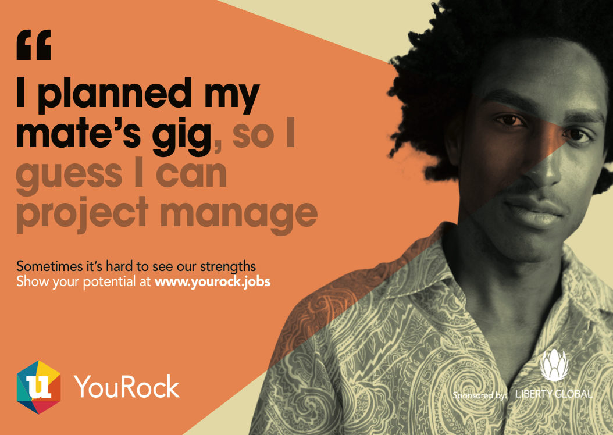
What is the plan from here?
Focus on user & employer engagement
Resource pack developed for user & employer engagement
Autumn promo campaign
starts now
Social Media collateral in translation
User Guide supports telecentres
Employer Guide shows how HR depts can use YouRock in recruitment.
Notes:
function

Slide 8
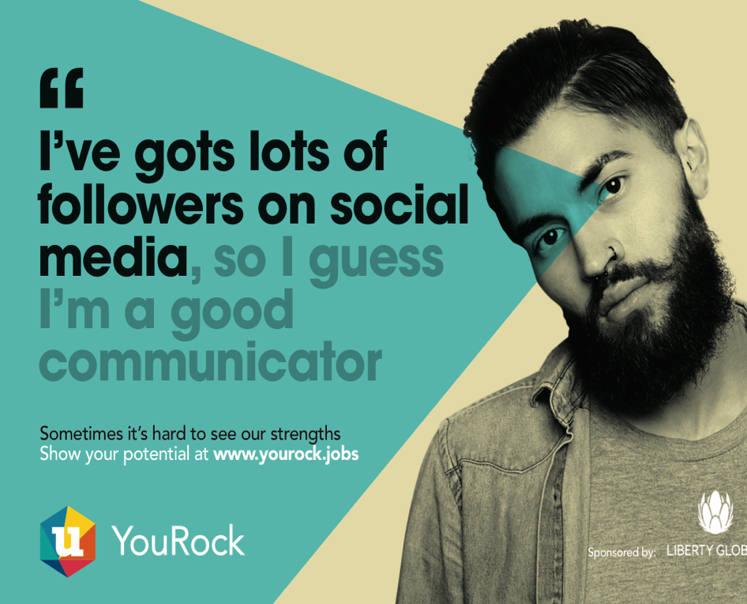
How will it reach people?
Virals, intermediaries, ambassadors
Engaging visual campaign messaging challenges preconceptions of youth and employability
Three channels to users
1. Youth-focused social media materials for markets and multipliers (youth networks, etc.)
2. Networks of grass-roots intermediary organisations and/or telecentres
3. Network of YouRock Ambassadors to act as national role models

Slide 9
Why use YouRock?
A new, free and engaging employability tool for clients
Could be used in groups and as content for a course of sessions
Centres can attract and better support clients with YouRock
How can telecentres help?
Engage and support users to build YouRock profiles during employability sessions deepening your relationship with users
Promote http://yourock.jobs and online visual assets on your Social Media, websites, blogs, newsletters, etc to engage users
Gain press exposure for support for YouRock through PR
We will we provide you with?
A User Guide to run effective sessions & access to online support
Free advertising space on YouRock in your country
Access permissions to create blogs for your country
Customized collateral for use in your social media channels
Draft PR for use with press

Slide 10
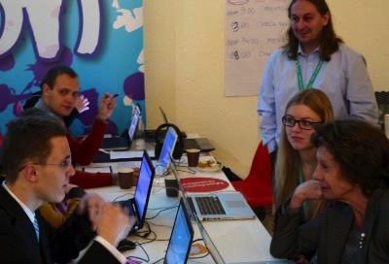

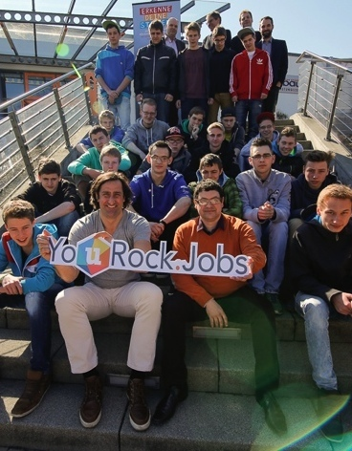
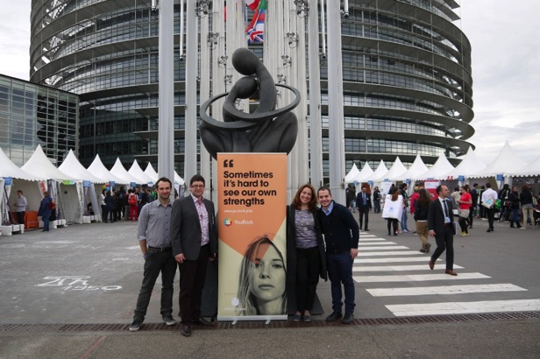
Background
EC Vice President Neelie Kroes visits hackathon in Lithuania where prototype was built.
Testing session in Berlin
Winner in EC Erasmus for Young Entrepreneurs Business Challenge at EC Parliament in Strasbourg.
Young people and Christian Schenk, Olympic Decathon gold medalist.

Slide 11
Who is behind YouRock?
Multi-faceted team with a history of engaging stakeholders & delivering on a mass scale
Ian Clifford, the founder, has 18 years experience with youth and community organisations at a senior level. Ian co-founded Telecentre Europe, comprising 30,000 EU community learning venues helping people with employability.
Ekaterina Fedotova is a non-profit program director with 16 years of experience, directing ‘Your Course’, a Microsoft CSR initiative which trained over 300,000 people in over 170 Russian community learning centres.
Gabriel Dragomir is a founder of Drupal Romania Association and a member of the Young Advisors Expert Group of EC Commissioner Neelie Kroes.
Manolis Labovas also manages "Getbusy.gr" through which more than 140,000 young people in Greece have been helped with employability.
Sven Weber is a Board member of Telecentre Europe. He managed the German national digital literacy program 'Internet erfahren’.
Rebecca Hobson is a journalist, who most recently worked at Plotr.co.uk (a youth employment site), The Times and Independent newspapers.

Slide 12
What’s the evidence?
5.5m unemployed, only 17% use LinkedIn
Research shows only 17% of young people use LinkedIn
(Millennials & Social Media, 2013, Young People Hate LinkedIn, 2013)
EC & ICT industry in Grand Coalition for Digital Jobs is focused on an estimated 500k unfilled ICT jobs by 2015.
(eSkills for Jobs in Europe report, EC 2014)
  Only 40% employers confident they would find skilled graduates to fill junior positions. 33% of employers in GR regularly leave positions open since they cannot find the skilled employees they need.(Education to Employment: Getting Europe's Youth Into Work McKinsey 2014)
38% of employers want young people to give greater prominence to real-life experience
19% of employers say that young people’s CVs often all look the same
33% admit good candidates miss out on interviews because their application is not exciting enough.
(Survey of over 900 line managers, ICM Research 2014)

Slide 13
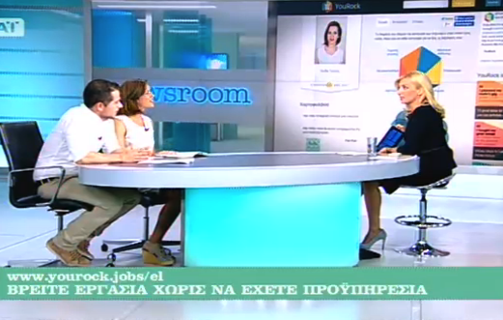
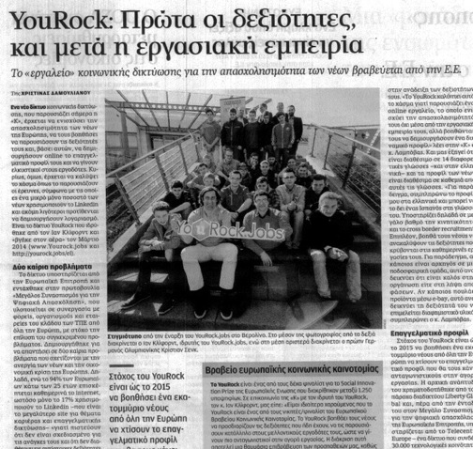
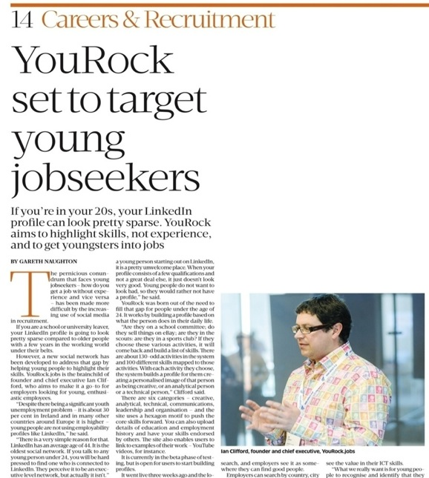
Where’s the PR?
YouRock is headline & media friendly brand
Newsroom Broadcast - Greek TV channel "Skai”
http://www.skai.gr/player/TV/?mmid=251933 (min 49-56)
Guardian Careers article
http://careers.theguardian.com/careers-blog/unemployment-social-innovation-european-union
Forbes article on Social Innovation Prize http://www.forbes.com/sites/federicoguerrini/2014/04/16/10-innovations-that-want-to-tackle-unemployment-in-europe/
EC Finalists of Social Innovation Prize http://europa.eu/rapid/press-release_MEMO-14-287_en.htm
EC supports Get Online Week & YouRock
http://europa.eu/rapid/press-release_IP-14-310_en..htm
Kathimerini, Neolaia & GetBusy(GR)(scan top)http://www.kathimerini.gr/768572/article/oikonomia/epixeirhseis/yourock-prwta-oi-de3iothtes-kai-meta-h-ergasiakh-empeiria
http://www.neolaia.gr/2014/05/27/yourock-jobs/
http://getbusy.gr/Home/News/All/18732
Sunday Business Post (Ireland) (scan right)
(Online story is behind paywall)
Careers Advice blog (Poland)http://uplosarek.wordpress.com/2014/05/19/yourock-jobs-rosnie-konkurencja-dla-serwisow-profesjonalnych/
EYE Event Blog from EU Youth Awardhttp://eu-youthaward.org/news/interview_ian-clifford
NESTA (UK): Living map of Jobs Innovators
http://jobsinnovators.org/2014/05/21/yourock/
Liberty Global & partners PR on launch http://www.libertyglobal.com/pdf/press-release/03-27-Liberty-Global-and-Telecentre-FINAL.pdf
http://www.umkbw.de/content/dam/umkbw-de/doc/140328_Pressemitteilung_UnitymediaKabelBW_YouRock_jobs.pdf

Slide 14


How to engage with us?
Site http://yourock.jobs
Email info@yourock.jobs
Facebook http://facebook.com/yourockjobs
Twitter http://twitter.com/yourockjobs
Instagram http://instagram.com/yourockjobs

