Slide 1


Uniting Europe through digital empowerment
This project has been funded with the support of the Lifelong Learning Programme (KA3) of the European Union

Slide 2
PARTNERSHIP
Partners | Country
Telecentre-Europe AISBL | Belgium
Malta Communications Authority | Malta
International Aid Network (IAN) | Serbia
DemNet | Hungary
LIKTA | Latvia
INTERFACE3 | Belgium
Educating for an Open Society (EOS) | Romania
Telecentar | Croatia
The National Union of Students in Europe | Belgium
This project has been funded with the support of the Lifelong Learning Programme (KA3) of the European Union

Slide 3
Unite-IT
MAIN GOALS
Create and establish an informal network of digital inclusion practitioners;
Collect and share practices on how digital competence can assist groups at risk of exclusion, foster employability, social inclusion an social cohesion;
Create new links and dialogue to promote joint initiatives to tackle digital divides;
Empower organisations and individuals about their contribution to overcome the digital divide.
This project has been funded with the support of the Lifelong Learning Programme (KA3) of the European Union

Slide 4
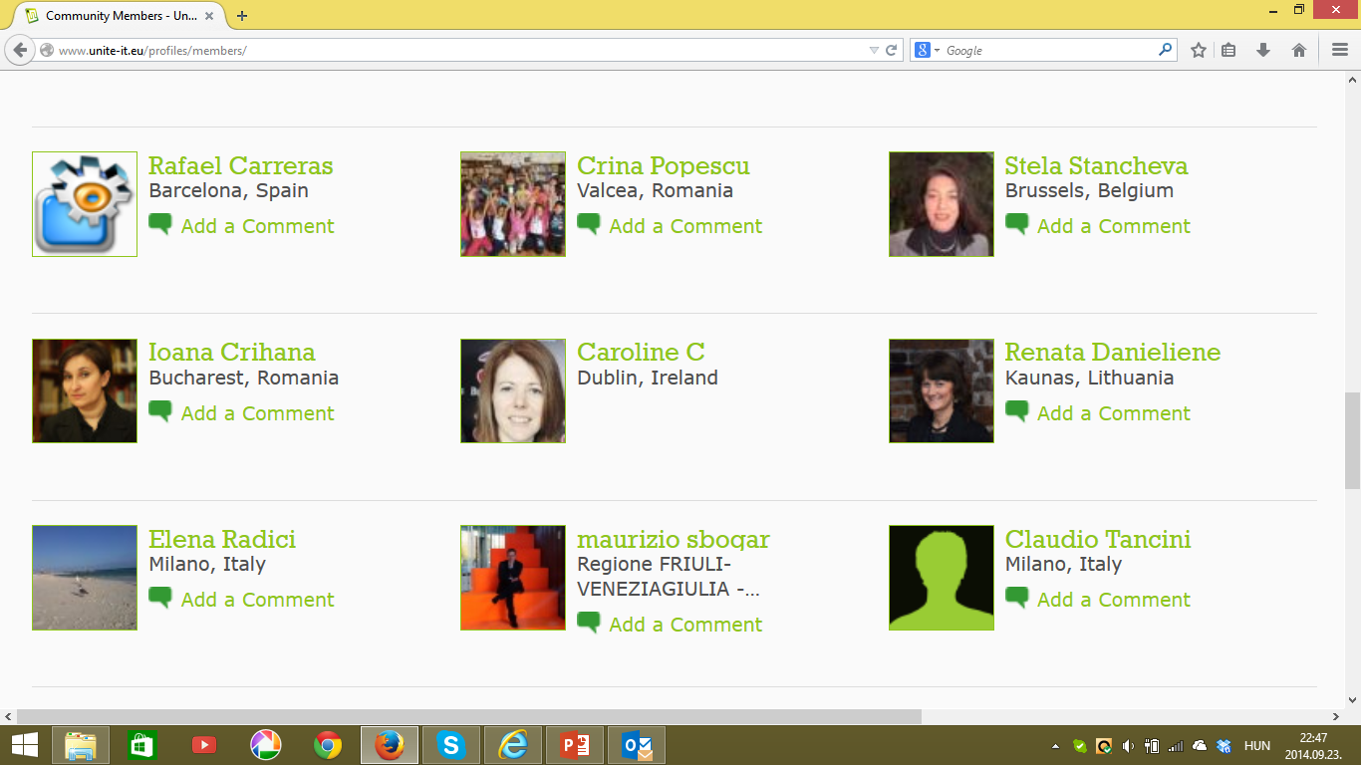
Unite-IT
AREAS OF ACTIVITIES
Establishing the network, providing the operational and administrative ground on which the members can act by exchanging practices, sharing resources and ideas.
This project has been funded with the support of the Lifelong Learning Programme (KA3) of the European Union

Slide 5
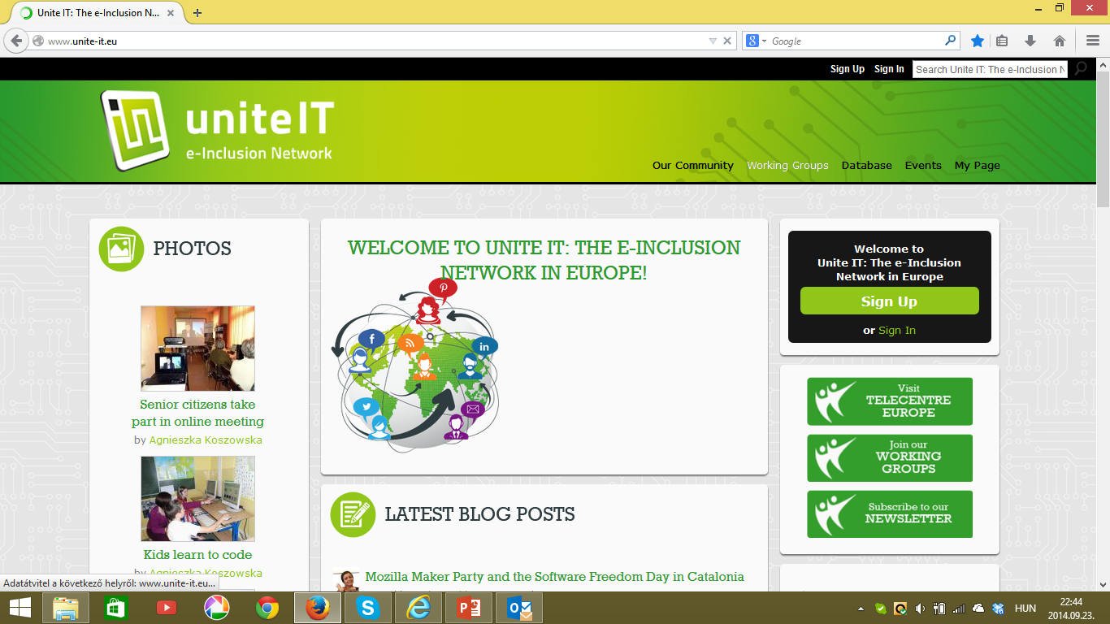
Unite-IT
AREAS OF ACTIVITIES
Developing an online portal (www.unite-it.eu) to serve the network, containing information, news, materials, access to network databases of practices and policies in Europe with specific regard to ICT for inclusion and social cohesion.
This project has been funded with the support of the Lifelong Learning Programme (KA3) of the European Union

Slide 6
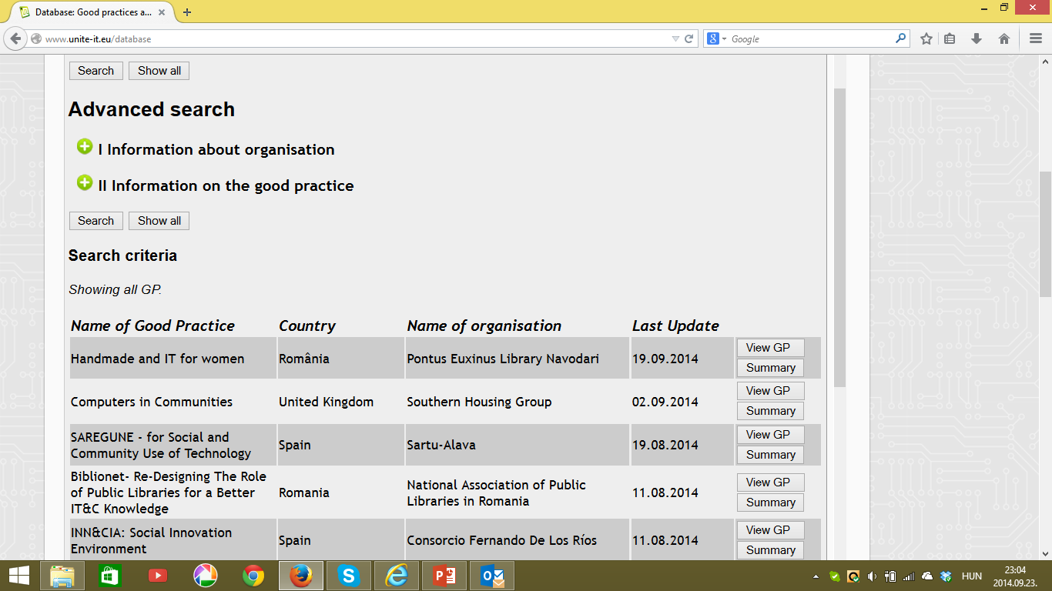
Unite-IT
AREAS OF ACTIVITIES
Pooling resources both in terms of good practices and policies, presented through structured tools.
Open call for good practices and policies.
Best ones will be awarded tonight!
This project has been funded with the support of the Lifelong Learning Programme (KA3) of the European Union

Slide 7
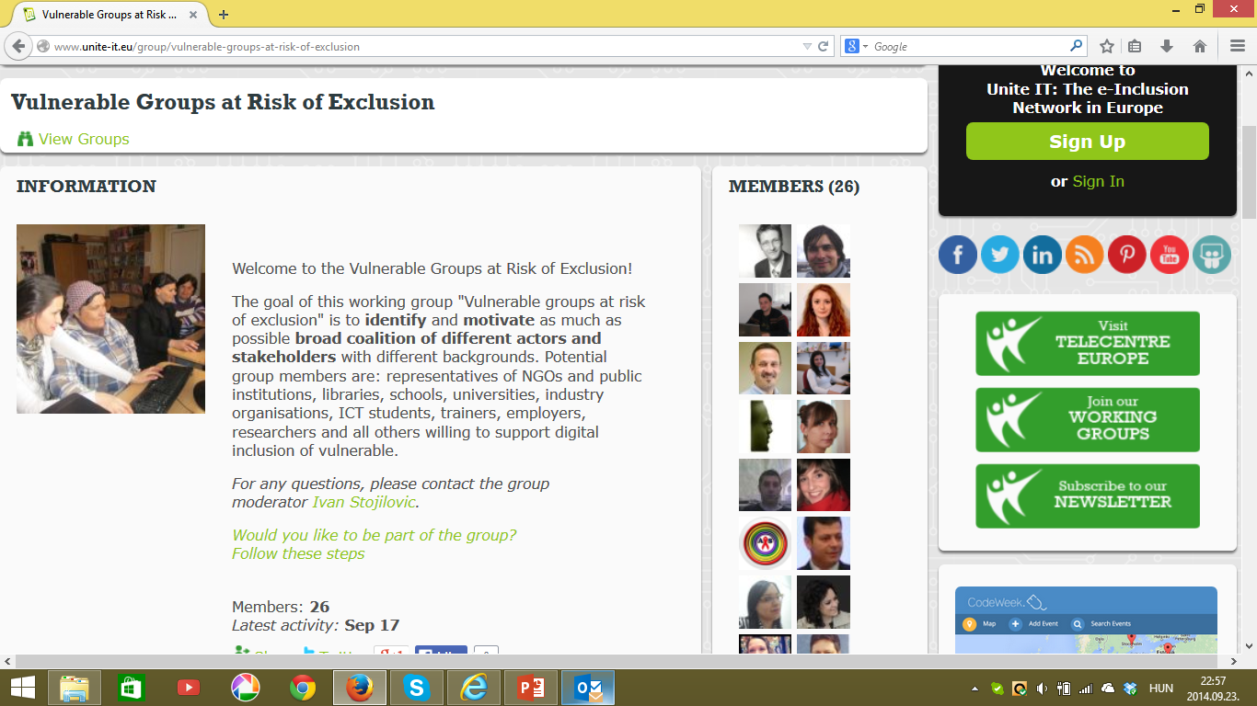
Unite-IT
AREAS OF ACTIVITIES
Establishing working groups related to digital competence for inclusion
Education, training, and certification
Vulnerable groups at risk of exclusion
Youth employability
Gender equality
This project has been funded with the support of the Lifelong Learning Programme (KA3) of the European Union

Slide 8
Unite-IT
AREAS OF ACTIVITIES
Raising awareness about the value of digital competence for inclusion and social cohesion purposes, dealing with policy makers and stakeholders at all levels, national and regional authorities, others concerned with the field;
Promoting links and positive synergies at a horizontal level (between policy makers, practitioners, and stakeholders), and at vertical level (between policy and practice)
This project has been funded with the support of the Lifelong Learning Programme (KA3) of the European Union

Slide 9
Unite-IT
AREAS OF ACTIVITIES
Providing updated state-of-the-art reports on yearly basis (presented at the yearly conferences)
Organising a yearly conferences, bringing together policy makers, stakeholders, and education and training organisations:
2013: Malta
2014: Zagreb
2015: Belgrade – we invite you to join us again!
This project has been funded with the support of the Lifelong Learning Programme (KA3) of the European Union

