Slide 1



Unite-IT
WELCOME TO Unite-IT:
THE E-INCLUSION NETWORK IN EUROPE!
Digitally empowered Europe Unite-IT Annual Report
This project has been funded with the support of the Lifelong Learning Programme of the European Union

Slide 2

The Unite-IT report www.unite-it.eu
Digitally empowered
Europe
Unite-IT
Annual Report
This project has been funded with the support of the Lifelong Learning Programme of the European Union

Slide 3
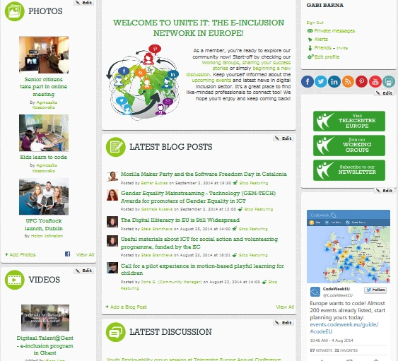
The Unite-IT portal www.unite-it.eu
This project has been funded with the support of the Lifelong Learning Programme of the European Union

Slide 4
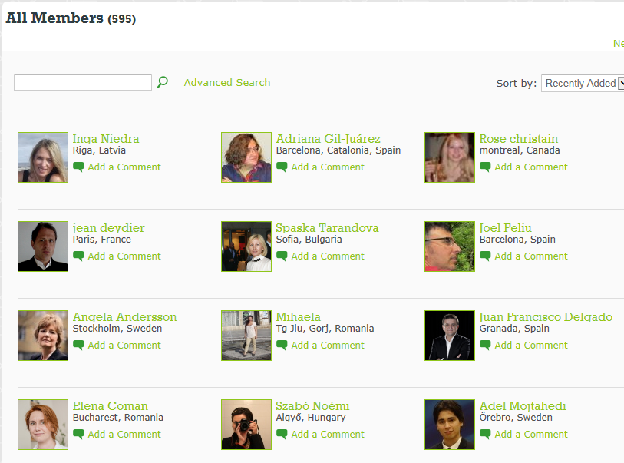
Unite-IT members:
There are currently over 600 digital inclusion practitioners and experts in the Unite-IT community. Our members represent over 50 countries
This project has been funded with the support of the Lifelong Learning Programme of the European Union

Slide 5
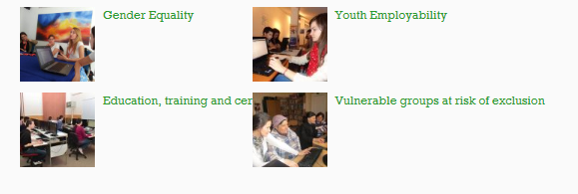
Unite-IT 4 working groups
- lots of benefits!
This project has been funded with the support of the Lifelong Learning Programme of the European Union

Slide 6
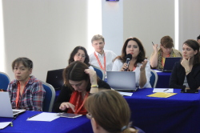
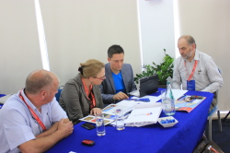
The Annual conferences www.unite-it.eu
Malta 2013
Croatia2014
Serbia 2015
This project has been funded with the support of the Lifelong Learning Programme of the European Union

Slide 7
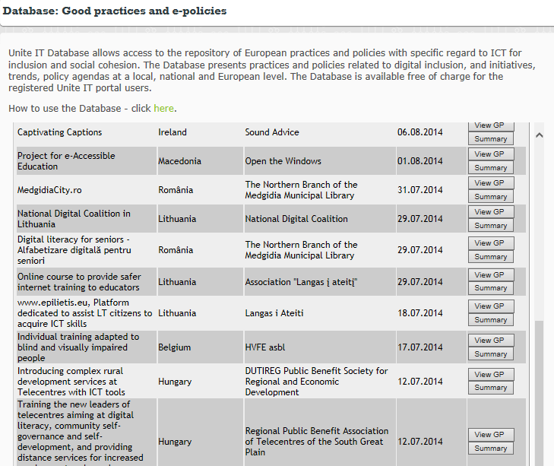
Best practices and e-inclusion policies collection and database
6 e-inclusion policies
76 good practices
This project has been funded with the support of the Lifelong Learning Programme of the European Union

Slide 8
You are invited to:
- submit your country e-inclusion policy
- submit best practices
- join working groups and propose topics for exploration
- make your voice heard
- influence policy
This project has been funded with the support of the Lifelong Learning Programme of the European Union

