Slide 1

Telecentre Multimedia Academy
Zagreb, 26 September 2014
Co-financed by the European Commission’s Lifelong Learning Grundtvig Programme aimed at the acquisition of key competences through adult education
Nov 2012 – Oct 2014

Slide 2
PARTNERSHIP
LIKTA (Latvia) – leading reserach
Telecentar (Croatia) – leading design and revison
ESPLAI (Spain) – leading development
EOS (Romania) – leading piloting
Langas i Ateiti (Lithuania) – leading dissemination
IAN (Serbia) – leading exploitation
DemNet (Hungary) – leading evaluation
Telecentre-Europe AISBL – leading the project

Slide 3
GOALS
Improve learning opportunities for adult learners in media literacy.
Equip learners with skills related to understanding, use and production of media, including audio, video, and photography.
Establish reference points for media literacy learning in 7 participating countries.
Increase telecentres’ training capacity through multimedia education.

Slide 4
OBJECTIVES
Conduct research to discover successful methods and programmes fostering the acquisition of media literacy skills.
Design a learning pathway on media literacy for adult learners.
Develop learning materials and provide tutorials for teachers for the implementation of the learning pathway.
Pilot the training programme in 7 countries.
Establish Telecentre Multimedia Academies.

Slide 5
RESEARCH
Extensive review of the present learning offers in 7 countries and at European level in the field of media literacy for adult learners
Identify the needs of clients
Methodology
  desk and field reserach
  stakeholder analysis through interviews and questionnaires
EU policies in the field, EU qualification frameworks and certification standards

Slide 6
DESIRED KNOWLEDGE AND SKILLS
To understand how different content (text, images, audio, video) is created
To learn about which software/application fits the best to the kind of content to be created
To learn how to edit content created by oneself or others
To develop confidence in content creation as well as explore new technologies, methods, ways and formats

Slide 7
RECOMMENDATIONS
Complementary to already existing learning offers
Suitable for the needs of various target groups
Flexible, simply to implement, modular learning pathway
Connected to the Digital Competence Framework (identified competence areas)
Two-level approach: basic and advanced
Compatible with major certification schemes
Training materials to be piloted and revised

Slide 8
BASIC COURSE OF MEDIA LITERACY
Familiarize students with the basics of sound recording and editing, photography and image editing, and video recording and editing.
Upon completion of the course, students shall be able to
Create a simple digital audio content
Create a simple digital photography content
Create a simple digital video content

Slide 9
BASIC COURSE (70 HOURS)
Sound
Basics of Sound
Photo
Video
Film and Video
Sound Design
Recording System
Microphones
Audio Editing
Audio Distribution
Radio
Visual Communications
Image editing
Image Composition
DSLR Camera
Camera Exposure
Color Control
Light
Photo projects
Film grammar
Filmmaking rules
Video production
Video editing
Video project

Slide 10
ADVANCED COURSE OF MEDIA LITERACY
Familiarize students with the methods of project planning, creation and distribution of media content for teaching and learning with digital media technologies.
Students acquire theoretical basics of project management, visual communication and digital media storytelling.
Upon completion of the course, students shall be able to
Write the script for media project
Develop and present a plan for the implementation of media project
Create a comprehensive digital media content

Slide 11
ADVANCED COURSE (70 HOURS)
Project manag.
Introduction
Digital storytelling
Audio-visual production
Pre-production
Human Resources
Time Manag.
Cost Management
Communication
Project Cycle
Project Proposal
Media news
Introduction to digital storytelling
Storytelling techniques
Interview
Production
Post-production

Slide 12
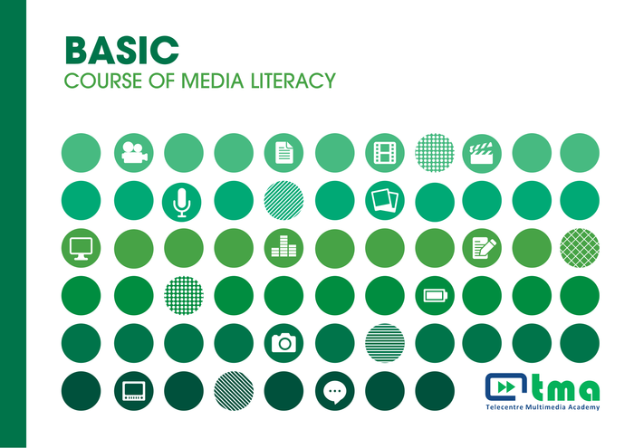
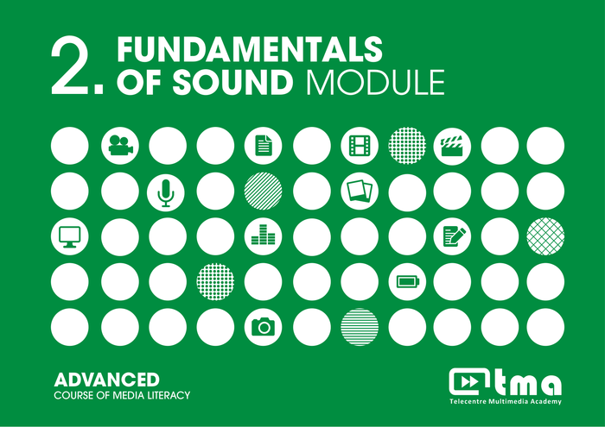
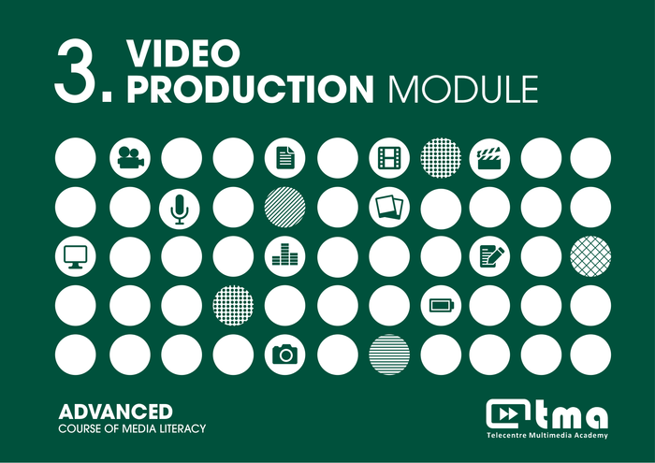
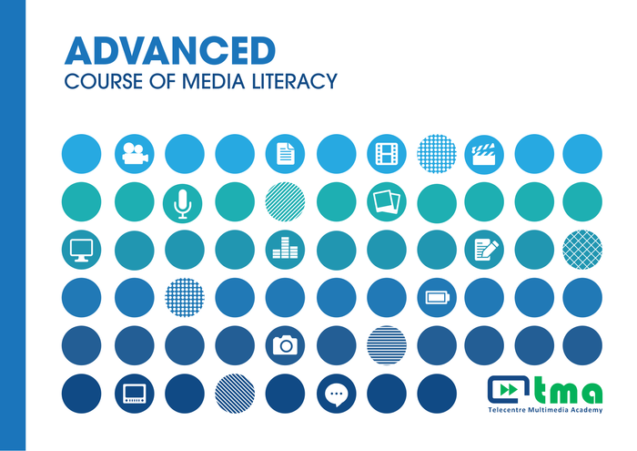
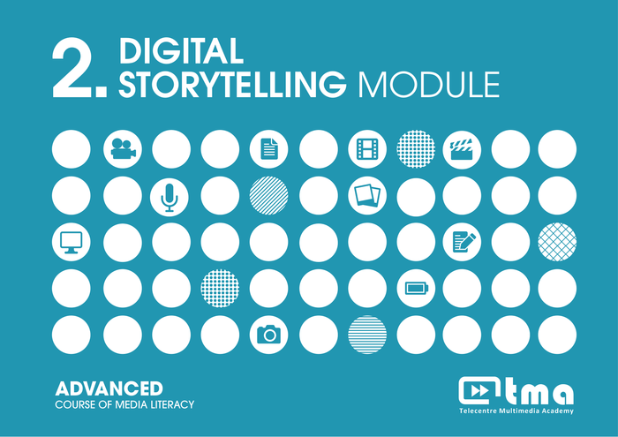
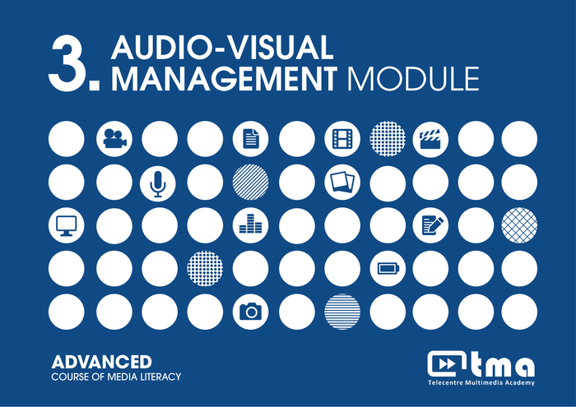
TRAINING CURRICULUM

Slide 13
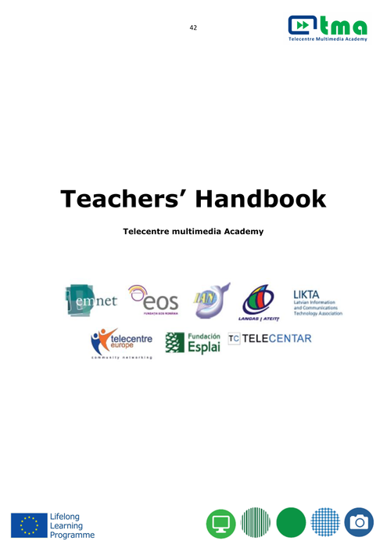
TEACHERS HANDBOOK
Notes for trainers
Practical examples
Assignments
Background materials
Editable files for further processing

Slide 14
PILOT TRAINING
Pilot trainings organised in 7 countries
Over 90 participants trained
Both basic and advanced cources were piloted
Target group included: telecentre operators, NGO activists, librarians, ICT teachers, youth, unemployed…
Training curriculum revised, translated to 7 languages (Lithuanian, Latvian, Romanian, Serbian, Croatian, Hungarian, Spanish)

Slide 15



Thank
for your attention!

