Slide 1

TMA –Spanish Pilot (Fundación Esplai and Oviedo’s Telecentre).
Telecentre-Europe Conference | eSkills for the 21st century
Zagreb, September 2014.

Slide 2

Looking for the right telecentre
Hello! We are looking for telecentres interested on becoming a Multimedia Academy.
We offer teaching contents and methodology, equipment and support!

Slide 3
A hard decision: the selection
We received 7 candidates proposals and we chose Oviedo’s Telecentre because:
They have already collaborated on beca.MOS with a great commitment.
English was not a problem.
They work hard for people’s employability and they were interested on developing video curriculum creation skills.

Slide 4
A hard decision: the selection
They have great facilities.
Previous experience on multimedia training and European programs.
Experienced teachers with all kind of users.
And…

Slide 5
Dissemination of training offer on Oviedo using city council resources:
Posters placed on libraries, social centers, educational institutions and telecentres.
Social media publications, city council web, Job Search and Entrepreneurship Facebook pages.
Youth bulletin from the Municipal Younger Office.
Local press.

Slide 6


Slide 7
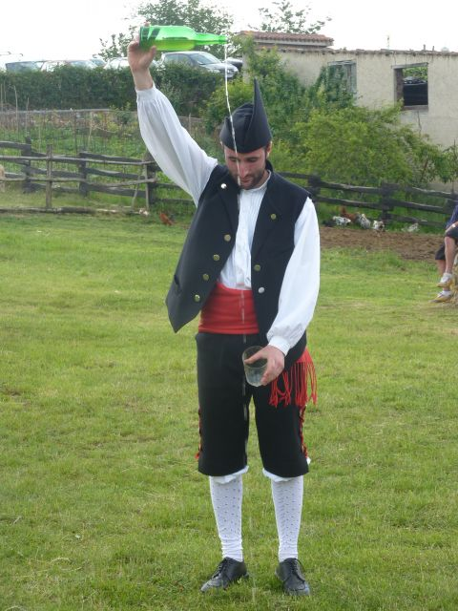
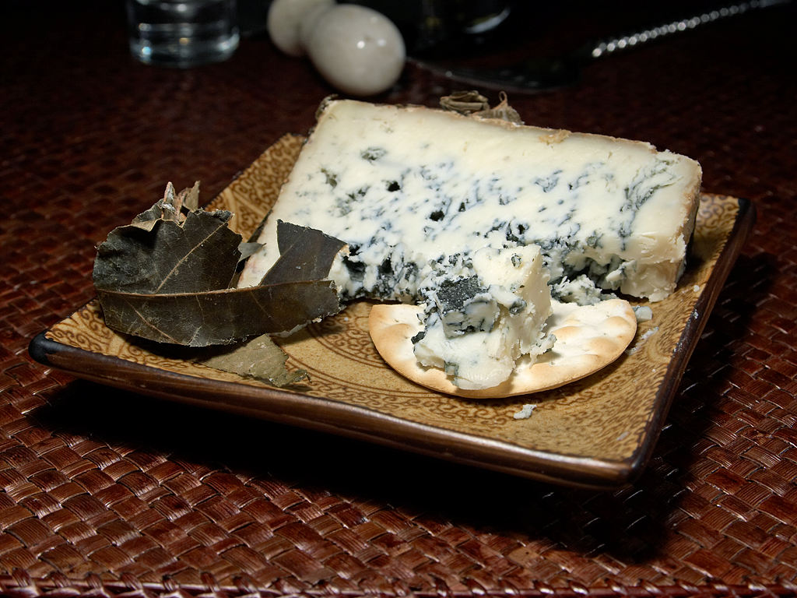
Cabrales cheese and sidra!

Slide 8
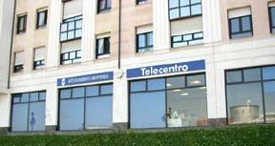
Oviedo’s Telecentre
Telecentre is an accessible space for people with disabilities, organized on reception, job insertion and mediation offices, workshop area for basic instruction, computer’s classroom and multipurpose space.

Slide 9
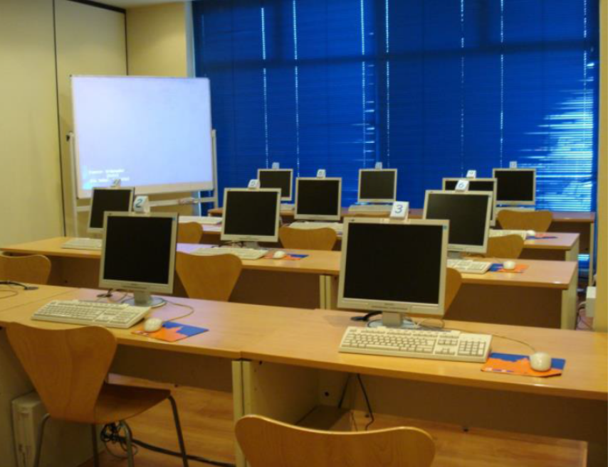
Oviedo’s Telecentre
Training was made using computers running Microsoft Windows 7 (updated by Fundación Esplai) and productivity and multimedia software and led projector.

Slide 10
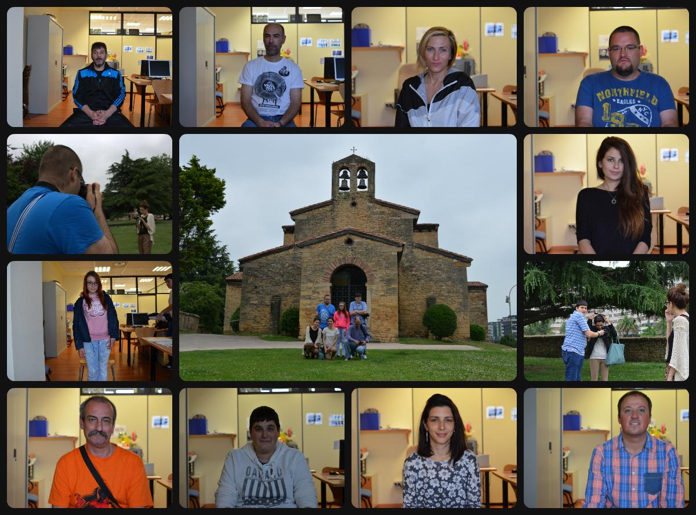
Target group

Slide 11
Selection criteria
Alejandro, Jesús, Leticia, Lucio, Eva, José Luis, Florentino, Laura, Patricia and Sandra were chosen because they represent a group with different educational level (from primary studies to college), a range of ages from 17 to 50 years old and with both genres presence.

Slide 12
Selection criteria
A diverse group, with different personal background to promote collaboration and supporting possibilities, improving social relations and interaction along the learning process.
None of them had great knowledge on multimedia skills.

Slide 13
Selection criteria
Unfortunately, 8 of 10 are unemployed, one person is retired and just one of them has a job but not a full work day.
The whole group use multimedia devices on its personal life, but never, have used them to professional purposes (except one person on communication work).

Slide 14
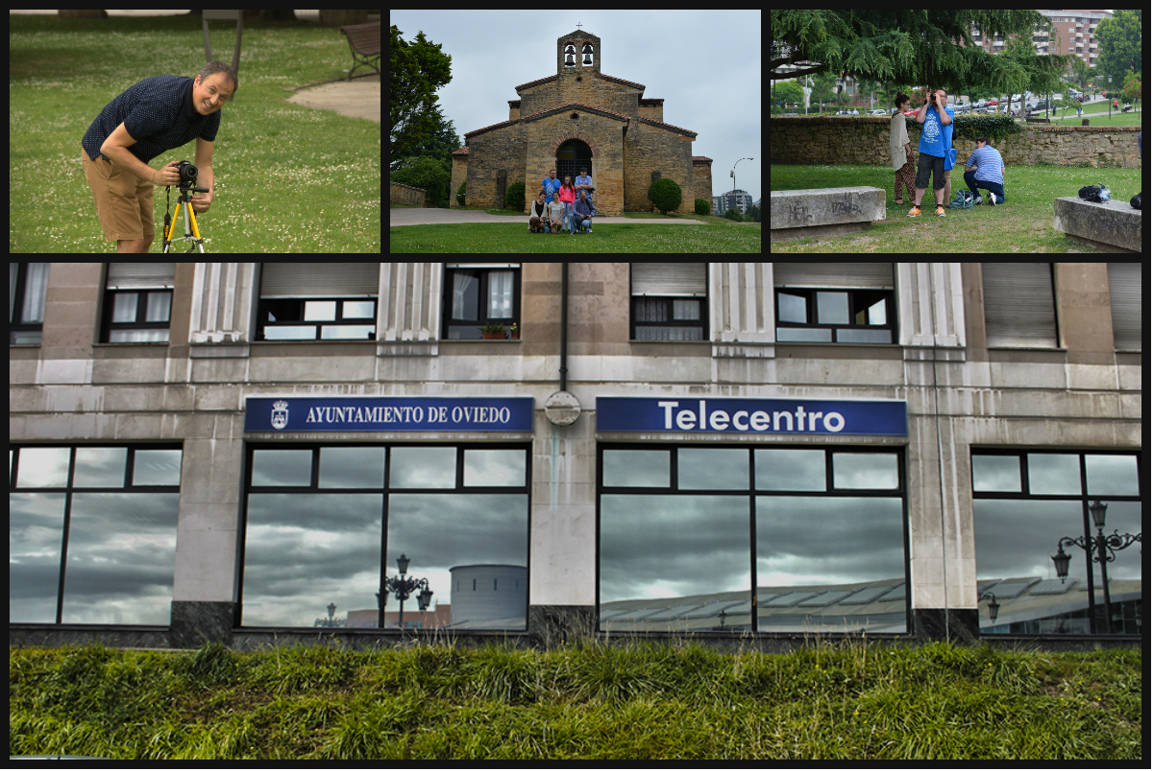
68 hours working with sound, pictures and video (basic course)

Slide 15
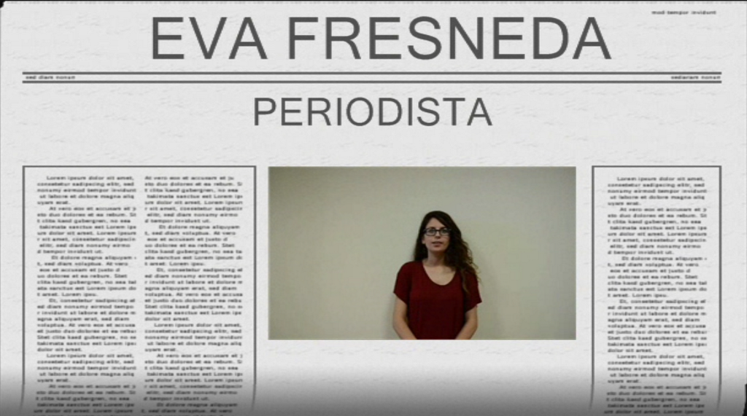
Activities organization
Activities were designed to promote active job searching. For example, we modified video module practices in order to produce CV videos.
This question was of great value for students and they asked for more time to work in.

Slide 16
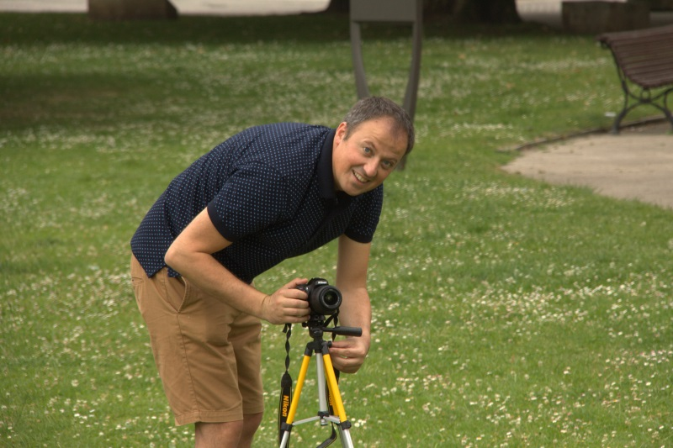
Activities organization
We made several excursions in order to find different locations and making practices similar to proposal activities in different multimedia resources. Exiting from the telecentre was an opportunity to generate new dynamics and relationships between participants.

Slide 17
Results
According to participants evaluations, training time is correct in general, but some lessons would need more time to go in depth of the software capabilities and others like the sound module, should be shorter or make some kind of improvement of its contents.
Teachers and learning materials have a great value for students.
Thanks to TMA training, students think that they have new tools and skills for job searching and communication.

Slide 18
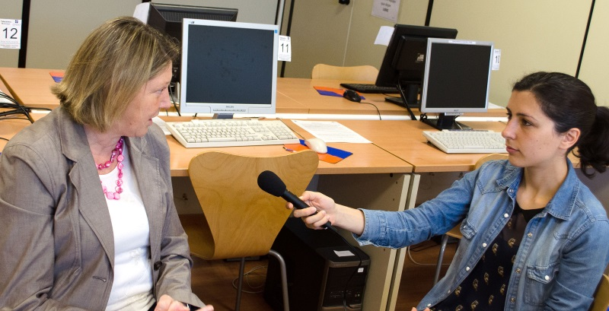
Results
80% of students values as very useful this training: although all the participants have previous basic knowledge about multimedia, they have improved their skills thanks to this training.

Slide 19
Results
Talking about video training, some students suggested using a more powerful free software video editor, and having more recorded contents. They also think it would be interesting practicing with chroma recordings and effects, although they understand it’s a basic training and these are advanced aspects on video edition.
Students ask for a greater level of detail explaining software capabilities and options, and better wording for practical activities.

Slide 20
Finally… some quotes from participants
“I have always liked photography but never had the chance to learn it. Thanks to this training I have approach myself to this world, and even for free.
Thank you very much!”.
“This training has been very useful to improve some skills I already had and now I see there is a lot of thing to learn!”
“I have dropped-out my studies, but with this training I’m motivated to make an image / sound module”.

Slide 21
Thank you!
Pedro Aguilera paguilera@fundacionesplai.org
Fundación Esplai (Spain)
More information about the project: http://tma.telecentre-europe.org/

