Slide 1

Piloting in Serbia
Ivan Stojilovic
Zagreb, Croatia
26/09/2014
Funded under Grundtvig Multilateral Projects, Development of Innovation,
4.2.1 Acquisition of key competences through adult education

Slide 2



“Basic Course of Media Literacy” piloted by IAN International Aid Network from 26 May to 27 June 2014

Slide 3
Modules
Sound production
Photography
Video production

Slide 4
Activities
Pilot group: 12 participants
  single mothers
  youth
  unemployed
  Classes organized every working day, 3-4 school hours every day
  Multimedia classroom and outdoors

Slide 5
Activities
Three trainers (one for audio, one for video and one for photography) used different methods, theory lecture and practical work, discussions, group and individual work, presentation during the training.

Slide 6
Activities
The participants were given various tasks, such as:
  Making photos of other participants for a CV,
  Making photos of still nature, buildings,
  Filming daily training activates,
  Filming job interviews…
They also worked outdoors

Slide 7
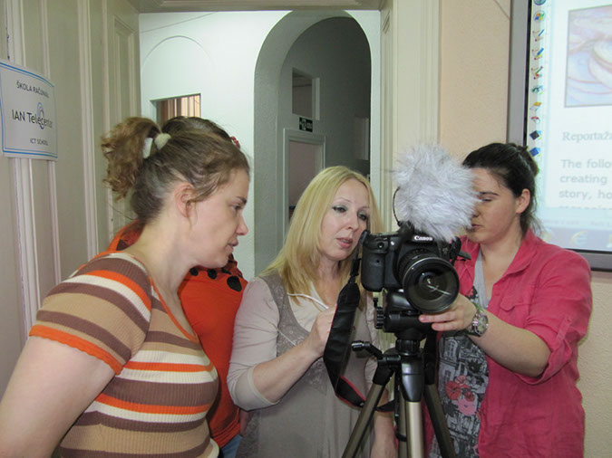

Slide 8
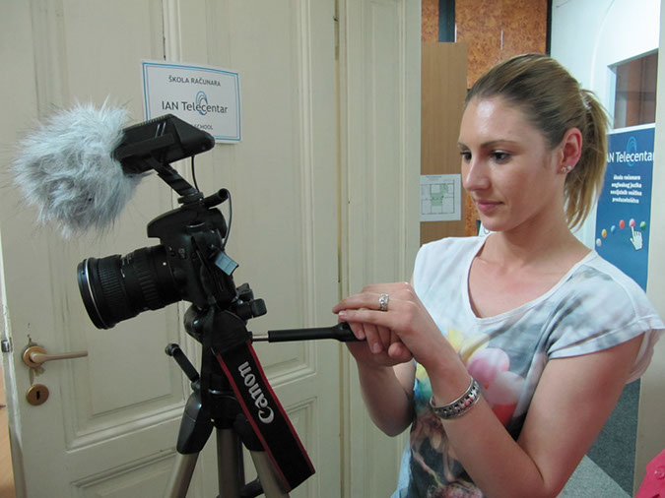

Slide 9
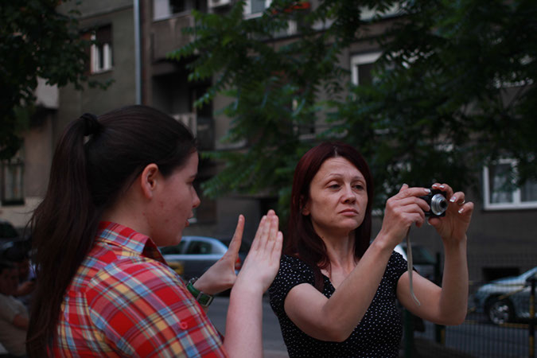

Slide 10
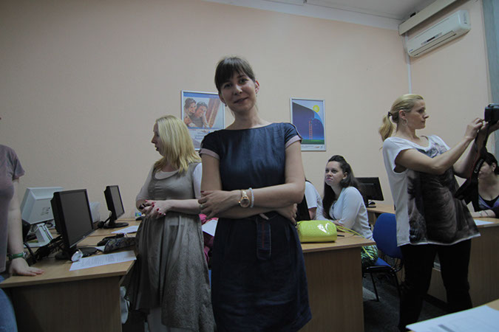

Slide 11
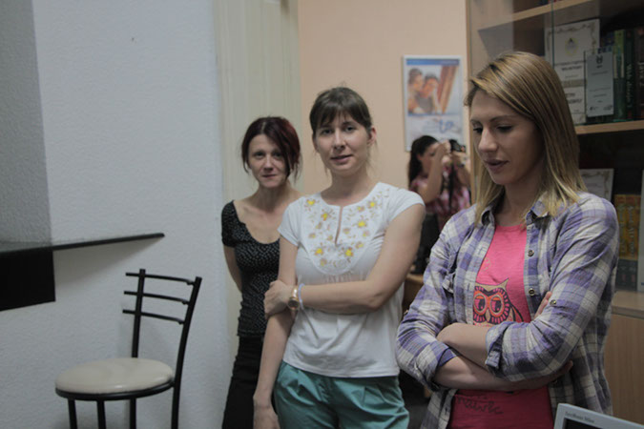

Slide 12
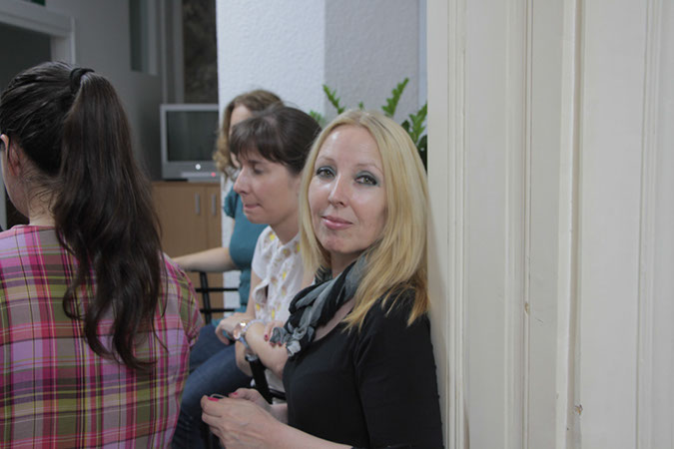

Slide 13
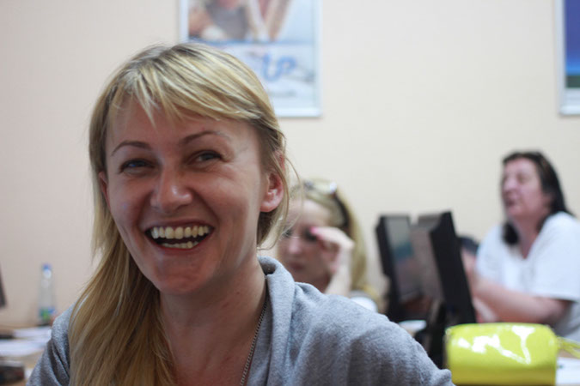

Slide 14
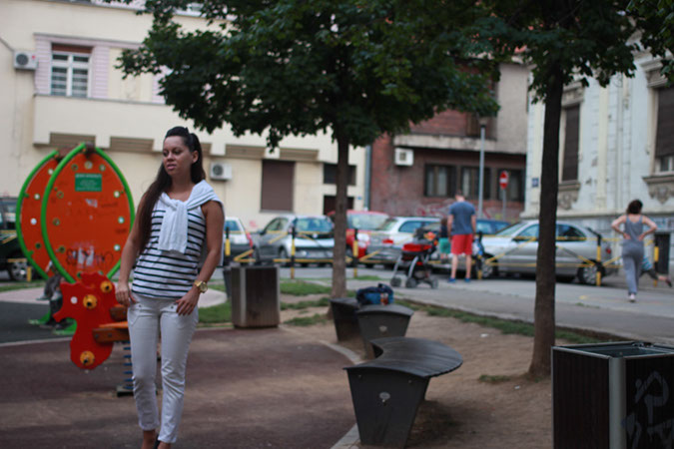

Slide 15
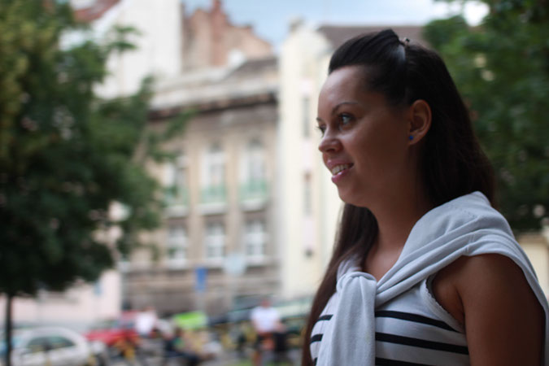

Slide 16
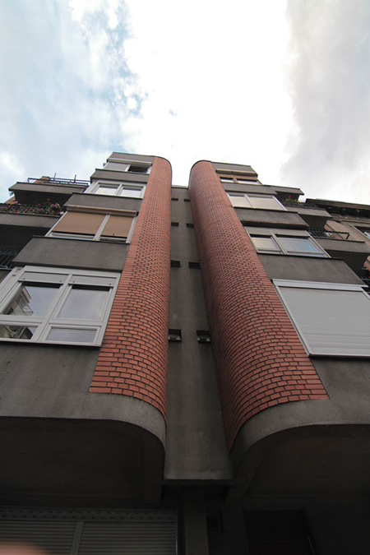

Slide 17
Quotes
“These new multimedia skills will help us in future work and finding the job. Trainers were patient and tried to convey their knowledge and motivate us to succeed and help us increase our confidence.” (Bojana K. single mother)
“After the course I acquired new skills as well as friends. This is the first time I met with movie production. I learned how to make a movie, how to edit and I think my future profession will be related to this field.” (Stevan J., secondary school student)

Slide 18
Video
Video link

Slide 19

Thank you !
Ivan Stojilovic edu@ian.org.rs

