Slide 1
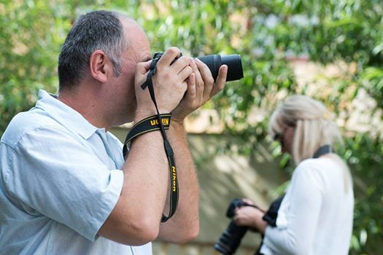

TELECENTRE MULTIMEDIA ACADEMY PROJECT IN ROMANIA
COORDINATOR: EOS ROMANIA
Cornelia Popescu
Zagreb, CROATIA
26 September 2014
Funded under Grundtvig Multilateral Projects, Development of Innovation,
4.2.1 Acquisition of key competences through adult education

Slide 2
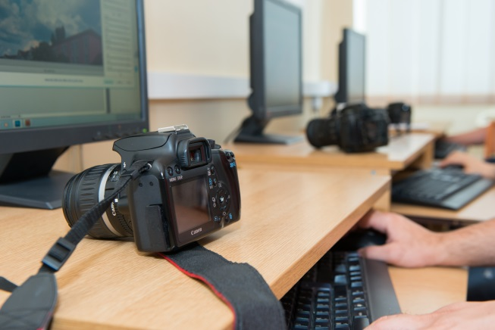
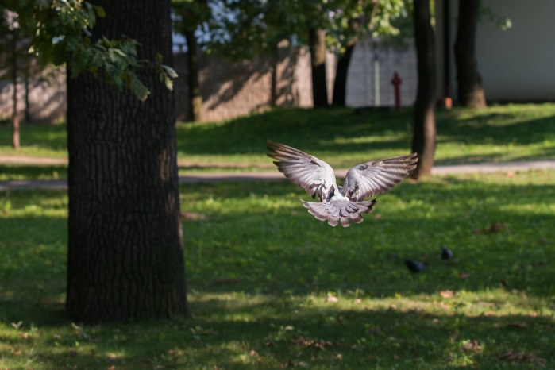
TMA PILOT IN ROMANIA
BASIC COURSE training was chosen for the pilot phase
Training modules piloted:
Basics of Photography;
Introduction to Video Production Basics;
Fundamentals of sound production.

Slide 3
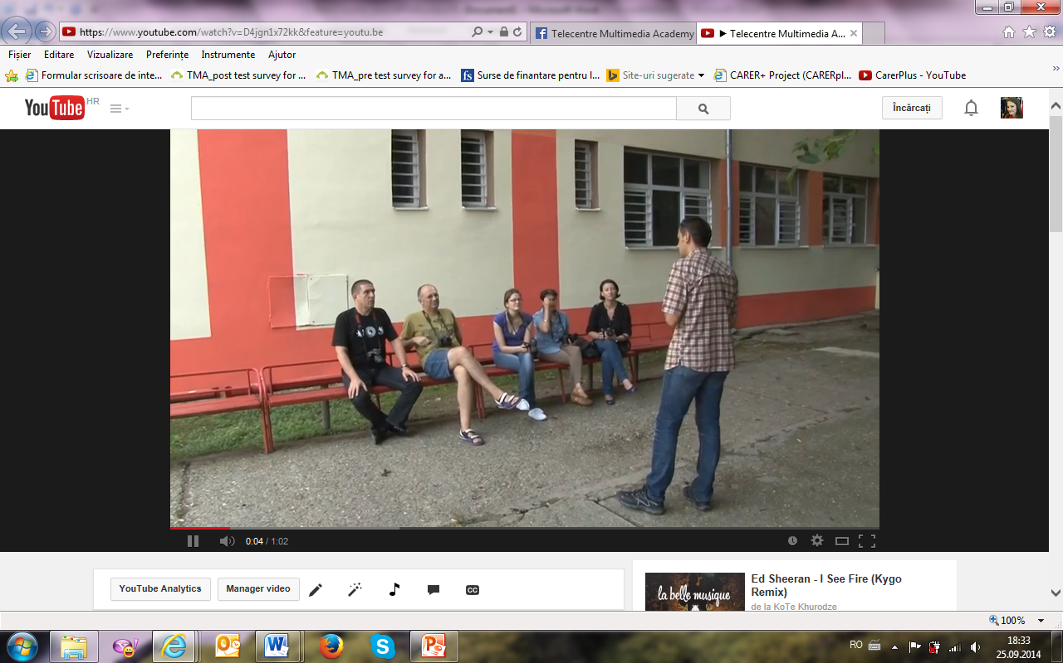
Telecentre Multimedia Academy video

Slide 4
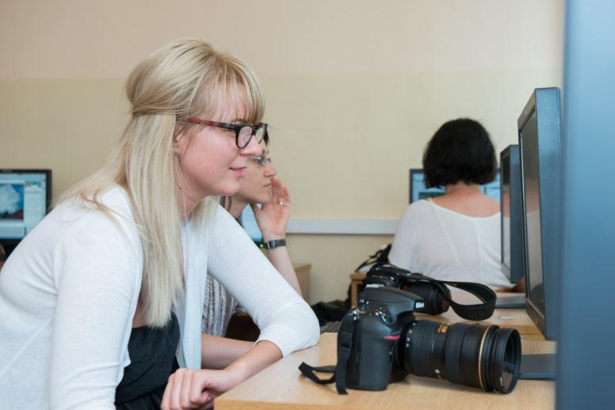
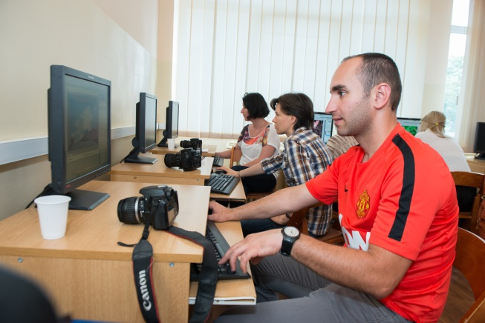
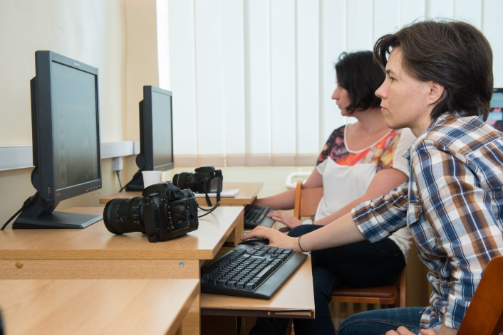
PARTICIPANTS
TMA piloting programme
13 participants with ages between 22- 60
Trainees were:
Teachers from undergraduate schools;
Community facilitators;
People working in NGOs with focus on adult education and training.

Slide 5
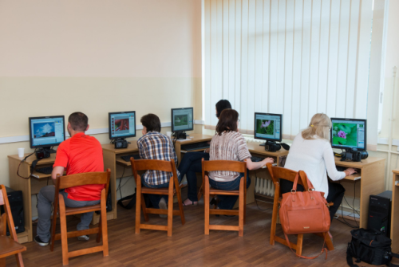

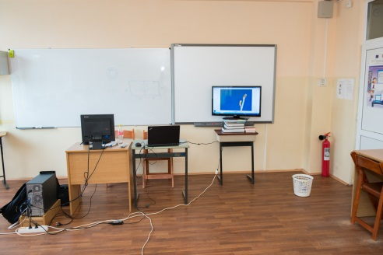
Training location
The location was chosen taking into account the technical and logistical requirements of the project.
Training room: School Centre „Paul Popescu Neveanu” Timisoara.
Classroom facilities:
desks equipped with computers
for each student;
Server to download materials
realized by students;
Video project;
Smart board;
Software: Adobe Photoshop, Adobe Lightroom and Adobe Premiere

Slide 6
EQUIPMENTS USED
Students had acces to multimedia equipment's as:
Photo cameras:
Nikon D700;
Nikon 3200;
Nikon D5100;
Camera objectives:
18-55mm VR DX AF-S;
Nikon AF-S NIKKOR 24-70mm f/2.8G ED
Nikon AF-S NIKKOR 14-24mm f/2.8G ED

Slide 7
Trainers feed back& recommendation's
“Regarding my activity as a trainer I can say that Telecentre Multimedia Academy project was a very good opportunity to improve my teaching technique of a course especially dedicated and designed for adult learners, given the fact that in the past I did this kind of trainings for many groups of children” – ALEXANDRU CRISAN, TMA trainer in Romania - Professional photographer
Recommendations – small changes must be made in the curriculum content that was developed
Photography module – missing explanations which should be added: difference between the devices / objectives DX (crop) and equipment / objectives FX (full-frame) and their operation mode.

Slide 8
Trainers feed back& recommendation's
Recommendations & feed back
“Even if the photo module is called "basics of photography" I think this aspect is very important in learning how to use a DSLR camera and capture quality images”.
I would introduce new parts related to equipment and work processes;
Some parts related to the history of photography/video/audio I think that can be removed;
Duration of the training modules is good but I think that it must be correlated with the interest of the learners for each of the three modules.
“The course can be adapted during the training and the missing parts can be summarized and explained briefly, in addition to the written material” – this is the very good part of the training materials

Slide 9
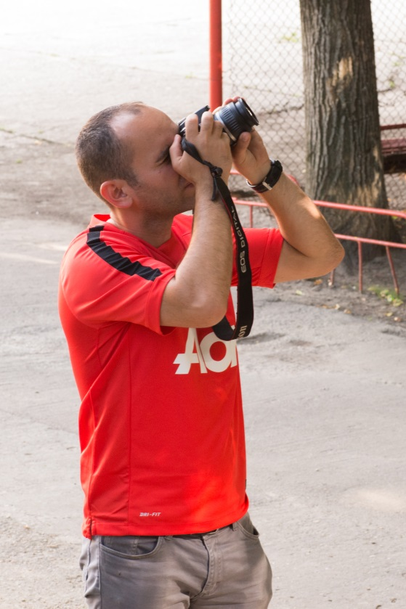
Quotes from participants/opinions
It was a training that opened for me new horizons of knowledge, a very practical course that offered to all of us the chance to extract the essential ideas without making too much effort and also I managed to develop a range a skills that will help me in my professional paths!” tells Marian Duculescu – Trainer at County Youth Foundation FITT

Slide 10
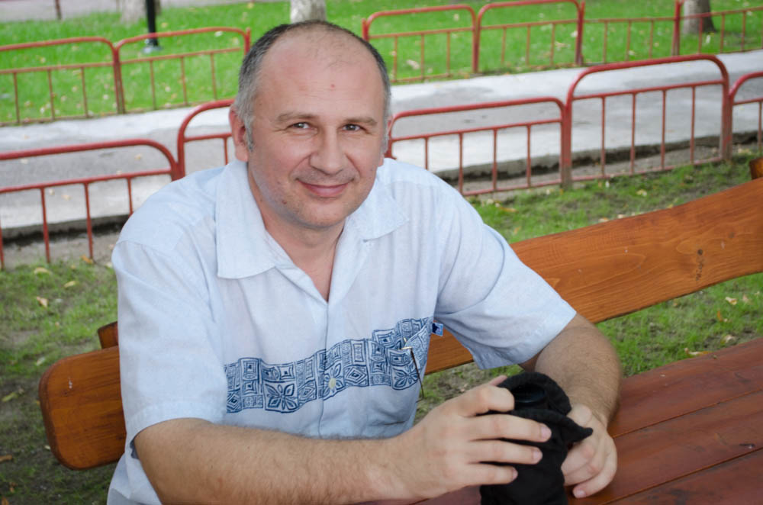
Quotes from participants/opinions
“Photography is an image with an instantly magic character. During the Telecentre Multimedia Training we learned as better as possible to capture this snapshot!” tells Bogdan Verșigan – independent ICT trainer consultant

Slide 11
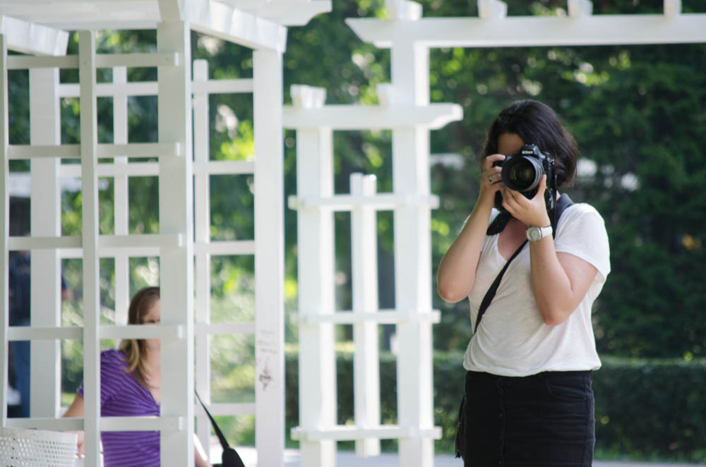
Quotes from participants/opinions
“I learned that taking a picture is more than keeping a camera in your hand. To capture the essence of things and the movement in a single button press requires knowledge, perseverance and of course – some heart!” - tells Madalina Popițu – Project Manager at APEL Foundation and trainer& career guidance counsellor

Slide 12





Thank you!
+40 256 498 172
Cornelia Popescu, Project coordinator
EOS Romania
www.eos.ro
cornelia.popescu@eos.ro

