Slide 1
Telecentar, Croatia
Association Media, Croatia
Practical demonstration of multimedia skills presented by participants of the TMA training programme in Croatia

Slide 2
Association Media
non profit group
consists most of people working in the education system of Croatia
Mision:
- media education for all generations

Slide 3
we have started partnership with Telecentar, Zagreb and included in TMAs courses
These courses are structured of 3 basic moduls of photography, sound and video and also 3 advanced courses
We have finished 2 basic moduls of photography and sound and the third one of video is in process

Slide 4
COURSE DESCRIPTION:
In lectures, students have learned theoretical basics of multimedia production, including digital sound, digital photography and digital video.

Slide 5
During the first part of exercises, students have acquired basic skills of sound recording and editing and have participated in a team production of digital audio content.
In the second part of exercises, they will learn the basic skills of photography and image editing and participate in a team production of digital photos.

Slide 6
In the advanced modules of exercises, students will learn how to shoot and edit video. The final team production exercises will combine the skills of digital video production with previously acquired skills of digital sound production and photography.

Slide 7
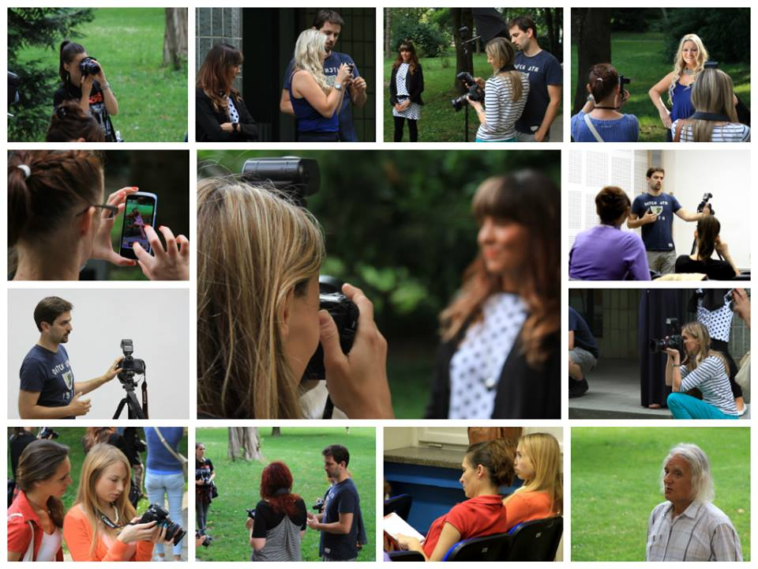

Slide 8
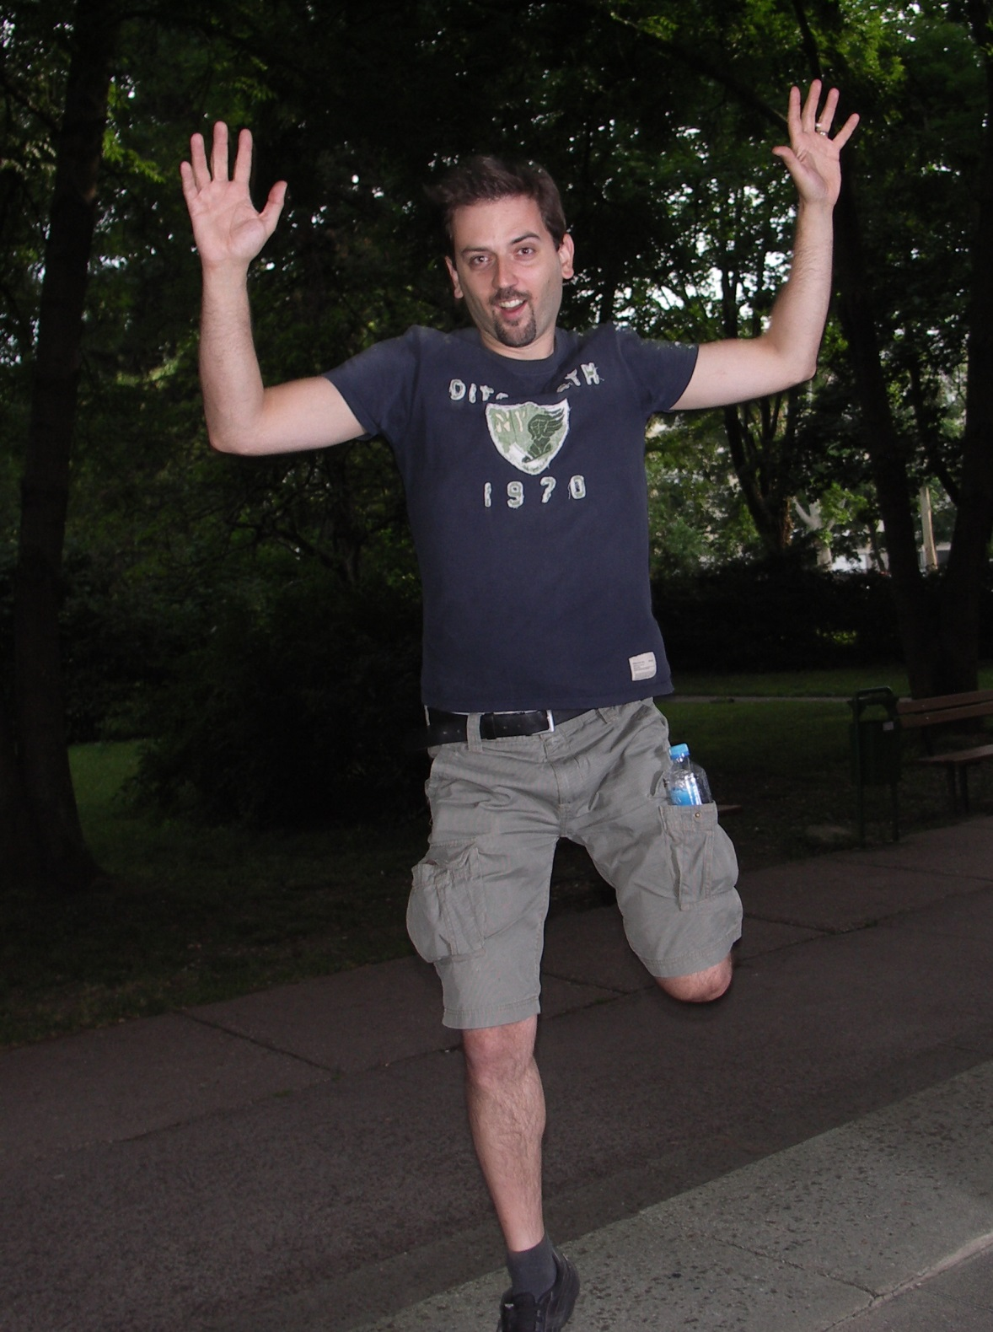

Slide 9
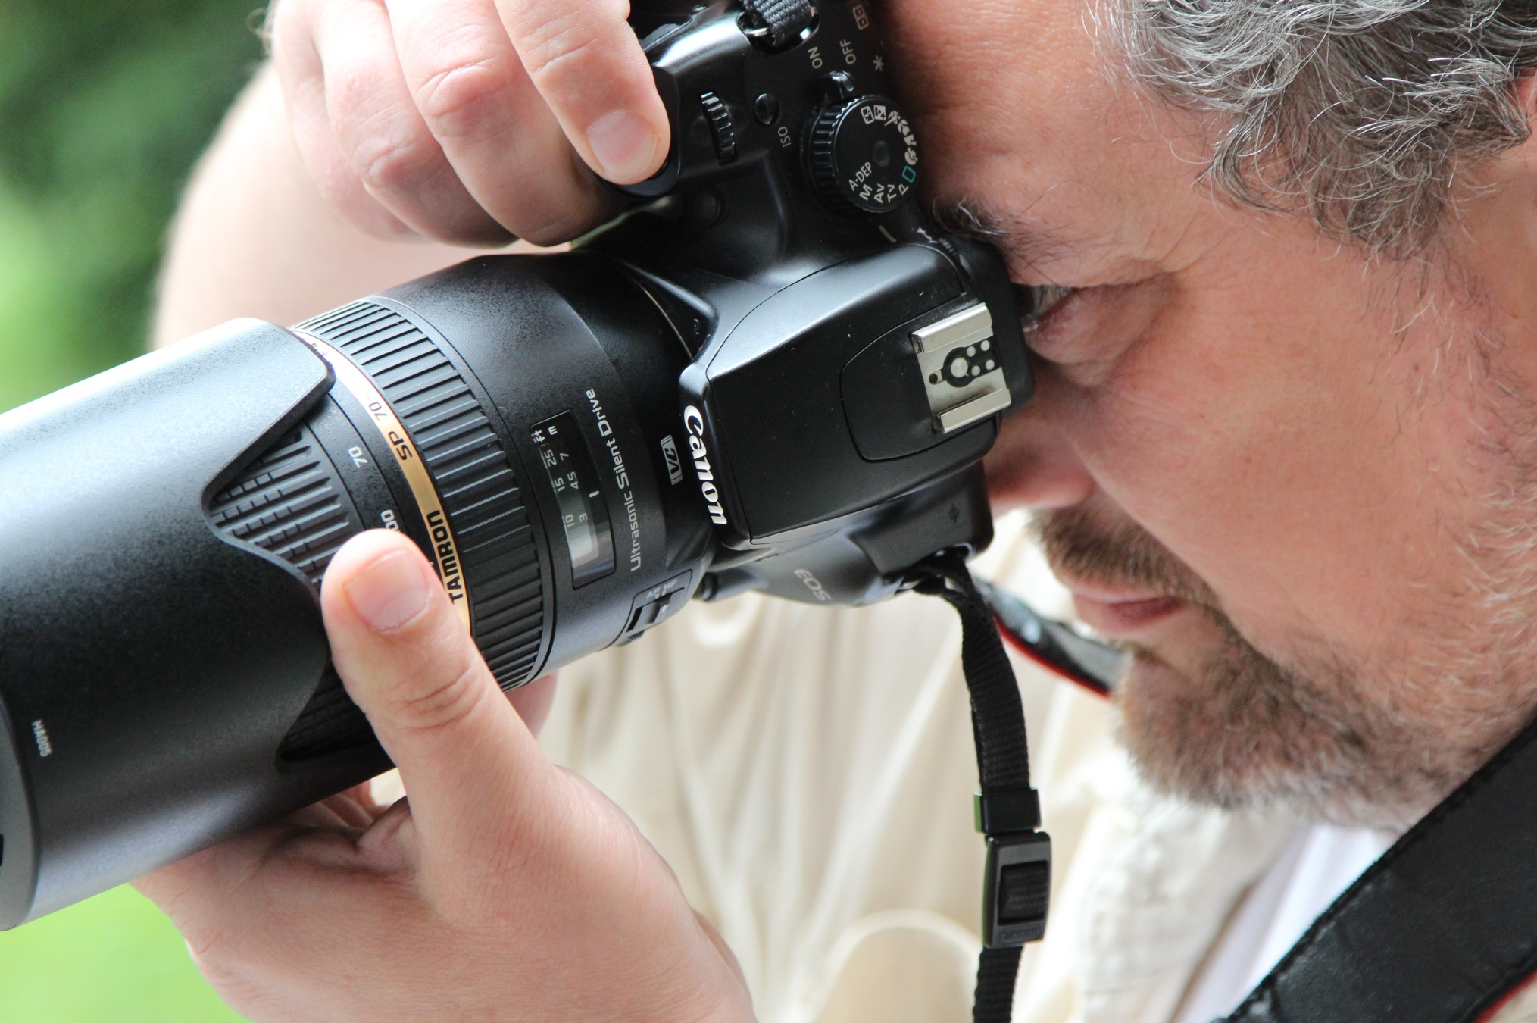

Slide 10
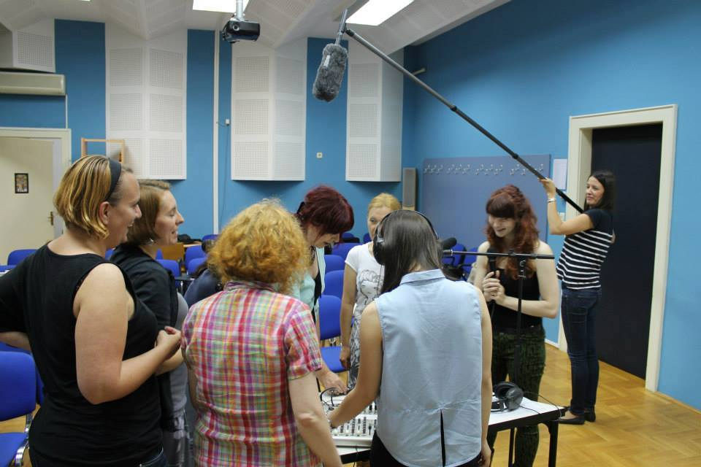

Slide 11
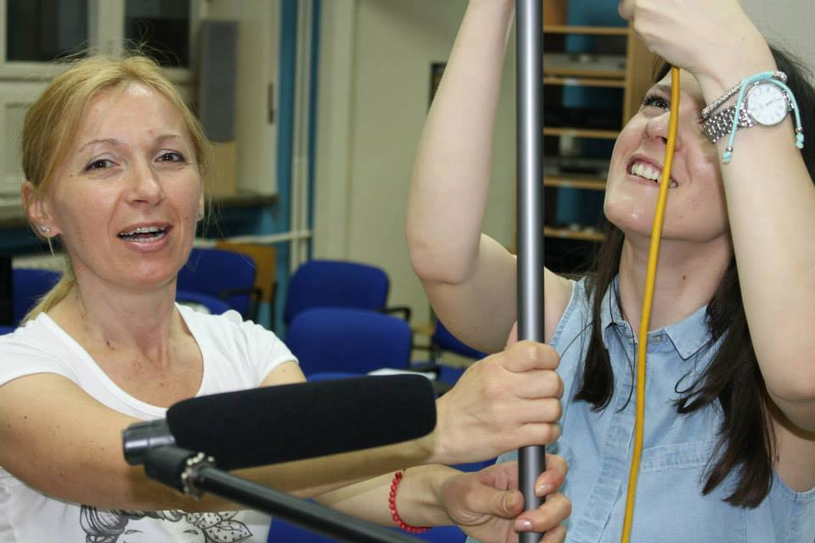

Slide 12
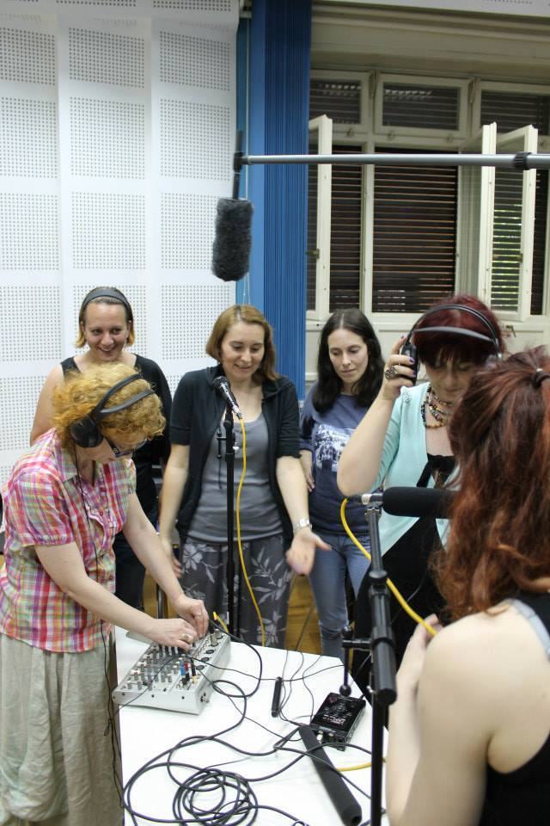

Slide 13
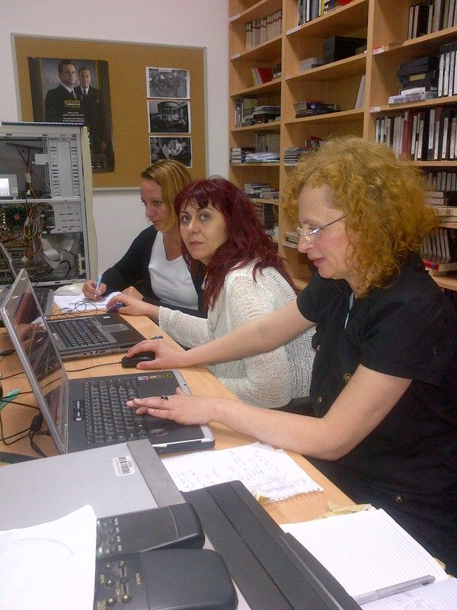

Slide 14
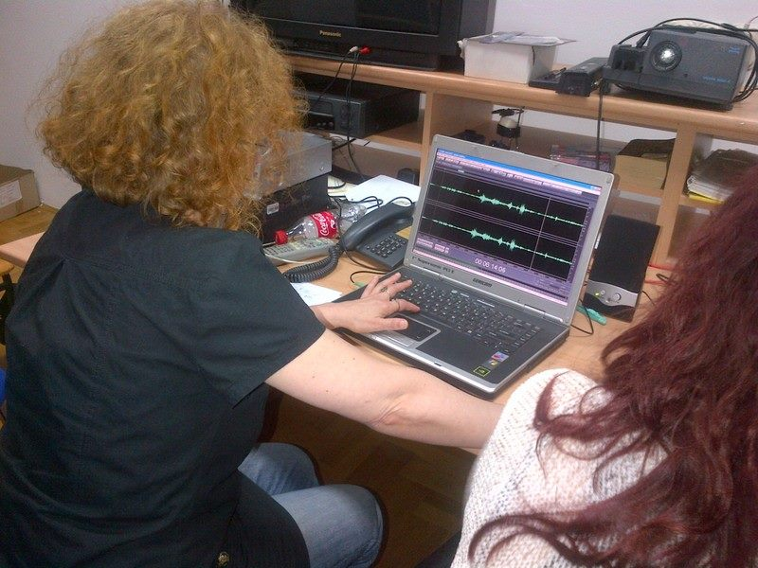

Slide 15
This type of education-for-educators gives a base for our further work with children and adults
Telecentar, Zagreb and Association Media have found common aim to influence improvement of media literacy in our society

Slide 16
