Slide 1



Training Impact of ANBPR on Librarians’ ICT Skills
IOANA CRIHANĂ,
EXECUTIVE DIRECTOR
ANBPR, Romania
Zagreb, 24 September 2014

Slide 2
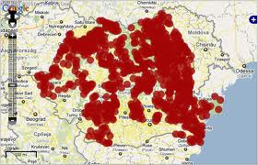
Who are we?
The most representative professional association of librarians at national level;
41 branches and over 3,300 individual and institutional members;
main partner of the Biblionet Program (GL Romania).
Notes:
main partner of the Biblionet program (GL Romania), the most important private investment in libraries in Romania

Slide 3

Mission
Ensuring democratic access to information;
Developing digital literacy activities and programs;
Providing integrated services for different categories of users;
Facilitating IT skills learning and extending technology benefits for the entire library system;
Supporting the continuous professional development of the member base.

Slide 4
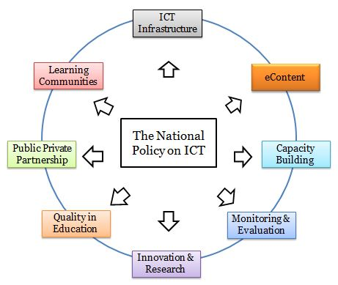
Pillars in the ICT field
Increase librarians’ digital skills;
Develop a digital culture in the Romanian library system;
Enhance the impact of ICT tools via ANBPR’s training courses on technology use;
Extend the benefits of technologies especially in rural libraries.

Slide 5
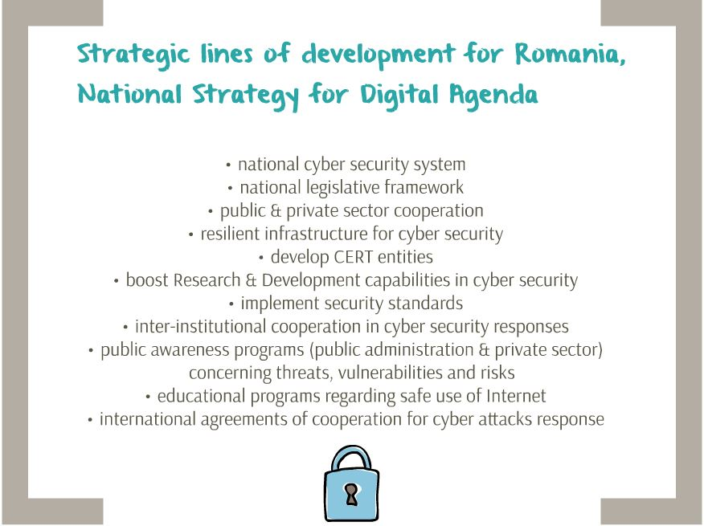
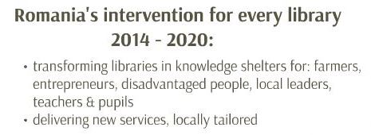

Libraries & Digital Agenda for Romania
increasing the level of digital literacy among community members;
helping to reduce the urban-rural divide in terms of access to technology;
transforming libraries into national facilitators of e-inclusion, willingness to provide good practices and mentoring models for users from different walks of life.

Slide 6
ANBPR represents a modern library system
Biblionet - the most important program which introduces technology in the public libraries of Romania - $ 26.9 million (private investment);
2,280 public libraries have received modern equipment for free access to information for the general public;
3,015 librarians were trained in IT skills;
41 functional Training Centers at the county library level;
90 trainer-librarians (Train-the-Trainers)
2,640 librarians trained in ‘The Fundamentals of New Library Services’
The Biblionet encourages the development of an educated and pro-active civil society.

Slide 7

Romanian public libraries infrastructure
2,280 libraries with Internet access
4.32 computers with Internet access per library
9,100 computers with Internet access for the general public
2,640 librarians trained in IT
national coverage
via Biblionet/ANBPR network
41 local Training Centers

Slide 8

Advocating for a common information space
Motivating and supporting libraries to develop digital collections;
Developing practical guidelines on how to create digital collections;
Offering specialized courses to train librarians in digital collections development;
Establishing standardized formats for digital resource description;
Exporting data to and from similar digital collections;
Digital collections’ interoperability.

Slide 9

Partnership with VISA Europe
(2013-2014)
a financial education program which addresses a wide audience so that participants improve their knowledge of financial concepts and products, such as budget planning, investments, incomes and expenses, loans, financial risk etc.
870 librarians trained in how to facilitate training on personal finance for the members of their local communities
over 10,000 Romanians educated in financial literacy in public libraries by using the BaniiIQ program

Slide 10

Partnership with APIA
(2011-2013)
APIA = Agency for Payment and Intervention in Agriculture 1,041 librarians and 151 City Hall employees were trained by the APIA experts, in public libraries, on how to use the online application system for agriculture subsidies;
    90,000 farmers submitted applications for farming subsidies via public libraries, amounting to $155 million.
more than 180,000 working days were saved by the farmers (two days per person on average, but some farmers saved as many as five days) by applying from their local libraries. With 200 working days a year, this covers a staggering 900 years.
about $1 million was saved in transportation costs.

Slide 11
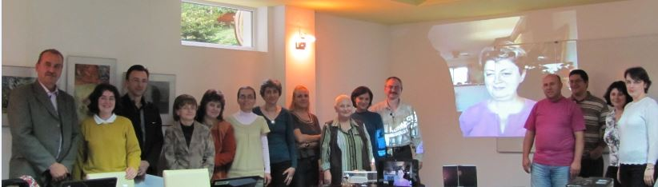
ICT training opportunities
Training on Informatics Competences - develops e-skills for librarians and how to develop modern library service with the support of technology;
Over 300 public librarians have already benefited from financial subsidies and were trained over the last 2 years.

Slide 12
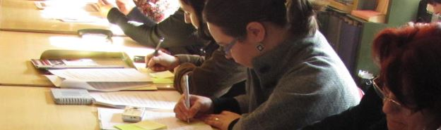
ICT training opportunities (2)
Training on Marketing for Libraries - BIBLIOMARKET - a dynamic and interactive way to develop simple solutions to better market the library’s services in the local communities;
Over 200 students have already completed this training, including the Digital Marketing and Social Media module.

Slide 13
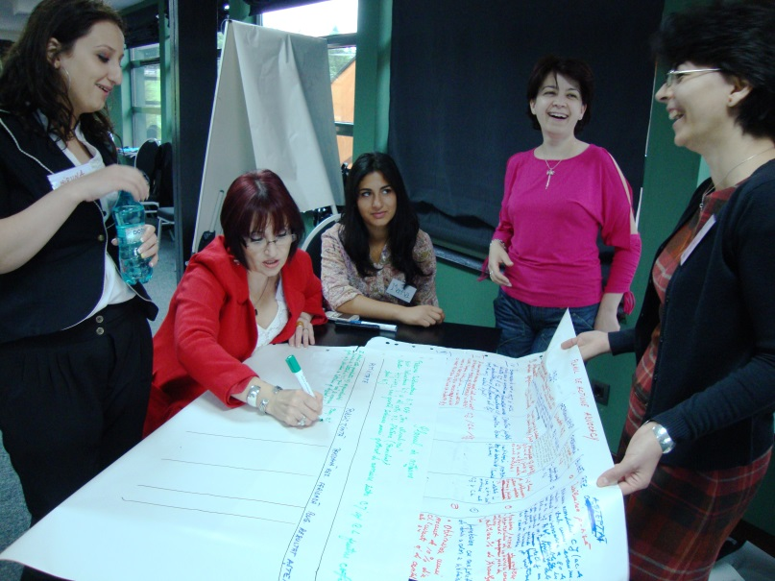
ICT training opportunities (3)
Advocacy Training - approaches the most familiar problems of advocacy and fundraising at community level;
After the trainings, an online network of "advocates“ is created so the trainees can keep in contact and work together;
Over 100 students have completed already this module.
Almost 10 librarians-trainers have provide already on their turn several local sessions of Advocacy training for librarians.

Slide 14
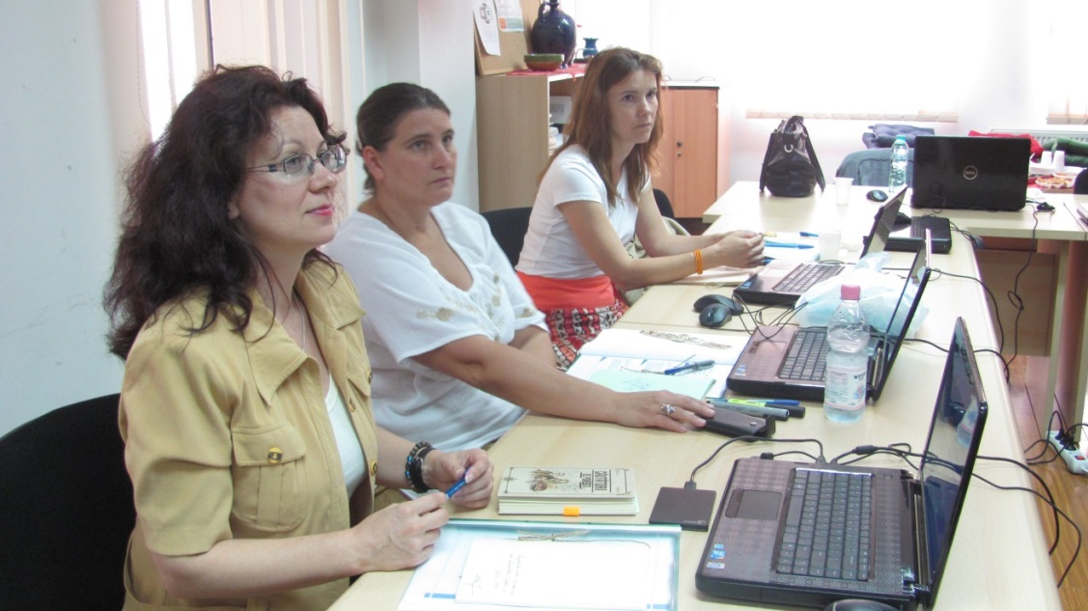
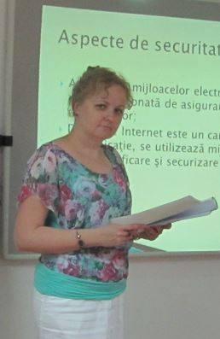
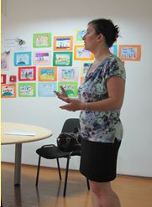
Projects based on ICT
Fundamental Financing @ Your Library - a financial education program, focused on the delivery of basic information regarding the main financial services;
During 2014, 1,000 libraries will benefit from this training program’s outcomes;

Slide 15

Projects based on ICT (2)
Profiller - Learning by sharing - a Career Guidance Program for young library users;
ANBPR, in partnership with the School of Psychology from Bucharest University developed an online TOT on how librarians can assist different target groups to choose a better job or to gain new skills for a better job.
The course is open to all the librarian-trainers in the ANBPR network.

Slide 16
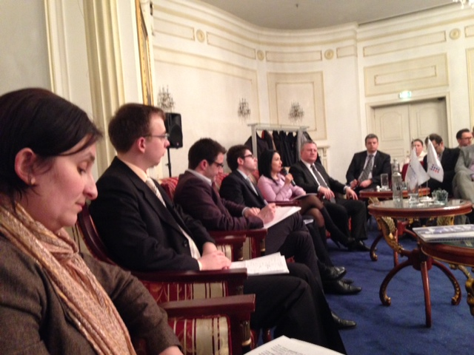
e-Skills for Jobs 2014
ANBPR have organized 1 webinar and is going to start other 2 webinars with different partners:
A Train-of-Trainers (TOT) course for librarian-trainers on career guidance for young people interested in ICT jobs;
An online workshop on public libraries as testing centres for different in-cloud services;
A webinar on the role of ICT certifications for career development for trainer-public librarians who, at their turn, will train young women and high school graduates particularly.

Slide 17



Player in the certification field
ANBPR was involved in the Get online Week! Campaign in the last five editions (2010, 2011, 2012, 2013, 2014);
ANBPR is registered as a Microsoft Academy and trained 20 of its most representatives members in MOS & MTA;
ANBPR initiated its own CERTIPORT Centre for the certification of the skills needed by its members.

Slide 18

Player in the certification field (2)
ANBPR is implementing a project with ECDL Romania - eBibliotecar. Skills for the Modern Librarian;
We are establishing 10 ECDL Centres in public libraries across the country. This is an ongoing project.
ECDL Profile for the Modern Librarian:
Beginner:
usage of computer
online tools
Intermediate:
usage of computer
online tools
text editing
Advanced:
presentations
web editing

Slide 19

Major objectives
Improving the digital skills of public librarians so they become e-facilitators for e-inclusion;
increasing community involvement, fostering the digital inclusion of vulnerable groups, and stimulating online collaborative working;
supporting lifelong learning, reducing digital exclusion, alleviating disparities between urban and rural areas by facilitating the access to information for broad categories of population;
enhancing knowledge and skills to manage online working tools, and turn libraries into hubs for democratization of the information, through technology.

Slide 20
Thank you!
ioanacrihana@yahoo.com
www.anbpr.org.ro

