Slide 1
HANDMADE AND IT
FOR WOMEN
by
Pontus Euxinus Library in Navodari
ROMANIA

Slide 2
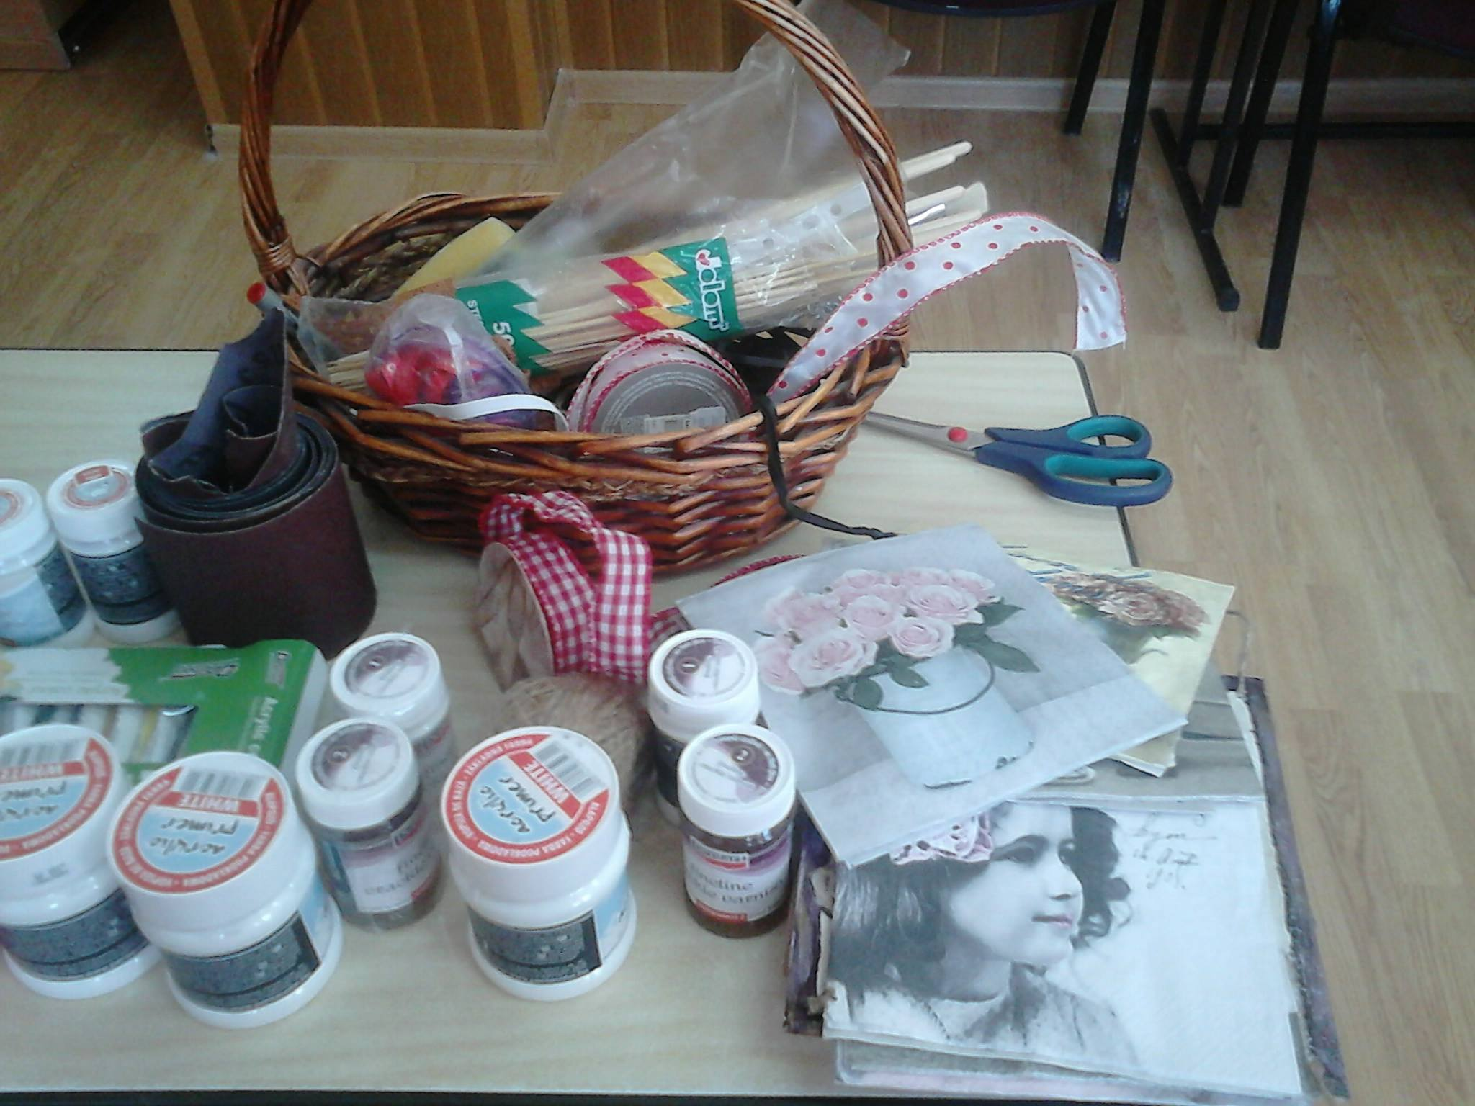
The project proposed and implemented by Pontus Euxinus Library in Navodari it’s a project which won the micro-grants contest organized by Irex Romania Foundation.

Slide 3
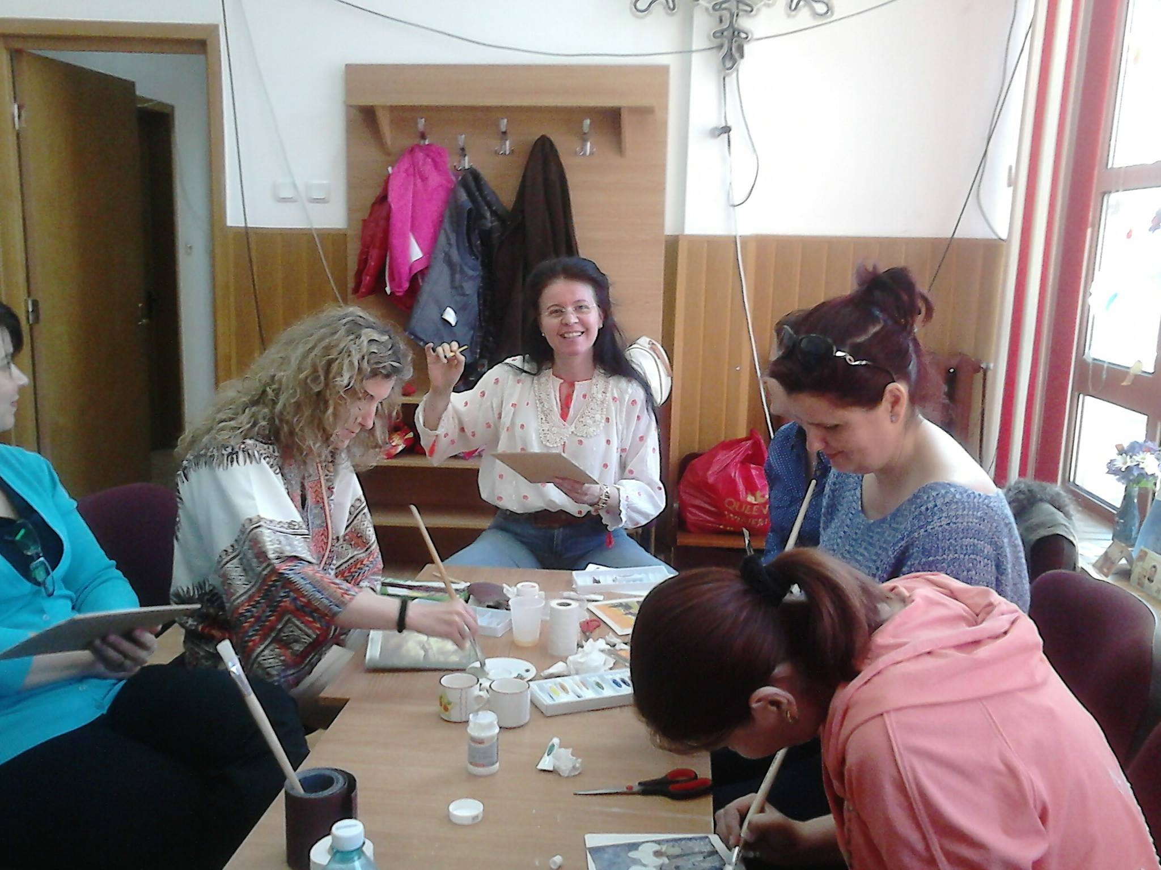
The project is aimed at housewives or unemployed women from Navodari .

Slide 4
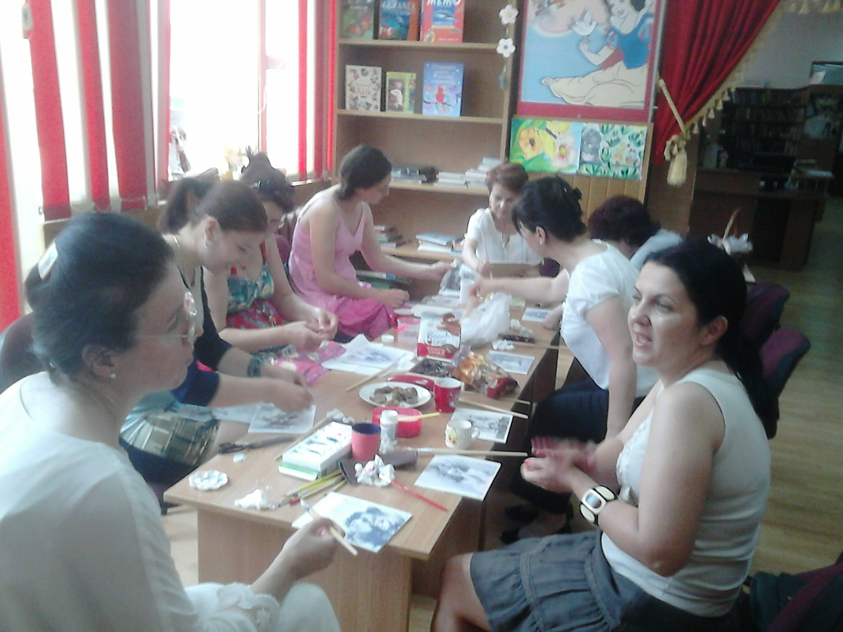
The manufacturing course takes place in the library,

Slide 5
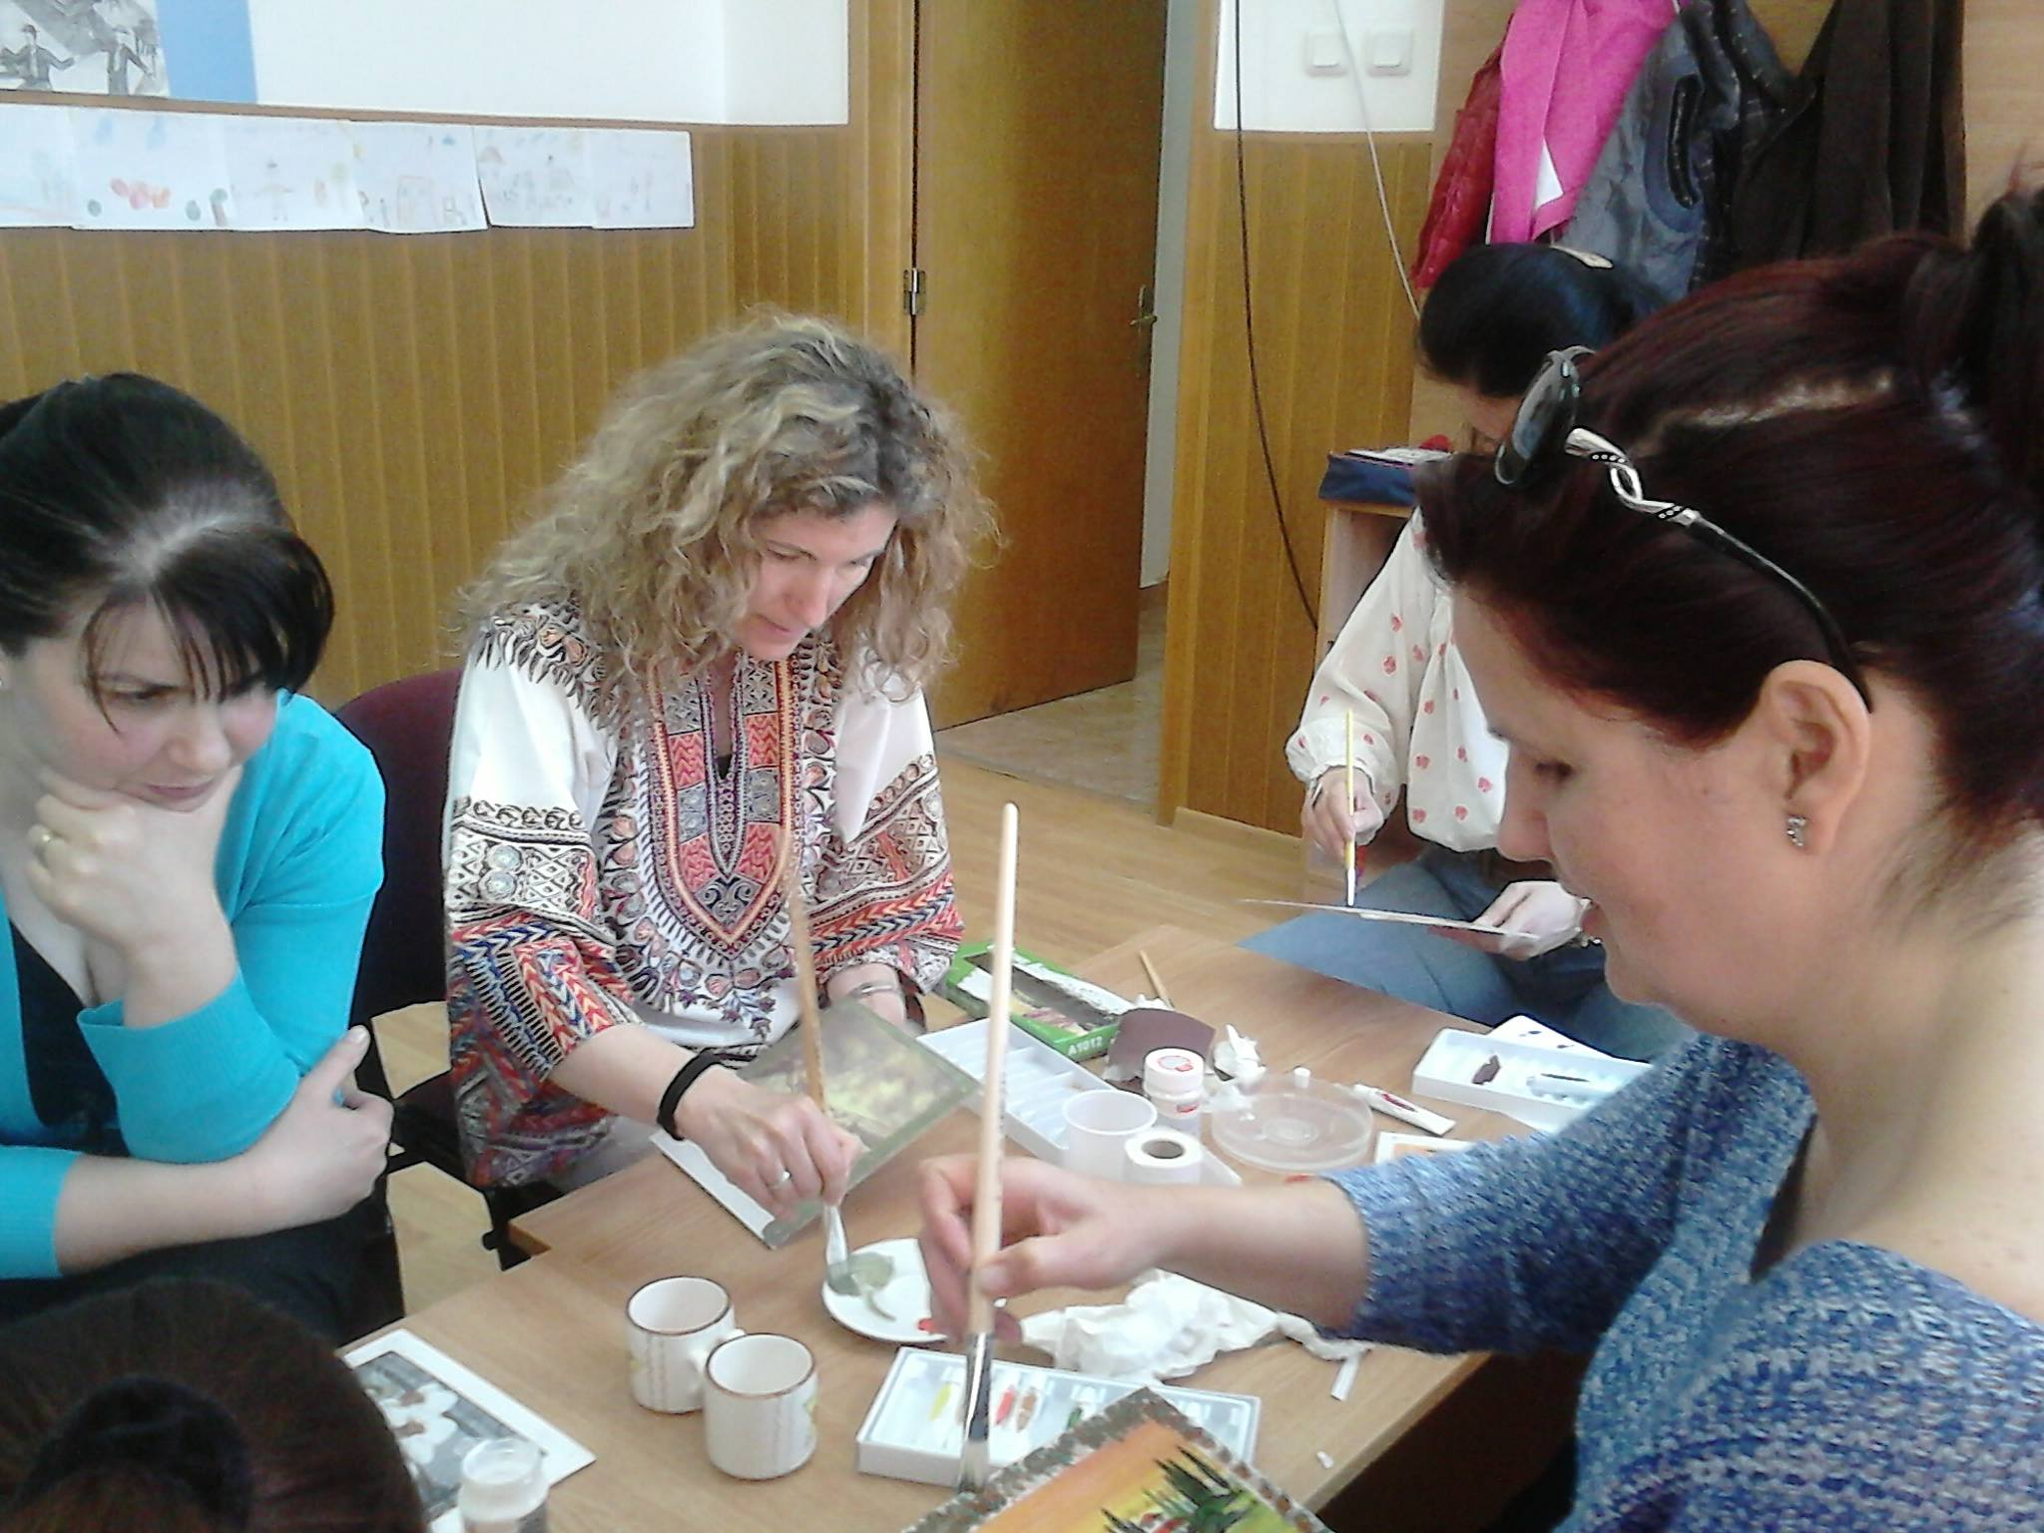
where many unemployed women have the opportunity to socialize,

Slide 6
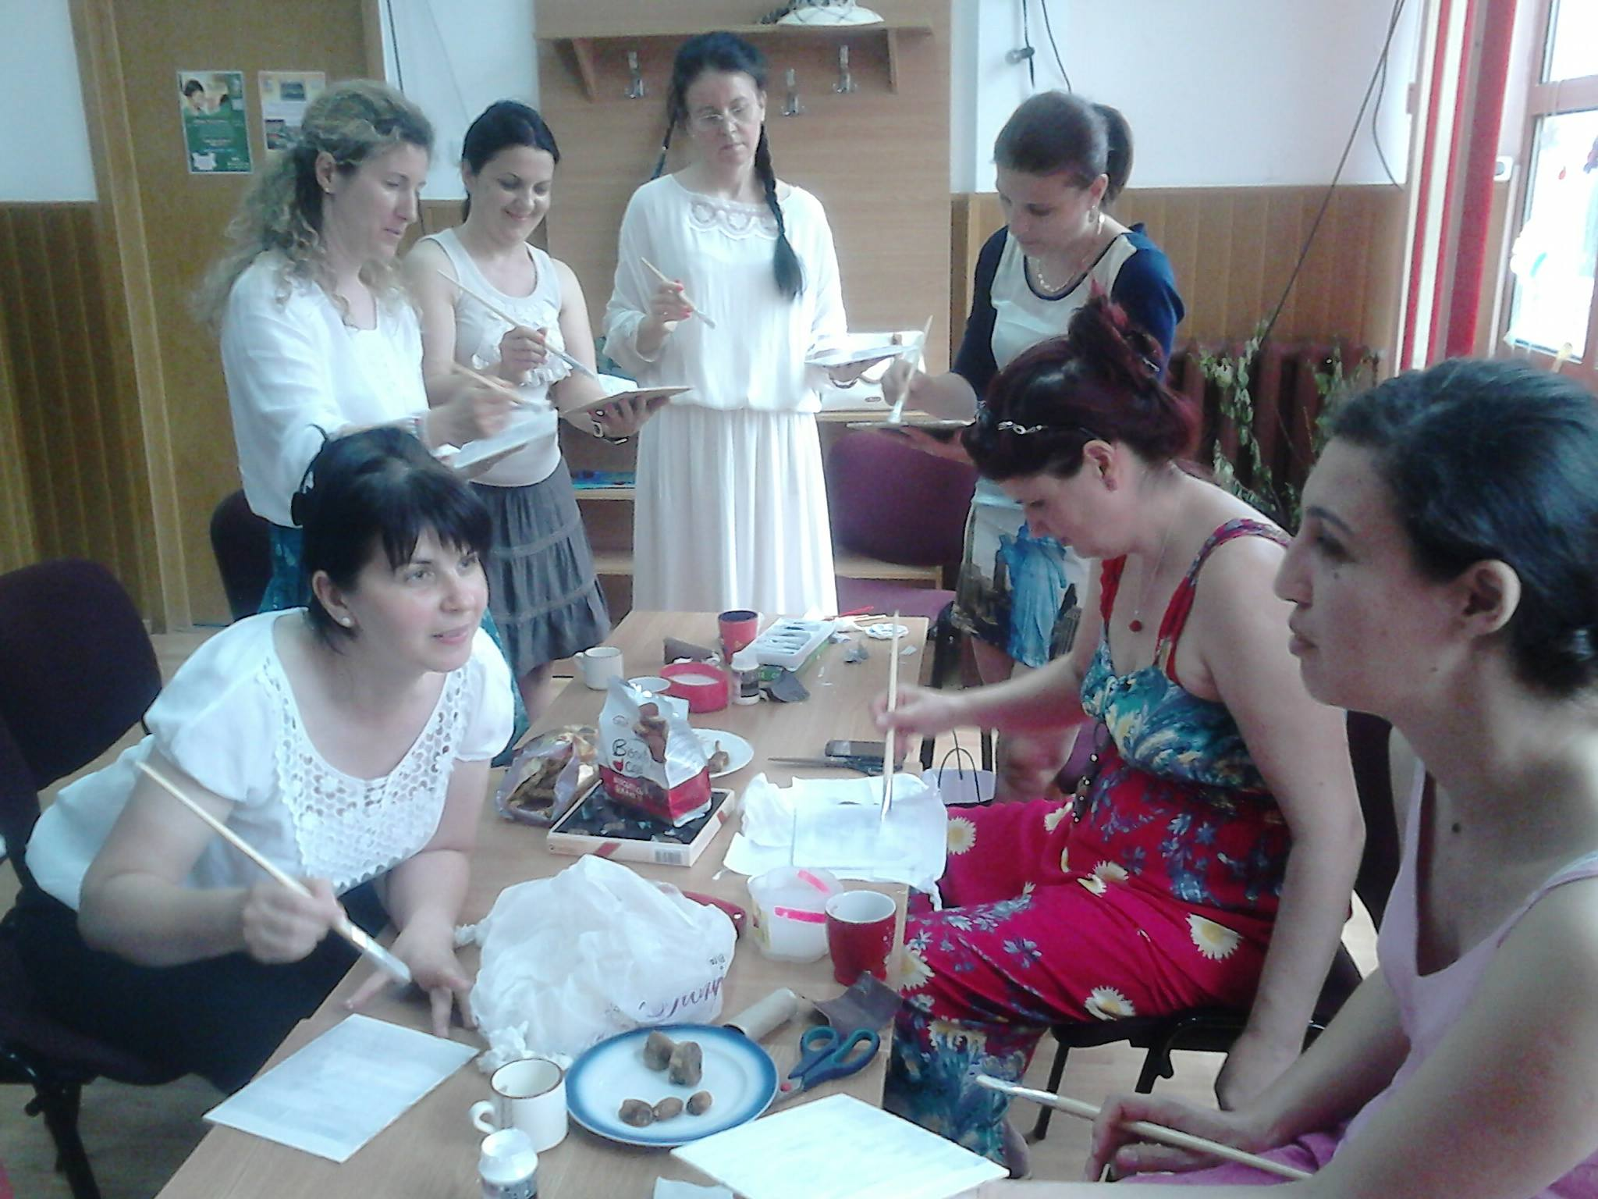
to exchange ideas,

Slide 7
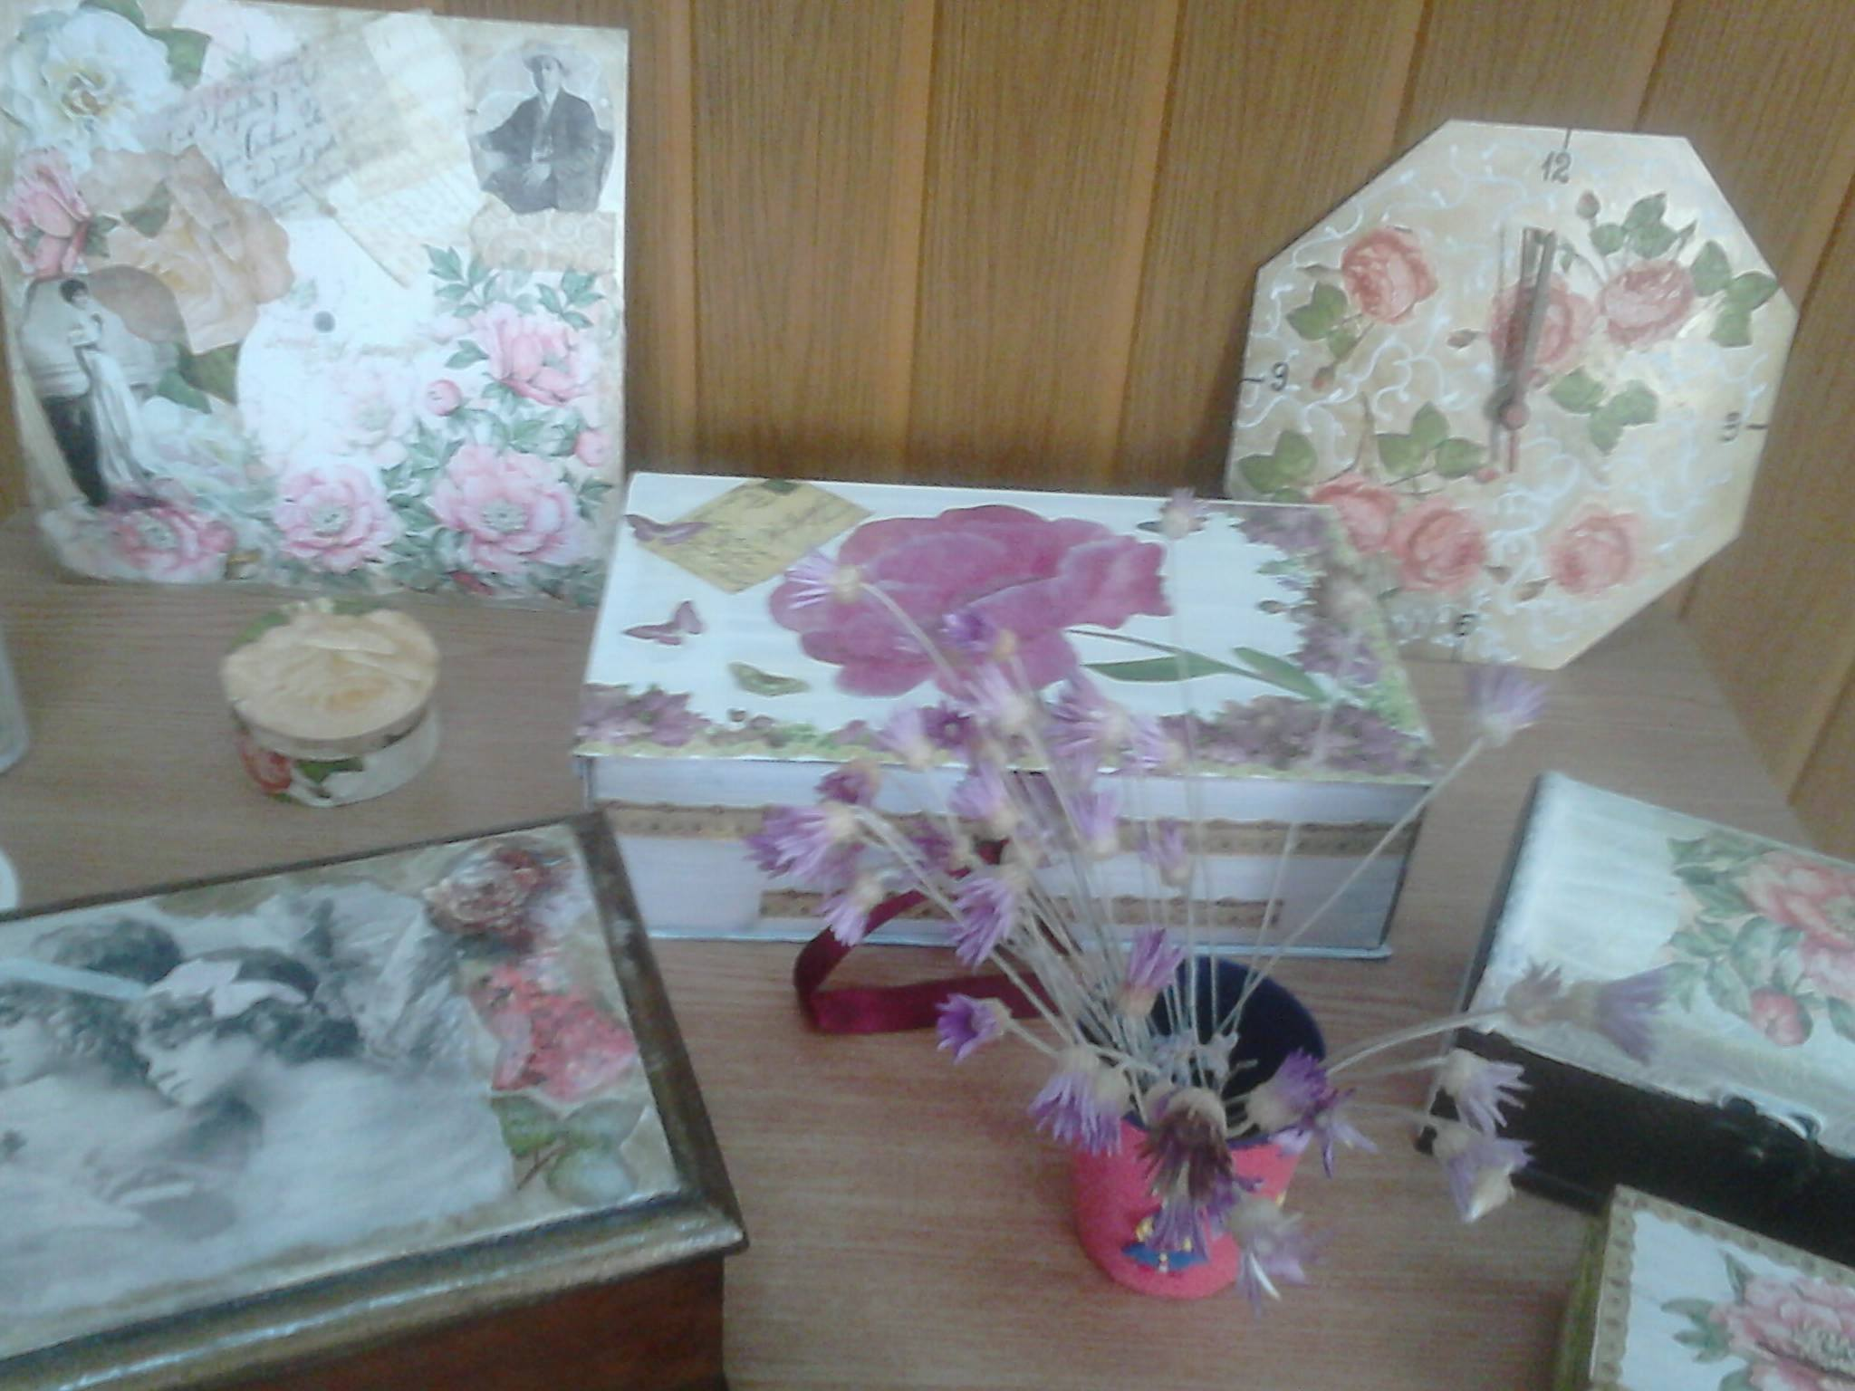
to learn how to create jewelry and other decorative items,

Slide 8
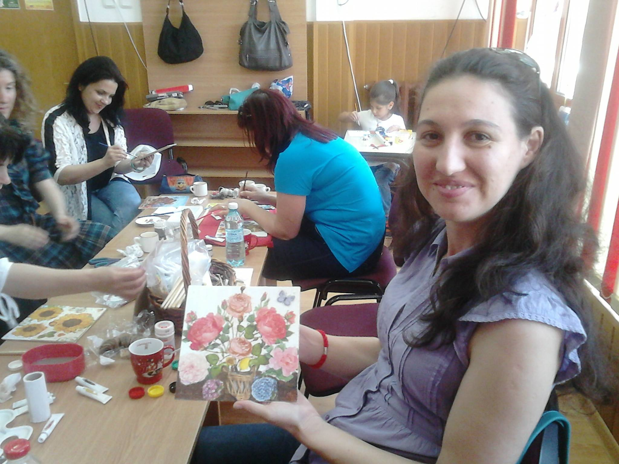
as well as paintings by means of the decoupage technique.

Slide 9
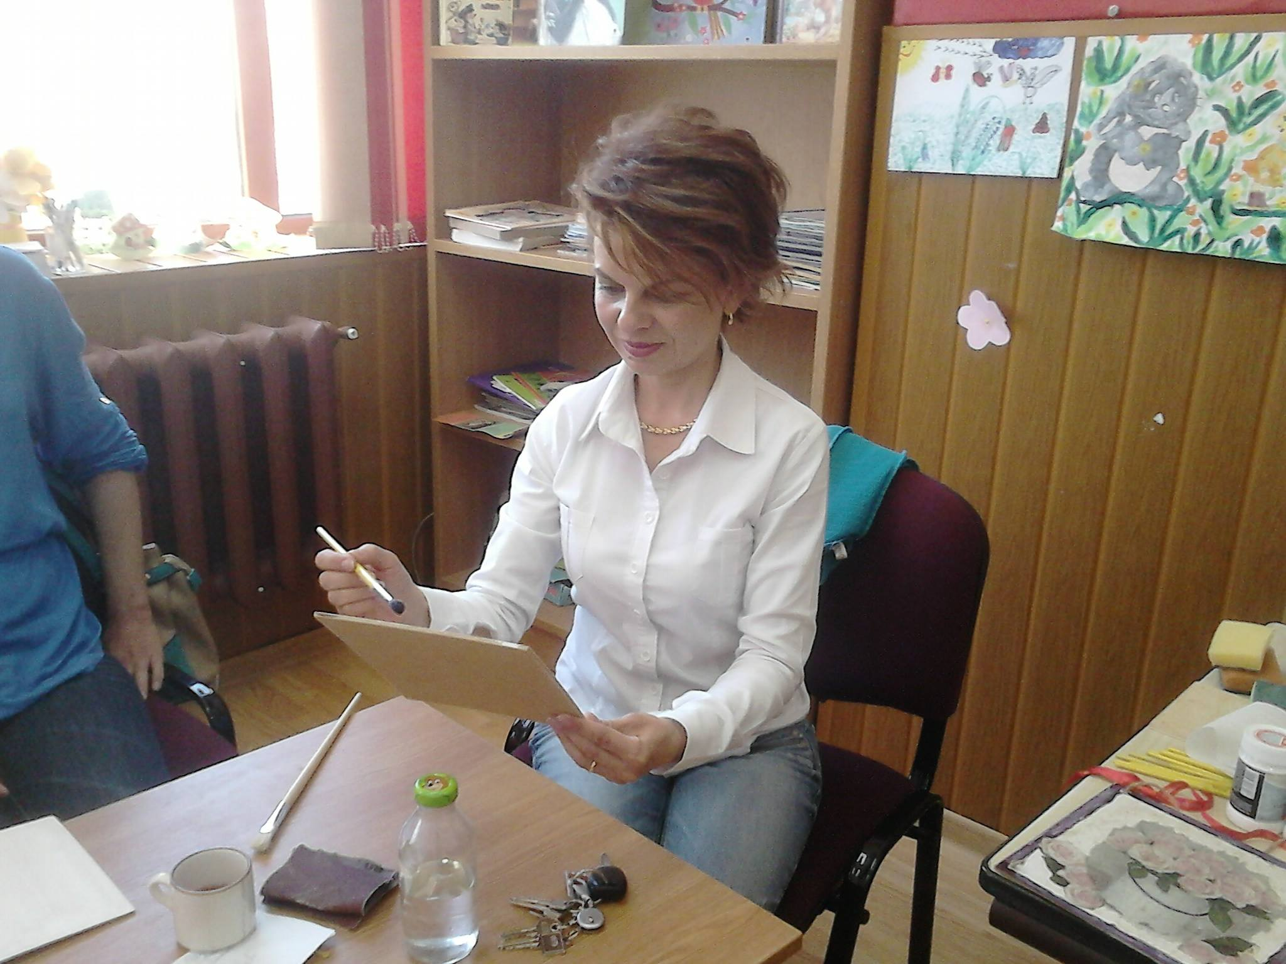
At the same time with the practical courses,

Slide 10
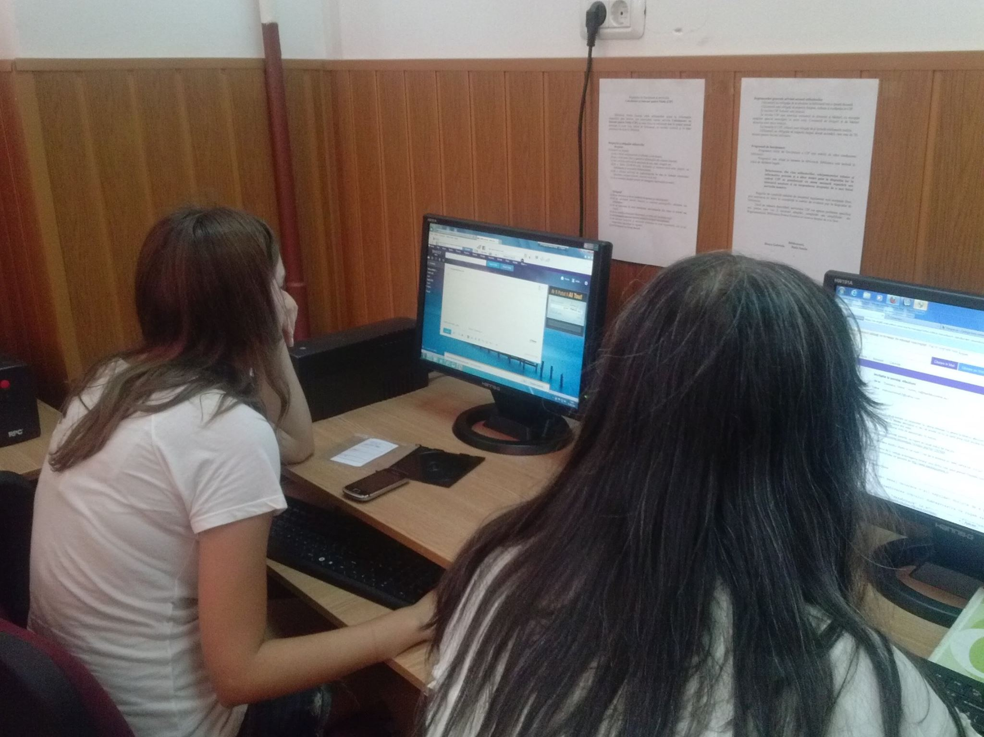
we have initiated IT courses.

Slide 11
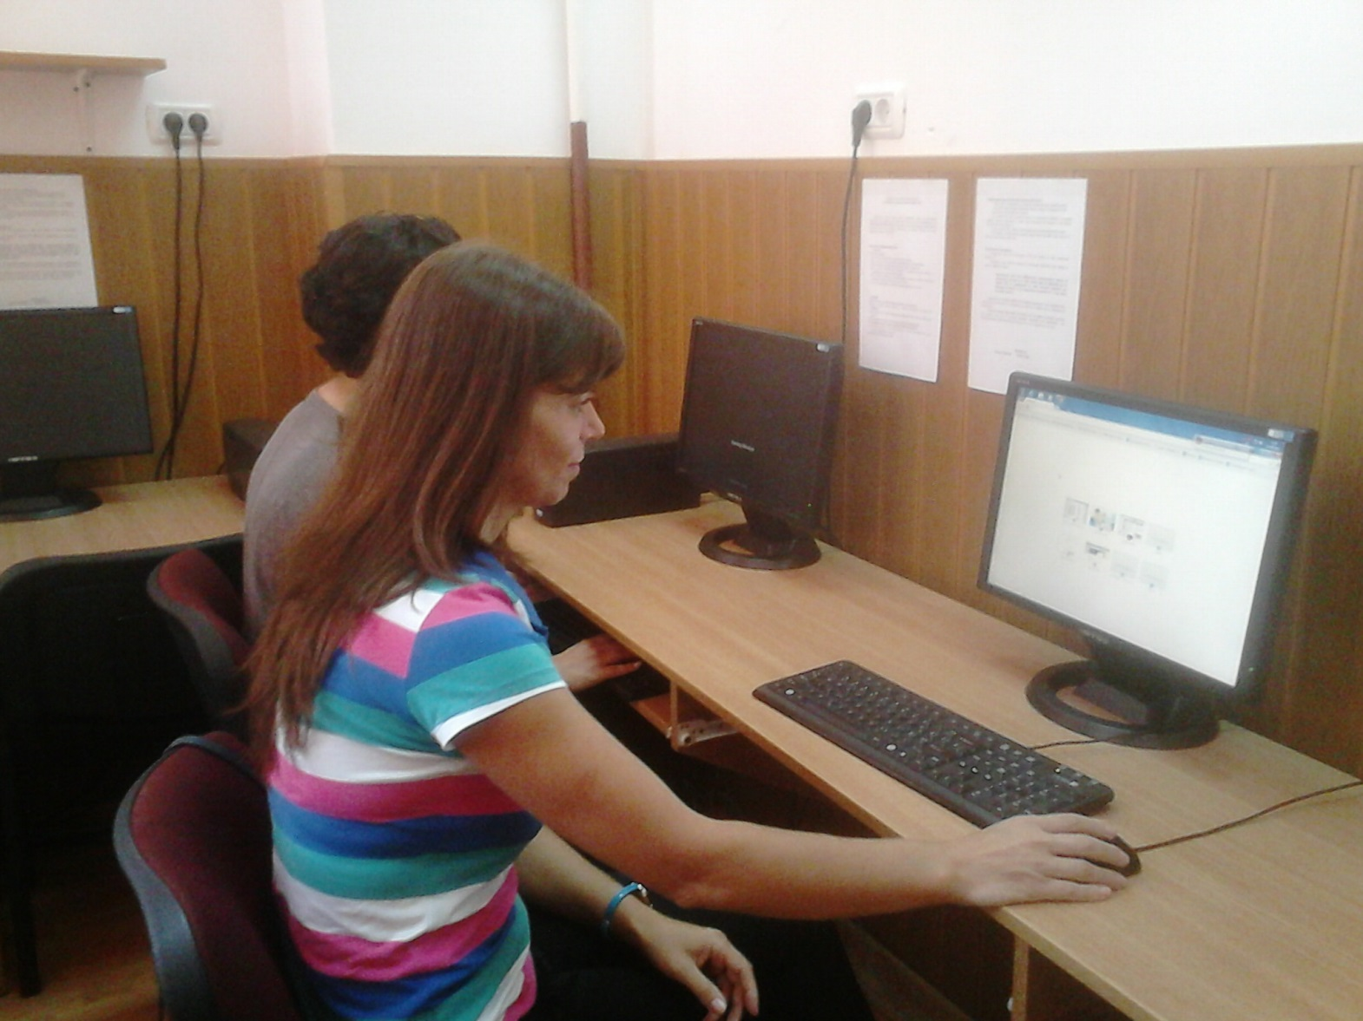
where womens learn how to create an email adress, a facebook page, an european CV, how to look for a job with the help of the Internet.

Slide 12
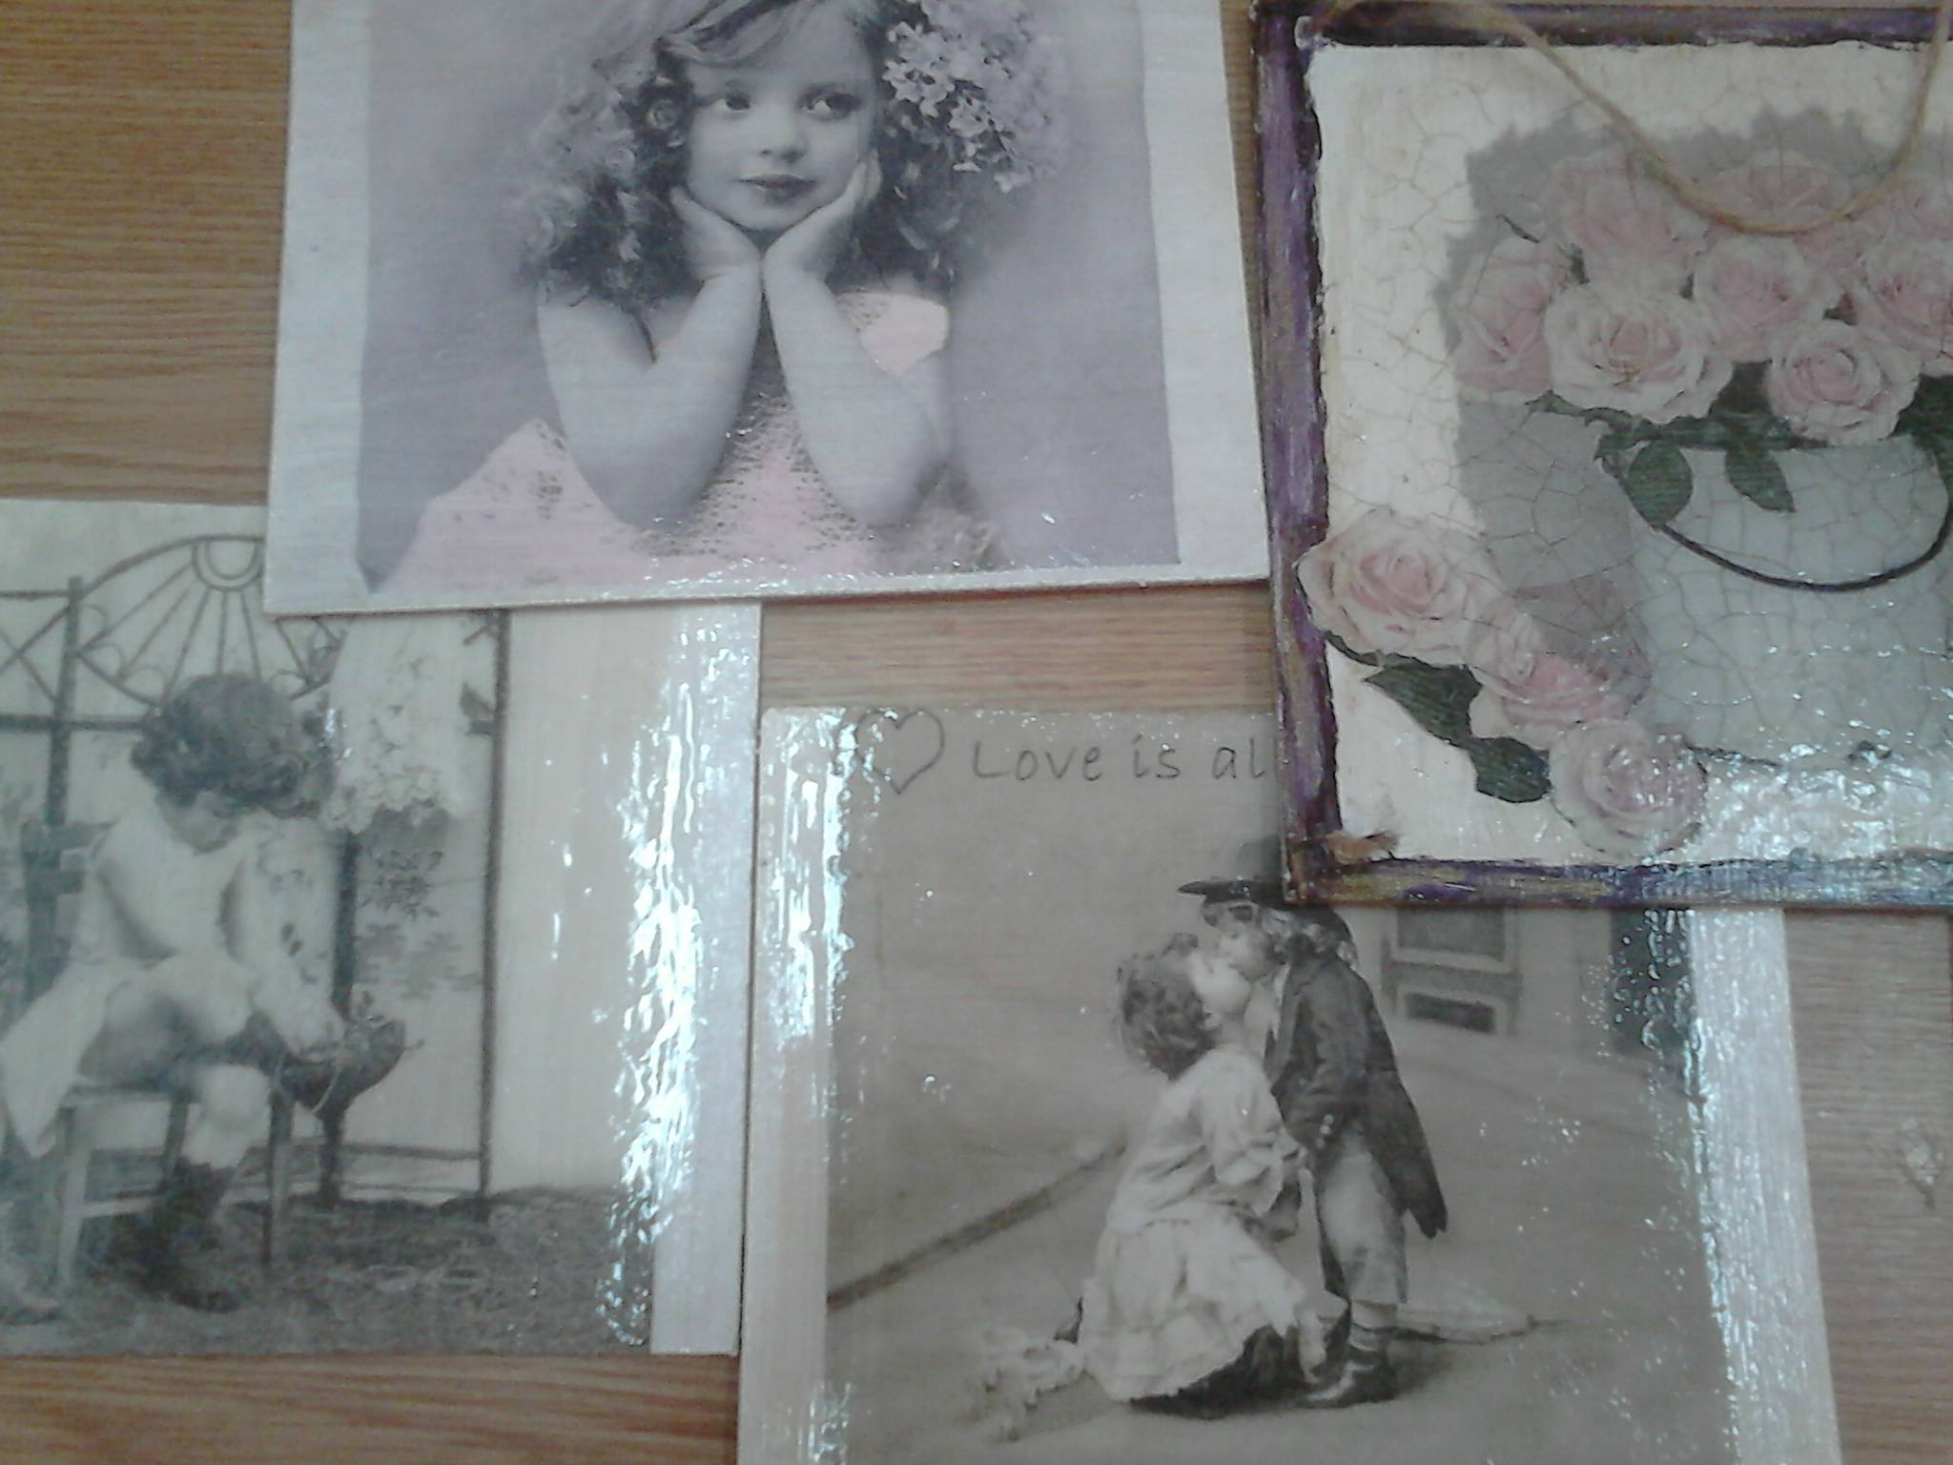
paintings by women…

Slide 13
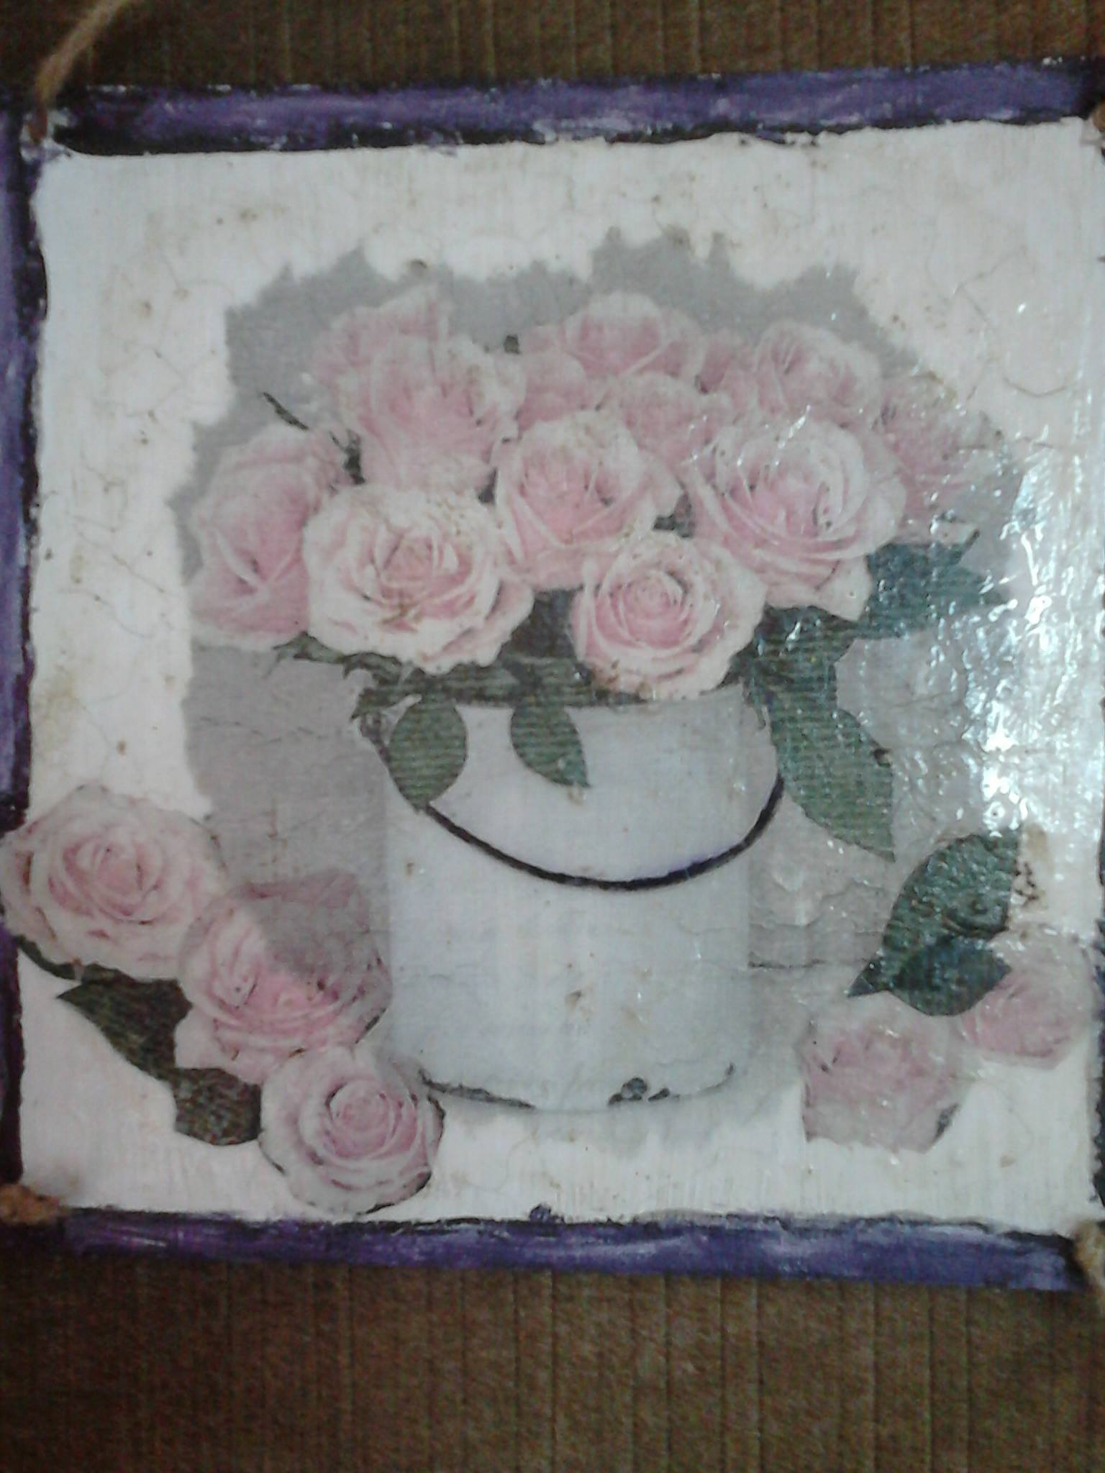

Slide 14
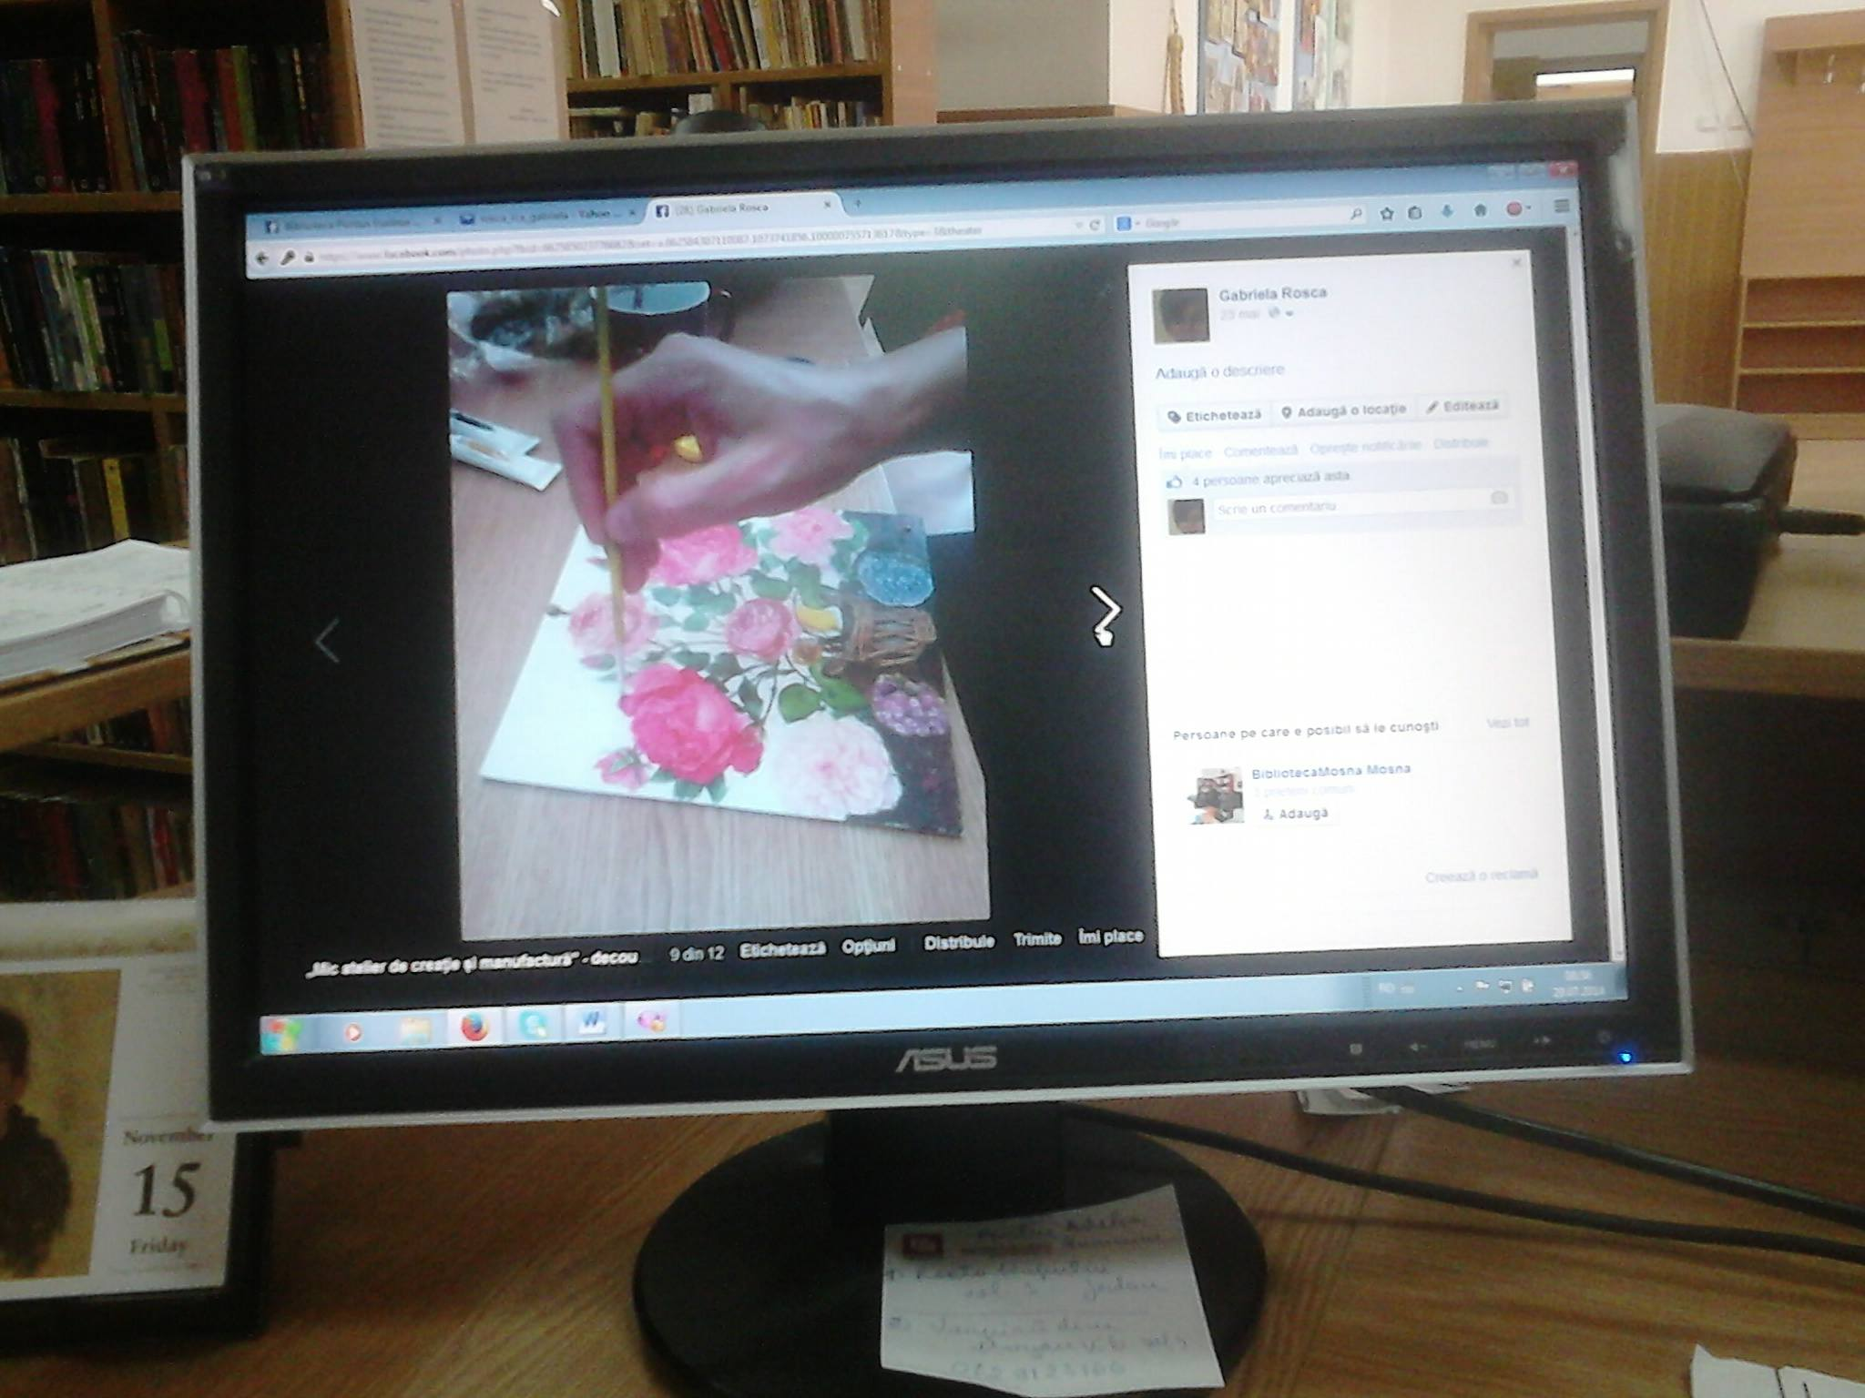

Slide 15
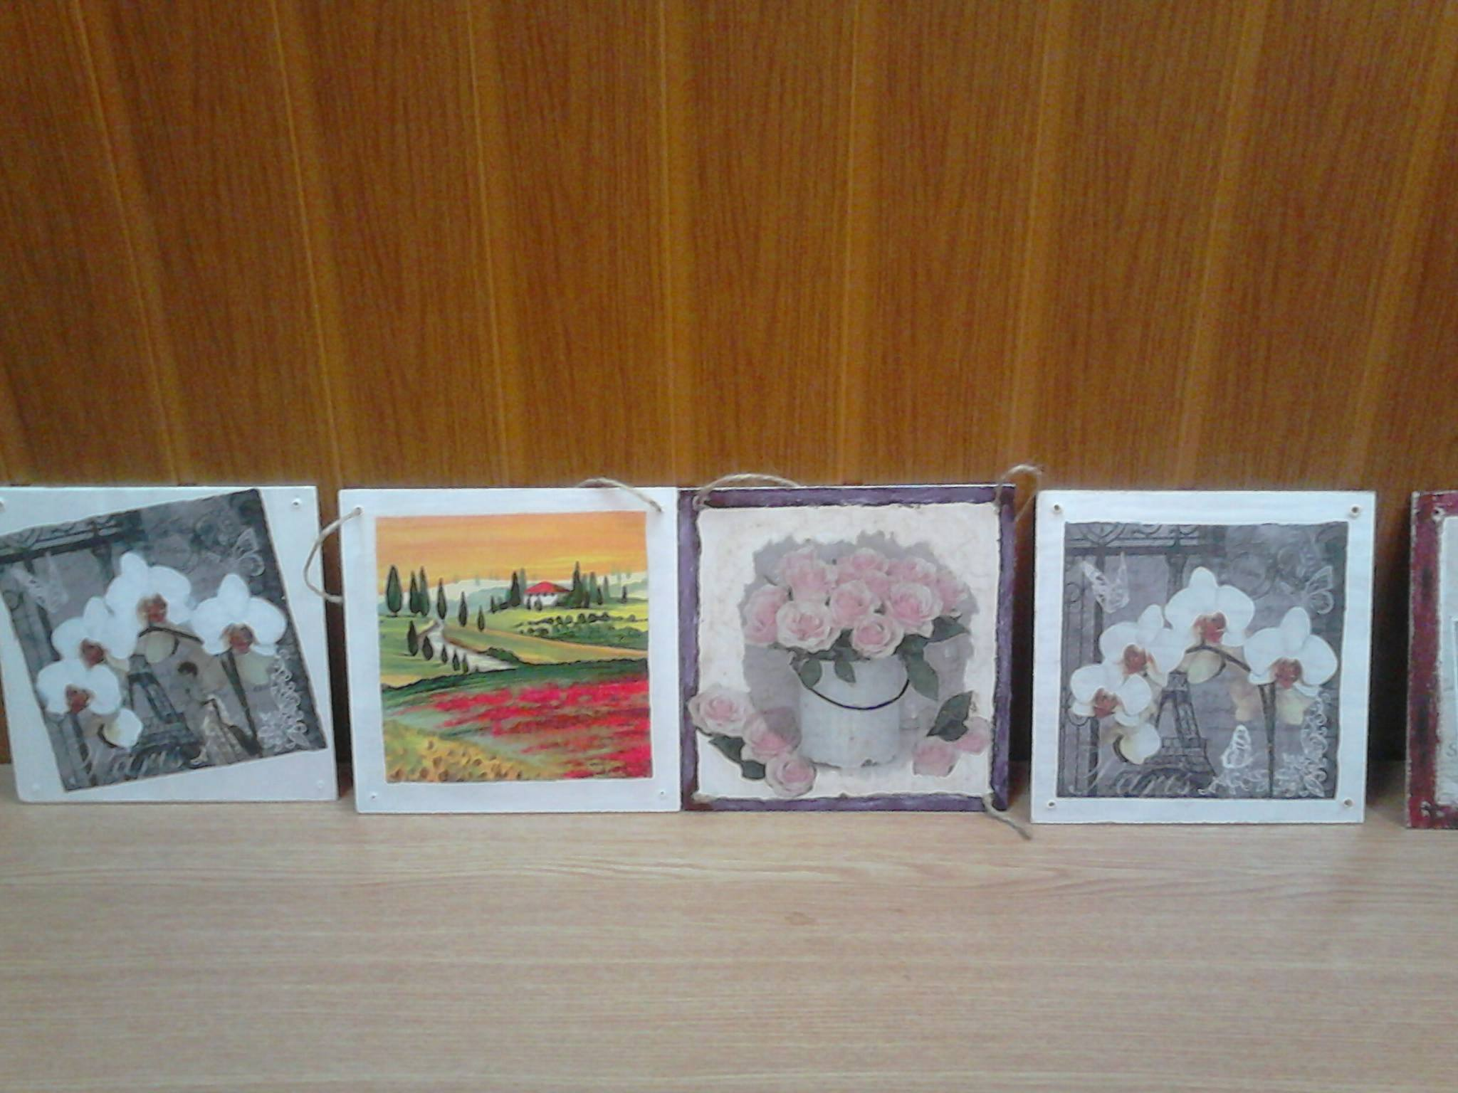

Slide 16
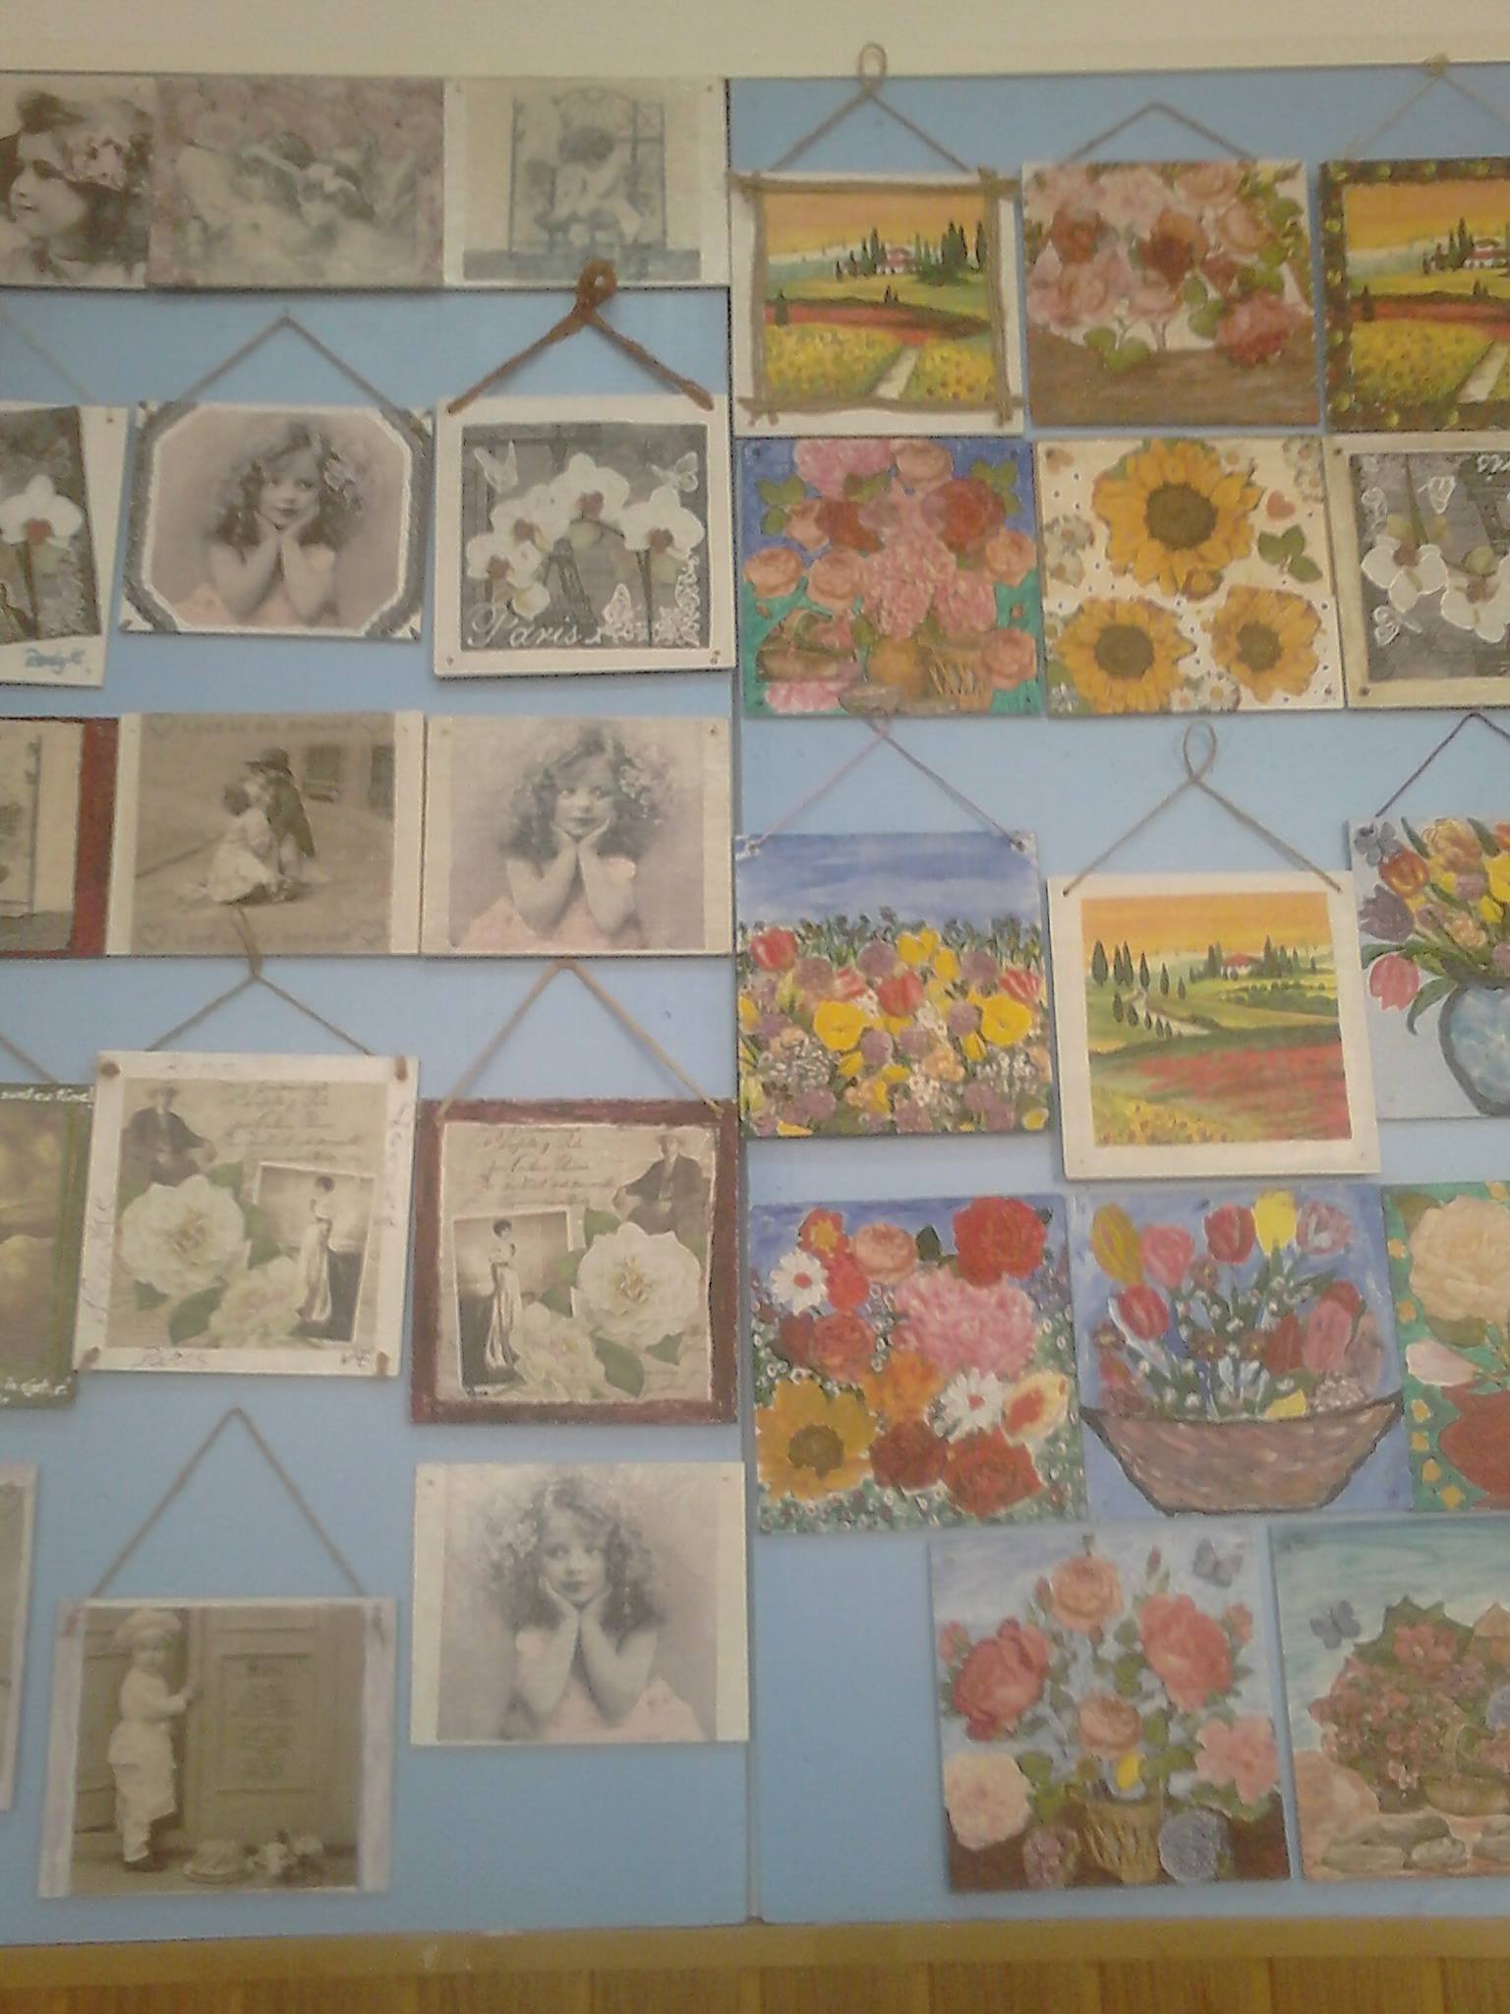

Slide 18
I’m very onored that my project ,,Handmade and IT for women’’ has been selected as the WINNER in the ‘Gender equality’ category . This project mins a lot to me and the fact that you believed in it makes me believe I’m headed in the right direction.

Slide 19
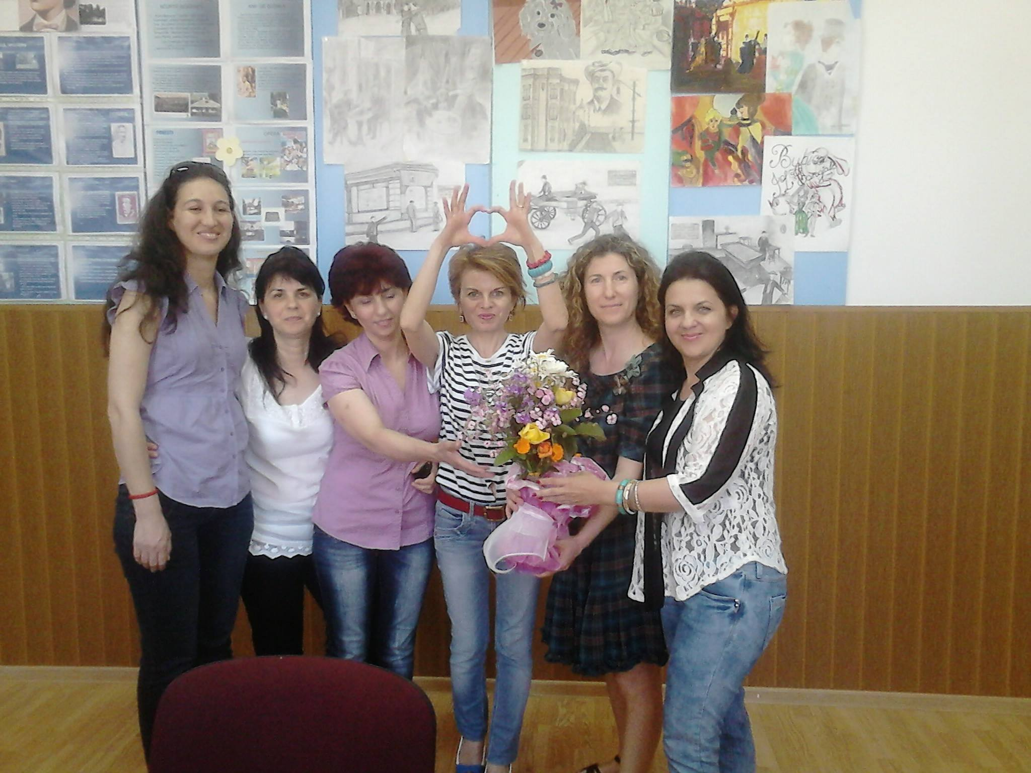

Slide 20
Gabriela Roșca România

