Slide 1


Media Literacy
Employment opportunities in the multimedia sector
(with EU policy context)
Mislav Balkovic
University College Algebra, Dean

Slide 2
„Job for life” vs. „Knowledge for job”
Impact of technology and globalization.
Knowledge is generator of competitiveness.
Knowledge is key to employment.
Has knowledge changed its position in economic and social development?

Slide 3
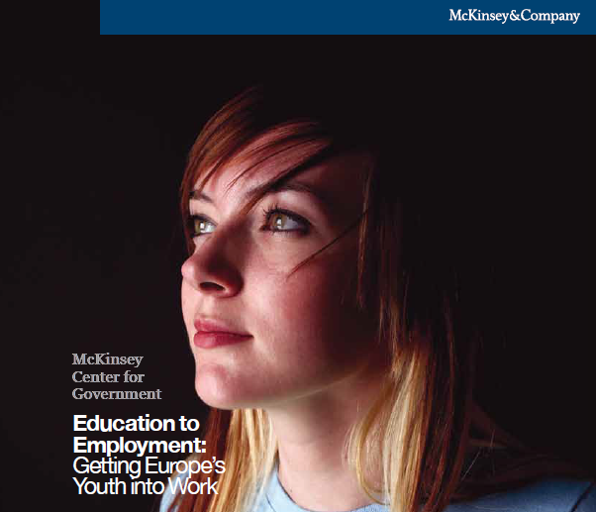
What is the quality of knowledge we currently produce?
Survey of more than 5,300 young people, 2,600 employers, and 700 education providers.
Countries with 75% of all unemployed EU youth.

Slide 4
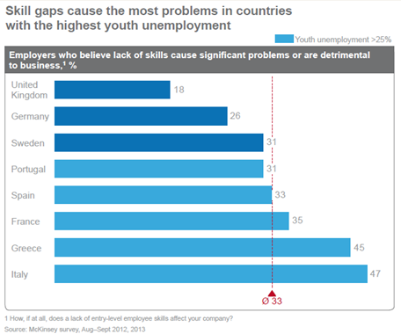
What do employers think ?

Slide 5
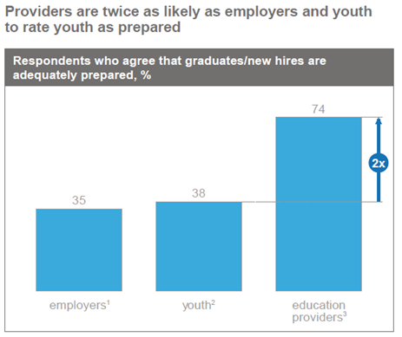
Are they correct ?

Slide 6
It should be relevant.
It should be applicable.
It should be visible / documented.
It should be recognized across labour markets.
How to best transform knowledge to employability?

Slide 7
The solution
Occupation Skill / Competency Qualification
Company X
Has need for
Media Engineer
Knows about
Media technology
Approved by
Master’s in Media Engineering
Obtained at
University Y
Can work at
Required to be
Testifying possession
Offers a program for
Occupation Standard
Media Engineer
Qualification Standard
Master’s in Media Engineering
Study Program for
Master’s in Media Engineering
List of skills and competences
List of learning outcomes
List of courses

Slide 8
Occupational standard.
Qualification standard.
Register of Units of learning outcomes.
QA system.
Qualifications frameworks elements

Slide 9
Employer’s survey of required competences for job roles.
Competences frameworks, BoK.
Technology outlooks.
Experts and professional organizations inputs.
Occupational standard development

Slide 10

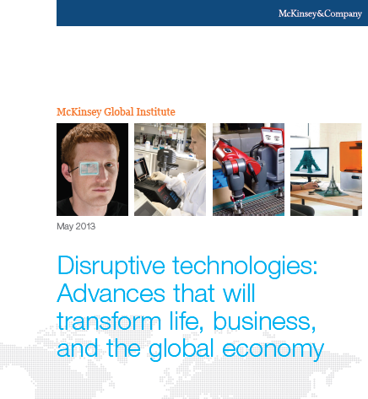



Slide 11
Inspired by Occupational standard.
Units of learning outcomes.
Level descriptors and active verbs.
Assessment examples.
QA.
Qualification standard development

Slide 12
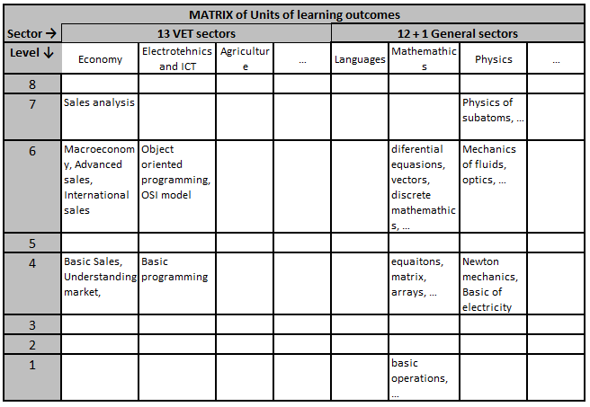
Building with the same blocks

Slide 13
Cover all units for specific qualification.
Can be institution specific but...
Quality assured delivery and results.
Study program development

Slide 14
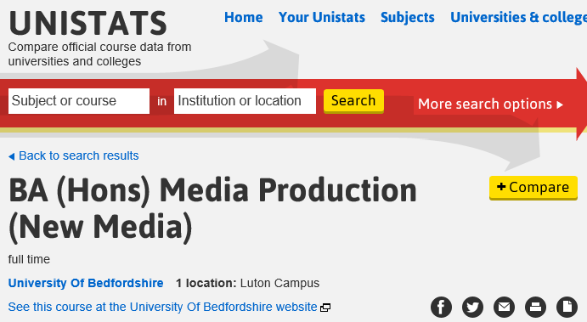
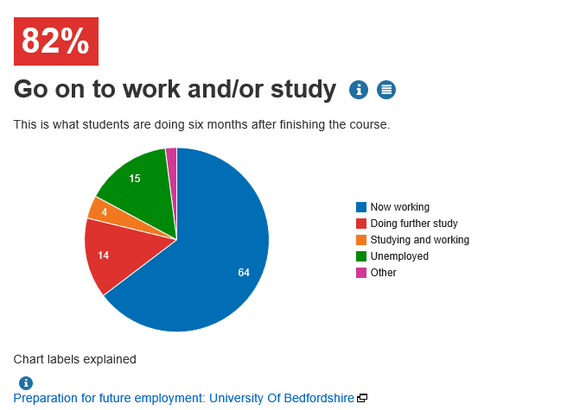
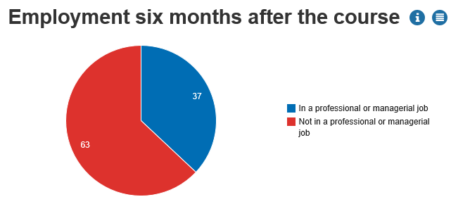
QA at the next level

Slide 15
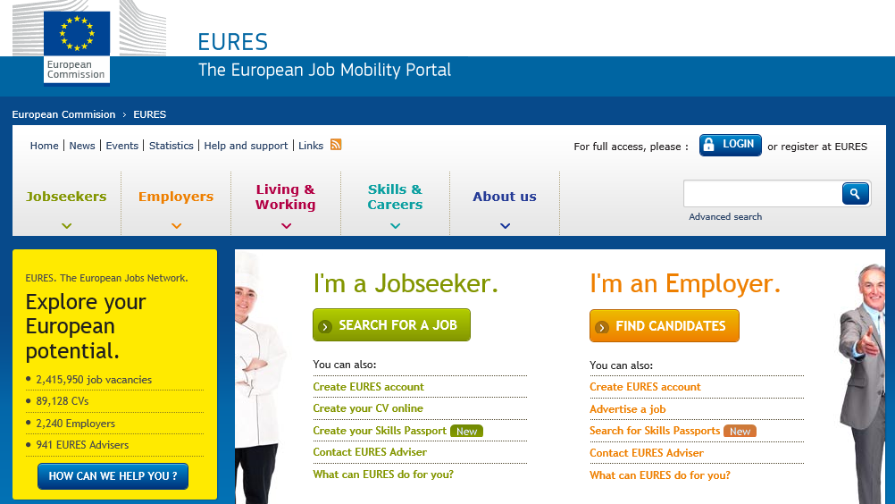
Welcome to the future of employment

Slide 16

Nice idea, but would it work?

Slide 17
“Now, here, you see, it takes all the running you can do to keep in the same place. If you want to get somewhere else, you must run at least twice as fast as that!”
So what is ahead of us?
Source: Alice's Adventures in Wonderland by "Lewis Carroll"

