Slide 1



National Coalition for
Digital Jobs (NC4DJ)
Renata Danielienė
ECDL Lithuania,
Young Advisor of EC Vice-President Neelie Kroes
Telecentre Europe 2014 “eSkills for the 21st century”
Zagreb, 25th of September

Slide 2
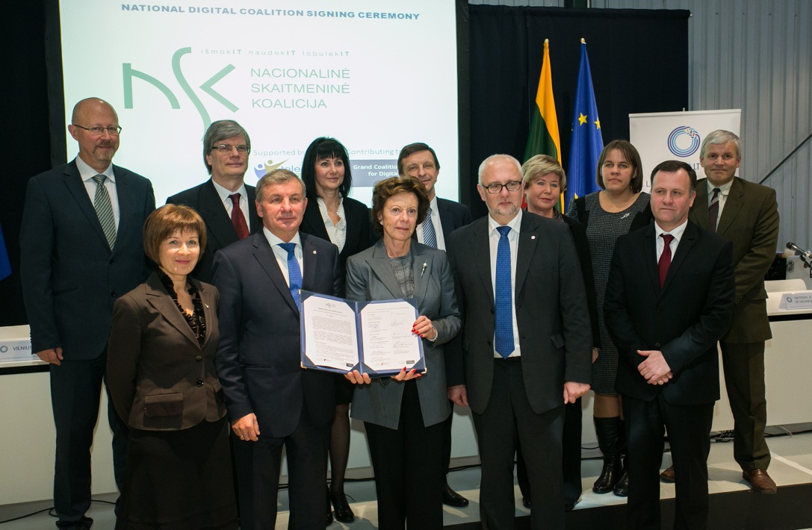
Reasons for NC4DJ
Youth unemployment rate in LT and EU
Lack of ICT professionals in LT and EU
Lack of ICT skills awareness raising
Formal education is not able to fill the lack of ICT professionals asap
Lack of cooperation between educational and business sector
Inspiration from Grand Coalition for Digital Jobs

Slide 3
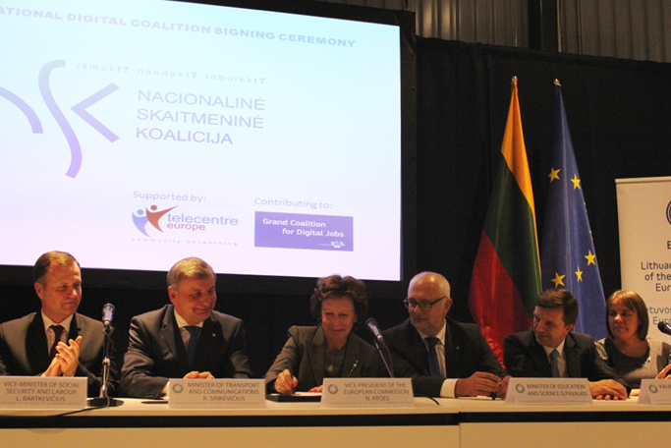
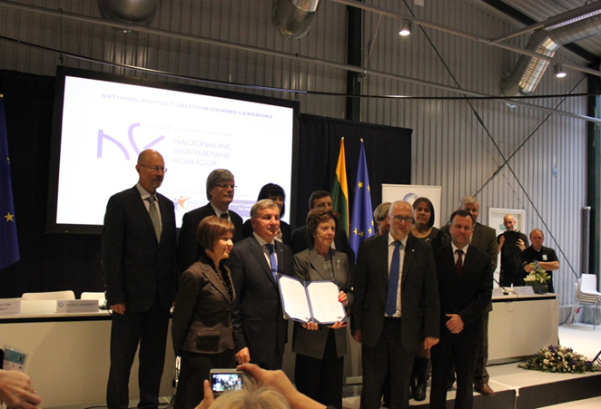
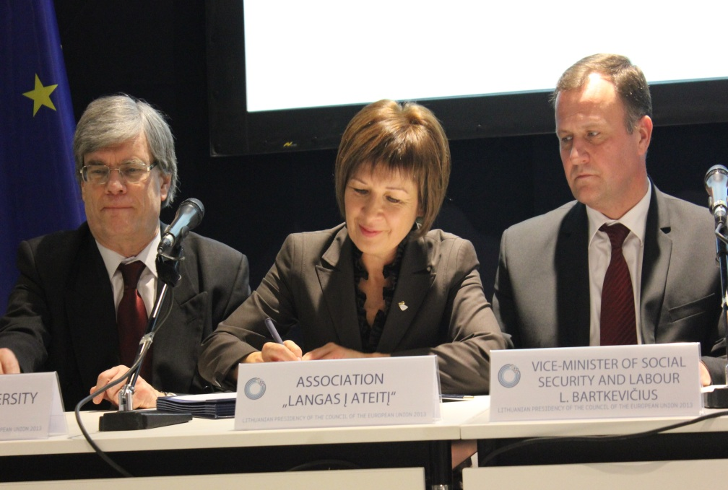
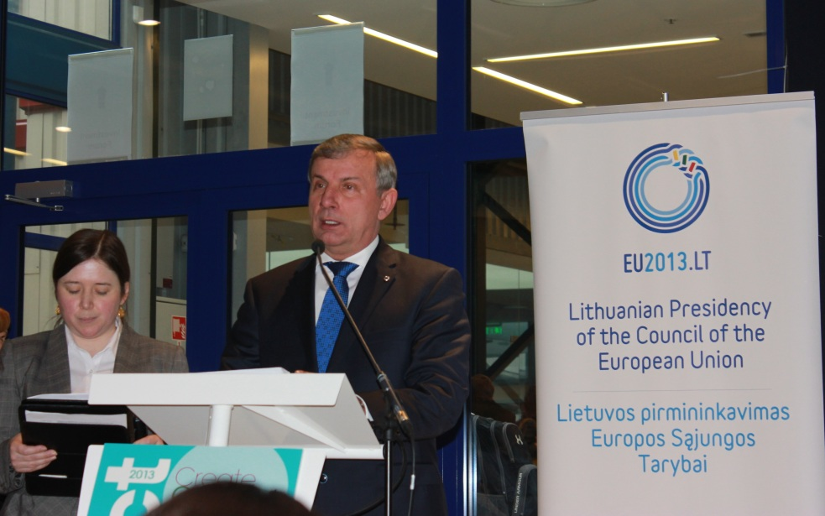
National Digital Coalition Memorandum signing ceremony
7th Nov, ICT 2013 Conference, Vilnius

Slide 4
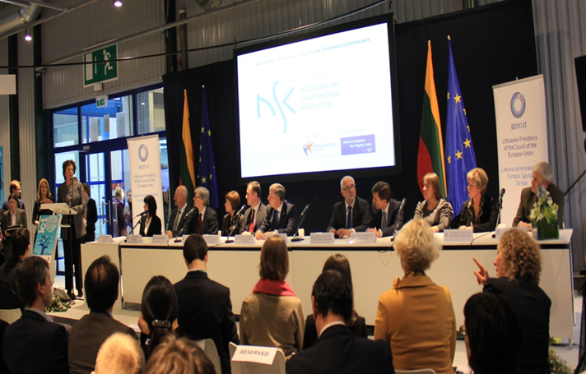
NC4DJ founders
Association „Langas į ateitį“
Ministry of Transport and Communications
Ministry of Social Security and Labour
Ministry of Education and Science
Kaunas University of Technology
Vilnius University
Association “INFOBALT“
Lithuanian Computer Society and ECDL Lithuania
National Distance Learning Association
Lithuanian Association of Informatics Teachers
Association of Lithuanian Public Libraries

Slide 5
NC4DJ goals
Train society to develop ICT skills for jobs through innovative learning approach
Increase involvement of young people in ICT labour market by developing their digital skills and attracting them to choose IT studies
Regular awareness raising about the importance of ICT skills for job and everyday life

Slide 6
NC4DJ activity (1)
June, 2013 – September, 2014
12 NC4DJ Meetings
  Mission and objectives
  Situation Analysis: ICT problems in LT
  Stakeholders
  NC4DJ establishement
  Stakeholders‘ activities corresponding NC4DJ objectives
  Procedures for New Membership of NC4DJ
  Formation of working groups etc.

Slide 7
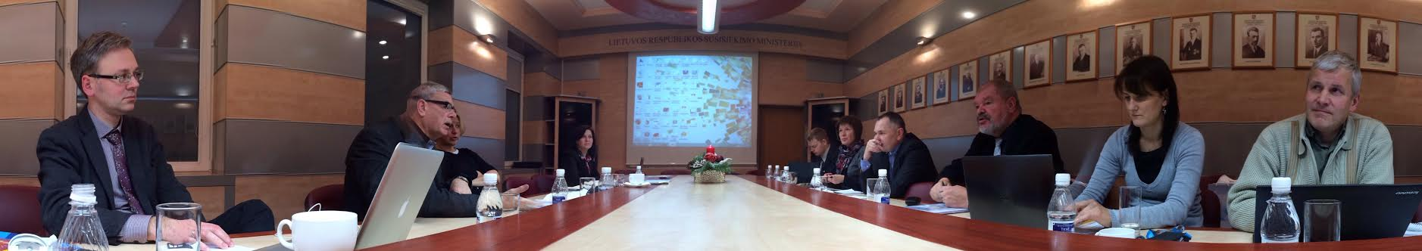
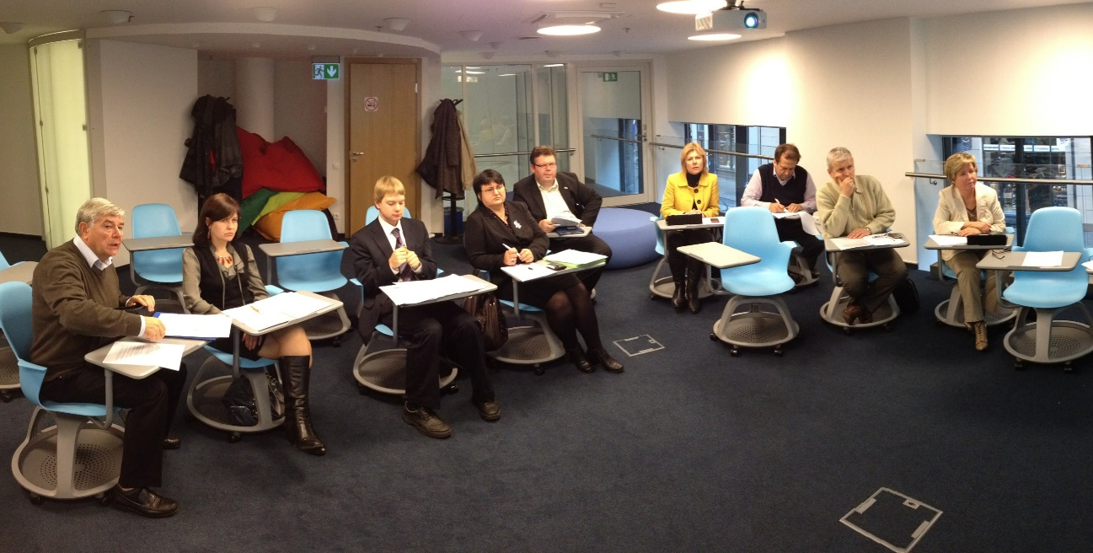
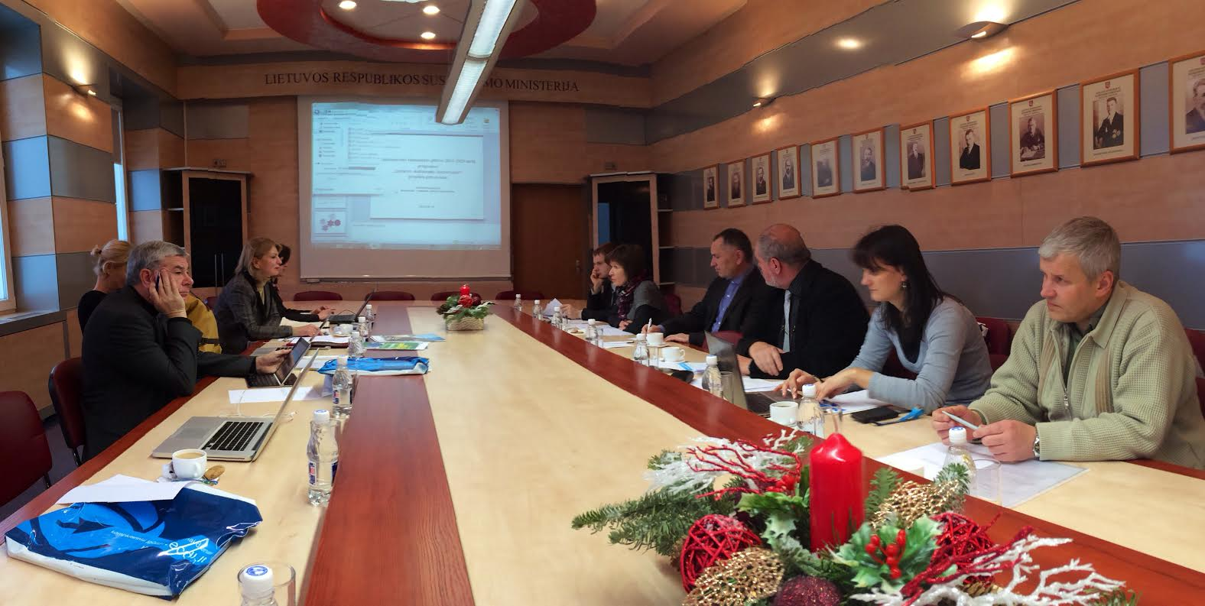

Slide 8
NC4DJ activity (2)
June, 2013 – September, 2014
Stakeholders of the National Digital Coalition divided into four working groups:
  IT professionals,
  IT users,
  School community,
  e-leadership.

Slide 9
NC4DJ activity (3)
Results of Working Groups
Stakeholders strongly contribute to NSK:
  By performing their own activities related with ICT
  By implementing information society development programme 2014–2020 Digital Agenda for Lithuania
  By participating in campaigns
    Get Online Week
    Safer Internet Day
    e-Skills for Jobs
    Code Week

Slide 10
Activities of
NC4DJ Stakeholders‘
Participation in the ICT projects
Digital skills (ECDL) certification
Attracting to ICT studies

Slide 11
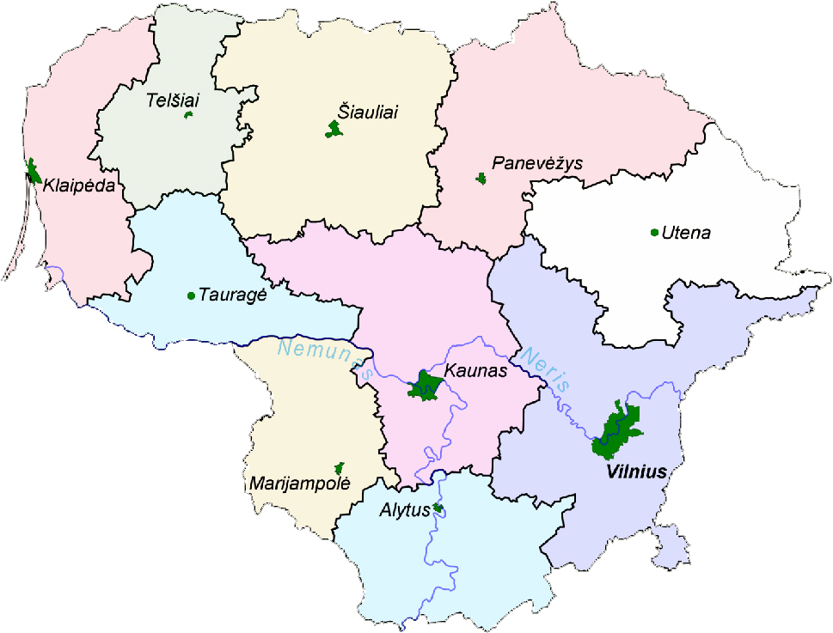
Challenges for the future:
To create NC4DJ LT network

Slide 12
Challenges for the future:
To involve more regional organization
Educational institutions
Small Business organizations
NGO

Slide 13
Challenges for the future:
To involve the society in the dissemination activities
Involve schools and libraries
Make more presentations about NC4DJ
Involve dissemination organizations

Slide 14
Thank you!
More information:
info@skaitmeninekoalicija.lt
www.skaitmeninekoalicija.lt/en

Slide 15
National Coalition for
Digital Jobs (NC4DJ)
Renata Danielienė
ECDL Lithuania,
Young Advisor of EC Vice-President Neelie Kroes
Telecentre Europe 2014 “eSkills for the 21st century”
Zagreb, 25th of September

