Slide 1

Project
Trans e-facilitator
Pilot experience and further exploitation:
evaluation by different countries and target groups
Reinis Rukmanis
LIKTA
Telecentre-Europe Conference
25th of September 2014
Zagreb, Croatia

Slide 2
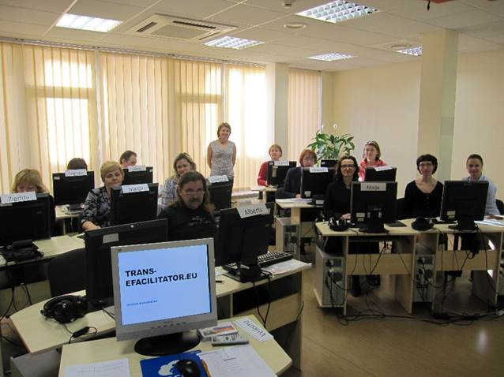
Pilot goals
test online materials of all modules
get feedback about platform and training material (contents, appropriatness for variuos target groups)
put into practice and evaluate communication tools
prepare recomendations for various target groups on further exploitation of the material
5 Module

Slide 3
Piloted modules in different countries
 |  | Germany | Latvia | Portugal
1 | Network
2 | Resources
3 | Sustainability
4 | Elderly people
5 | Migrants
6 | Office tools
7 | Digital photo
8 | Job seeking
9 | Digital literacy
10 | E-services
11 | E-safety/e-security
5 Module

Slide 4
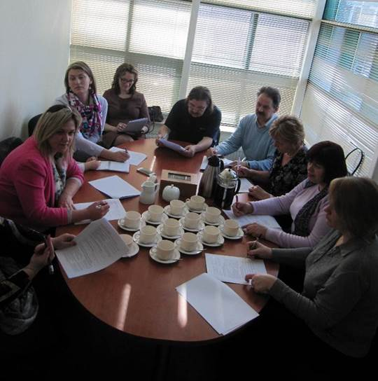
Pilot participants
selection criteria
Status criteria
Working as e-facilitator; and providing e-Skills training /support to end users
Representing organization or network (formal or informal ) promoting e-Skills : NGO, library, ICT training centre, school, State Employment agency etc.
Motivation criteria
Commitment to follow the training course and complete it
Motivation to self-development, achievements in personal career

Slide 5
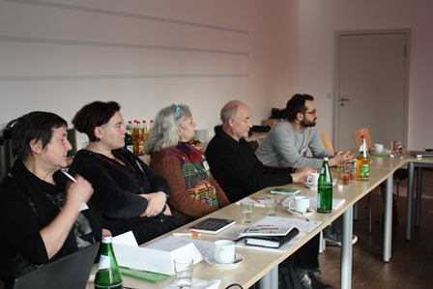
Training modules piloted
In Germany:
Promoting ICT for elderly at the telecentre
Promoting ICT with migrants at the ICT center
Facilitating job seeking in the telecentre
Planning a digital literacy Workshop
E-safety and e-security

Slide 6
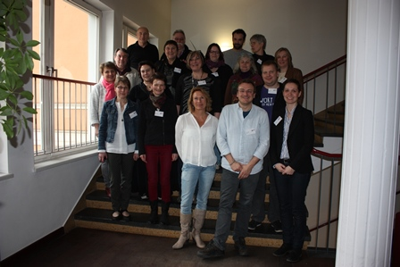
Pilot target groups
In Germany:
Adult education teacher/student
Social worker
ICT trainer
Librarian
Volunteers from different organisations
Representative from department for senior citizens
Online trainer
Youth centre trainer
Freelancer, computer service

Slide 7
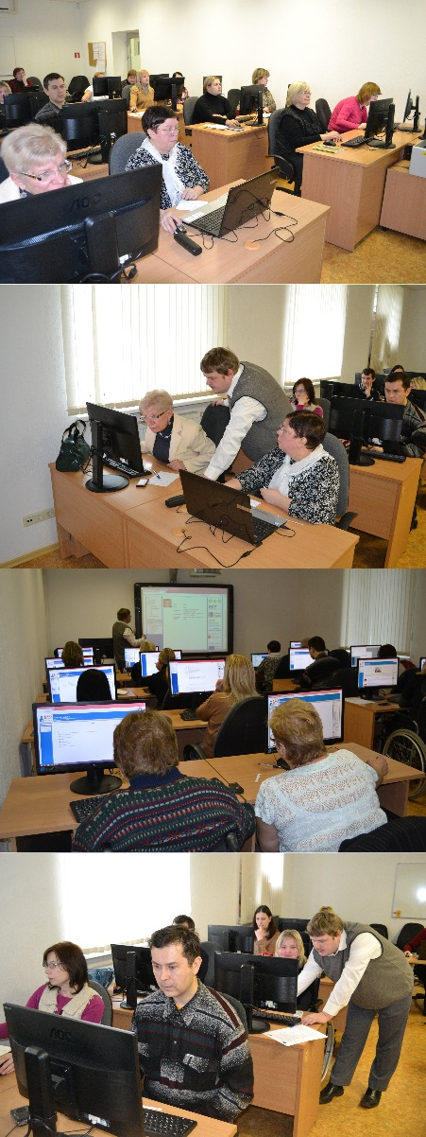
Training modules piloted
In Latvia:
Auxiliary resources to optimize activities in telecentres / ICT centers / libraries
Getting familiar with Office tools (Open/MS) for developing digital literacy workshops
Facilitating job seeking in the telecentre
Telematic procedures – facilitating access to e-services
E-safety and e-security

Slide 8
Pilot target groups
In Latvia:
IT Teachers
General education teachers
Librarians
Educational centre specialists
Adult Education and Information Center
Trainers from different NGOS

Slide 9
Training modules piloted
In Portugal:
Building a network culture
Auxiliary resources to optimize activities in telecentres / ICT centers / libraries
Developing a digital photography workshop in the telecenter
Planning a digital literacy Workshop
E-safety and e-security

Slide 10
Pilot target groups
In Portugal:
ICT trainers
Academic students
Librarians
Social cultural workers
Employees from public administration
Multimedia communication students
Volunteers from NGO

Slide 11
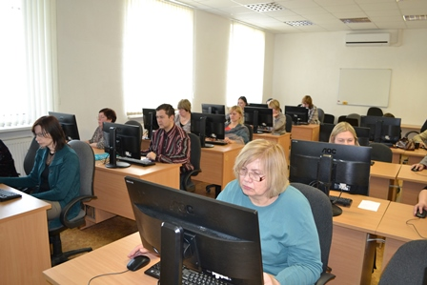
Testing
knowledge and skills
Online tests for self evaluation
Independent work graded by teachers
Final examination
Time limited online test with 20 questions from all learned modules
End of course sertificate
all independent works completed
final exam passed with score 75% or higher

Slide 12
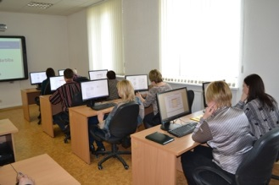
Pilot participants’ feedback
It was easy to learn because I could do it anywhere, any time, with access to a computer, the Internet. I learned a lot of new. Training materials are exciting and I would love to continue learning this way.
I am convinced that now our library will offer a new service that will help library clients to improve their competitiveness on labour market
Distance education allowed me to plan the time.

Slide 13
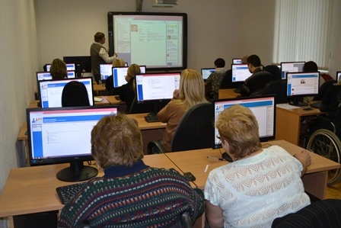
Conclusions and further exploitation
Conclusions
Blended learning proved to be very valuable approach
Face to face meetings are very essential. However, the proportion between distance learning and face to face learning could vary depending on the needs of the target group and the complexity of the theme
Further exploitation
In Latvia the training material will be used by :
  IT teachers, general subject teachers
  Librarians,
  State Employment agency
Notes:
Programm will be submitted to official acreditation

