Slide 1








Project
Trans e-facilitator
The 2-tier approach
2014 - September 24th

Slide 2
The 2-tier approach
Aim of ‘Trans e-Facilitator’ is:
provide training material to raise the quality of training for e-facilitators in order to improve their skills and work.
How:
With a curriculum by module(s) which qualify e-facilitators to use and implement learning opportunities with regard to key and transversal competences.
For whom:
The main target groups are people who works in a telecentres (spaces accessible for the public, that provide ICT equipment and facilitate adult learning especially for those target groups at risk of exclusion from the labour market and the community as a whole)

Slide 3
The 2-tier approach
End users
2nd tier trainers
1st tier trainers
Trans e-facilitator project

Slide 4
The 2-tier approach
1st Tier Trainer
Aim:
Prepare 15 trainers (5 per country) to train new e-facilitators, based on a set of learning modules which are adapted to specific national needs.
Profile:
Previous experience to train and facilitate other trainers/teachers;
Capacity to develop and comment training methodologies ;
Experience in delivering e-learning;
Knowledge of English and
Online learning environment.

Slide 5
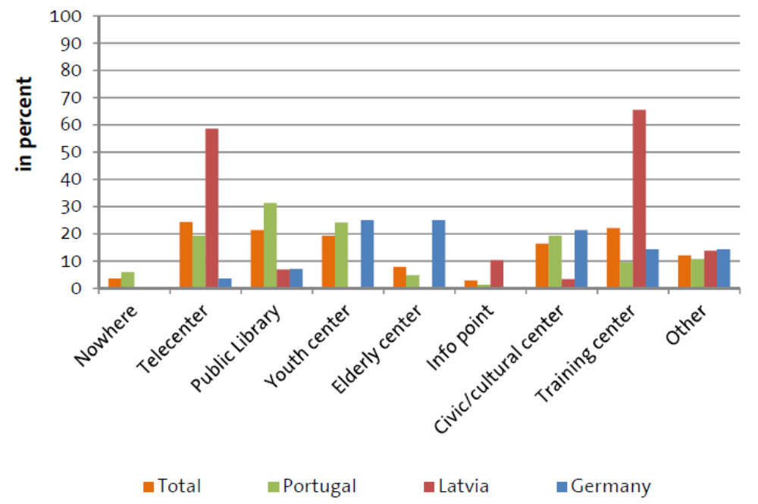
The 2-tier approach
1st Tier Trainer
Background and types of organisations for e-Inclusion:

Slide 6
The 2⁻tier approach
2nd Tier Trainer
Aim:
Prepare at least 45 trainers (15 per country) in order to ensure the piloting and continuity of the project.
Selection:
The 1st tier trainer select the second tier trainers out of their network (the learners might already know each other or must have something in common that would bond them and let them work together in an efficient and more open way)
Online application and best candidates were selected.

Slide 7
The 2⁻tier approach
2nd Tier Trainer
8 ICT practitioners; 7 from NGO’s; 2 from Libraries; 2 from Public Sector and 8 from several areas.
TOTAL: 20
17 from Libraries; 9 teachers, 8 from NGOs, 2 from learning centres, 1 from telecentre and 1 from administrative office work
TOTAL: 38
10 from ICT practitioners, 10 academic students, 5 librarians, 2 civil servants and 2 from NGOs.
TOTAL: 24

Slide 8
The 2⁻tier approach
Portuguese experience
Points to pay attention:
Blended learning can be valuable;
Engagement (certification; tuition-free);
Management of expectations (It’s necessary to be crystal clear about what the trainees can expect and to provide information about the courses’ content);
Awareness raising (motivation: sometimes the trainees don’t understand the benefits of this model)
The 1st tier trainer acquire and select the second tier trainers out of their network (the learners might already know each other or must have something in common that would bond them and let them work together in an efficient and more open way)
Online application and best candidates were selected.

Slide 9
The 2⁻tier approach
Portuguese experience
Reasons to like the curriculum:
Flexibility (trainees can choose which of the modules matches their needs, how many, schedule, etc.);
Broad scope (it included a different public from the one initially foreseen, e.g. social education students)
Effectiveness: short-time modules with high impact
The 1st tier trainer acquire and select the second tier trainers out of their network (the learners might already know each other or must have something in common that would bond them and let them work together in an efficient and more open way)
Online application and best candidates were selected.

Slide 10

The 2-tier approach
Multiplication factor

Slide 11
Project
Trans e-facilitator
Thank you
2014 - September 24th

