Slide 1

Project
Trans e-facilitator
The modular curriculum
- Content and structure -
Telecentre-Europe Conference
25th of September 2014
Zagreb, Croatia

Slide 2
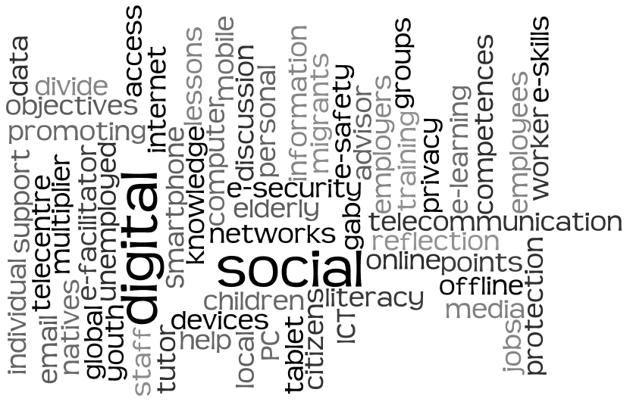
E-facilitators
5 Module

Slide 3
Where?
Telecentres
Advisory services
Internet access points
Youth centres
Libraries
Adult learning centres
Companies
5 Module
Associations
Senior centres
ICT centres
Employment agencies

Slide 4
What?
E-safety & e-security
E-government
E-services
Privacy
Social networks
Digital photography
Storage and editing of pictures
Job search
Using office suites
5 Module
Digital Identity
Creation of CV and cover letter
E-participation
Consumer Protection

Slide 5

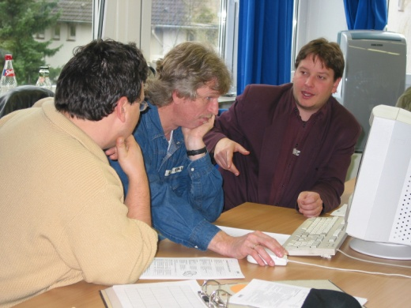
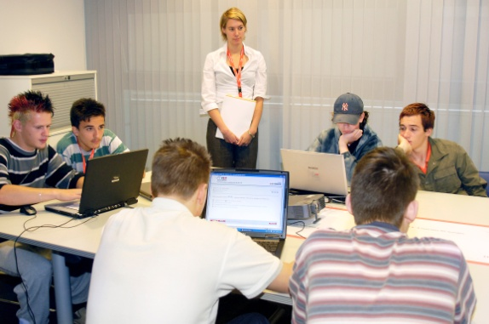
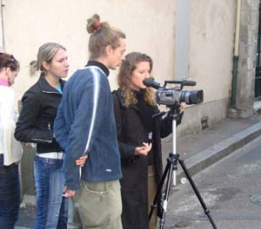
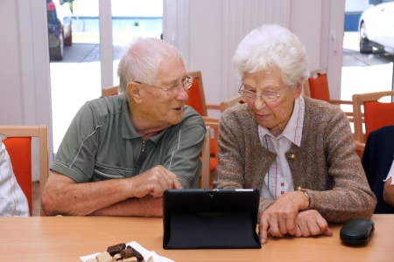
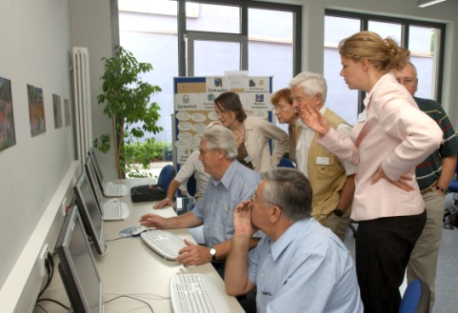


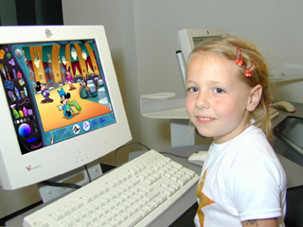
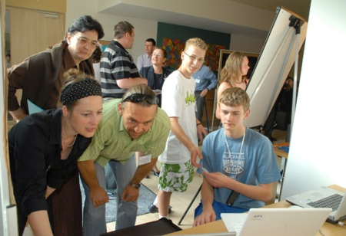
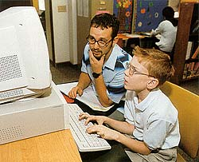
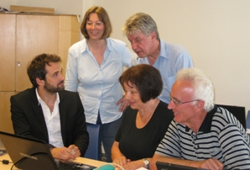
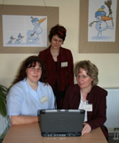
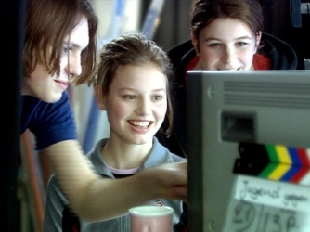
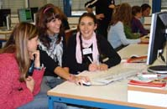
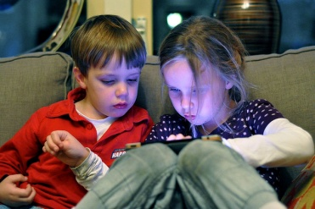
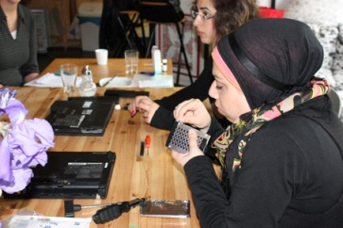
For who?

Slide 6



Categories
11 modules
5 Module

Slide 7
Categories
Management and Organisation
Working with groups of participants
Relevant subjects
Technical basic knowledge
5 Module

Slide 8

Organisation & Management
Building a network culture
Network spirit - what is a network?
Weaving the net (first steps in building a community with a social tool)
The potential 2.0 (What is web 2.0)
Building networks
5 Module

Slide 9

2
Organisation & Management
Auxiliary resources to optimise activities in
Telecentres / ICT Centres / Libraries
Which resources are necessary?
How to create and store content?
Create manuals, tutorial and exercises
Resources: word and image processing, converters, creative commons licenses
5 Module

Slide 10
3
Organisation & Management
Telecentre Sustainability
Concept of sustainability
Analyse sustainability in telecentres
Fund raising
Saving and making the best use of resources
5 Module

Slide 11

Working with target groups
Planning a digital literacy workshop
What is digital literacy and the digital divide?
Identification of learning needs
Tools and resources for digital literacy workshop
Assessment: the GPS for e-facilitators
5 Module

Slide 12

Working with target groups
Promoting ICT for elderly at the telecentre
Introduction to the target group
Challenges for the elderly and solutions
Technical assistance
Activities for the target group
5 Module

Slide 13

Working with target groups
Promoting ICT with migrants at the ICT centre
What does migration mean?
Intercultural exchange in the telecentre
Needs of the target group
Create a training curriculum
5 Module

Slide 14

Technical basic knowledge
Getting familiar with Office tools (Open/MS) for developing digital literacy workshops
Document and word processing
Spreadsheet
Slide presentation software
5 Module

Slide 15

Technical basic knowledge
Developing a digital photography workshop
in the telecentre
Main functions of digital cameras
How to store pictures
Retouching pictures
Sharing pictures
5 Module

Slide 16

Relevant subjects
Facilitating job seeking in the telecentre
Definition, analysis and diagnosis of the situation
Basic media skills to apply for jobs
Use social media for job search
Creating a workshop about online job hunting
5 Module

Slide 17
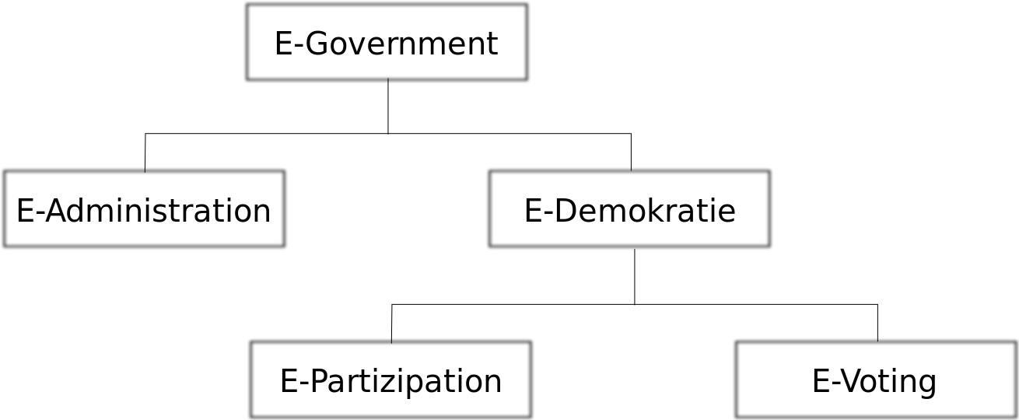
Relevant subjects
Telematic Procedures – facilitating access
to e-services
Concept of e-services
Tools and security
Directory of Telematic procedures
Spread the idea of e-services in your environment
5 Module

Slide 18
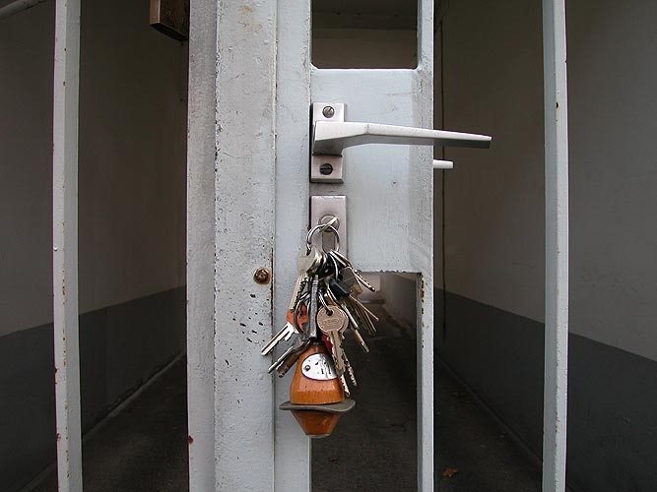

Relevant subjects
E-security and e-safety
Privacy, copy right, creative commons
How to protect the device of malware
Digital identity and privacy in social media
Youth protection
5 Module

Slide 19
Structure
Module
6 Units
Introduction unit
4 units with content
Final unit
5 Module
Introduction
Overview
Readings
Task(s)
Forum
Questionnaires
Final Exam
Farewell forum
Evaluation

Slide 20
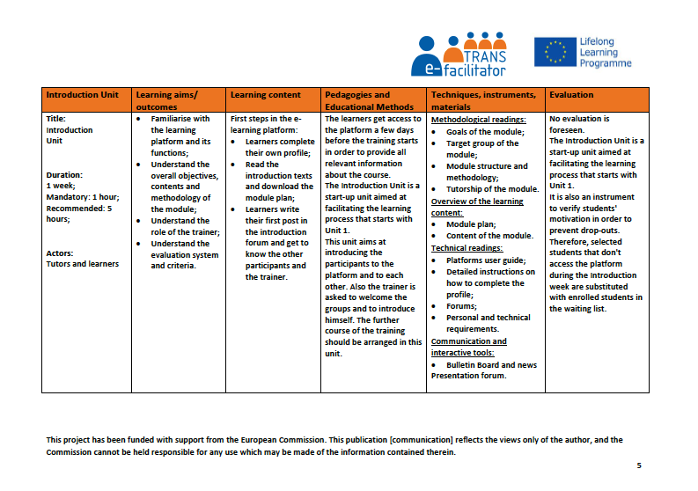

Transfer des Lehrplans

Slide 21

Structure
Time investment:
Introduction and final unit: 1 week, mandatory 1 hour, recommended 5 hours
Content units: 1-2 weeks, mandatory 5 hours, recommendation 5 – 10 hours
5 Module

Slide 22
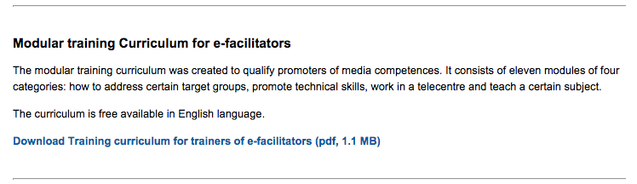
Download
English core curriculum is free available on the website:
Link: http://trans-efacilitator.eu/content/sections/
5 Module

